Slide 1
Dr. Eric Harmsen
Professor, Dept. of Agricultural and Biosystems Eng., Univ. of Puerto Rico-Mayaguez
Eric.harmsen@upr.edu
(787)955-5102
Taller de Riego
Juana Diaz, Puerto Rico, Marzo 12, 2014
Planificación de riego para ahorrar dinero, agua y energía

Slide 2




ACKNOWLEDGEMENT
Colegio de Ciencias Agrícolas, Universidad de Puerto Rico
Agro Servicios Inc.
USDA Hatch Project (H-402)
NOAA-CREST Project

Slide 3
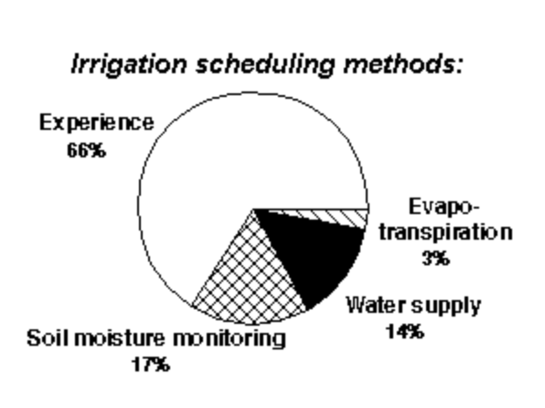
Irrigation Scheduling -
What is the problem?
There is anecdotal evidence that most farmers do not use scientific methods for scheduling irrigation
Data from Idaho, USA
http://www.webpages.uidaho.edu/~karenl/wq/wqbr/wqbr26.html

Slide 4
Definition
What is irrigation scheduling? Irrigation Scheduling is the process used by irrigation system managers (farmers) to determine the correct frequency and duration of watering. (wikipedia.org)

Slide 5
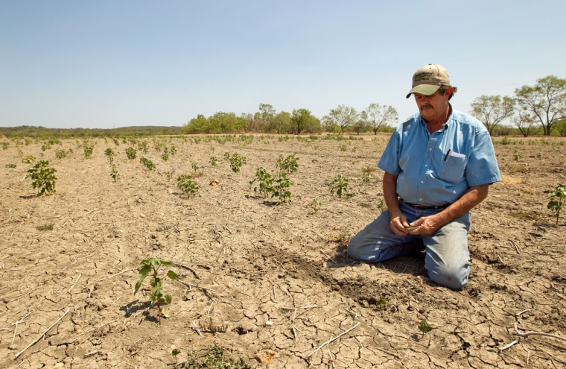

Why do we care?
Over application of water
Leads to the waste of
  water
  energy
  chemicals
  money
  may lead to the contamination of ground and surface waters.
  leaching of fertilizers past the root zone
  water logging
  lower crop yields.
Under-application of water
Leads to
  crop water stress
  Reduced crop yield
  loss of revenue to the grower

Slide 6
How much money are we talking about?
 | Relative Irrigation Applied
 | 0.4 | 0.5 | 0.8 | 1.0 | 1.3 | 1.5 | 1.8
Cultivo* | $ Lost / Cuerda
Gandules | 47 | 32 | 10 | 0 | 12 | 35 | 69
Pepinillo | 111 | 76 | 25 | 0 | 15 | 56 | 124
Repollo | 256 | 174 | 57 | 0 | 21 | 103 | 247
Sandia | 293 | 199 | 65 | 0 | 23 | 114 | 277
Platanos y Guineos, Plantilla | 318 | 216 | 71 | 0 | 24 | 122 | 299
Calabaza | 390 | 265 | 87 | 0 | 27 | 146 | 359
Cebolla | 543 | 369 | 121 | 0 | 34 | 195 | 490
Pimiento | 578 | 393 | 129 | 0 | 36 | 206 | 519
Barenjena | 757 | 514 | 169 | 0 | 44 | 264 | 670
Platanos y Guineos, Reton~o | 1,006 | 684 | 225 | 0 | 76 | 388 | 945
Melon, Cantaloupe y Honeydew | 1,027 | 698 | 229 | 0 | 56 | 352 | 899
Raices y Tuberculos | 1,041 | 707 | 232 | 0 | 57 | 356 | 911
    *Based model budget data from the Conjunto Tecnológico, UPR Experment Station

Slide 7
Objective
To review several important soil and water concepts related to irrigation management
To introduce several methods of scheduling irrigation

Slide 8
METHODS
Experience Method
Water Supply Method
Evapotranspiration Method
Soil Moisture Method
Water balance method

Slide 9
Experience Method
“I apply 1 inch of water to my crop every week.”
“The soil looks dry so I am going to irrigate.”
“The crop looks stressed so I am going to irrigate.”

Slide 10
Water Supply Method
The farm receives a certain amount of water on dates that are already fixed in advance.
The method takes into account the average rainfall only and thus does not take into account the actual rainfall;
this results in over-irrigation in wetter than average years and under-irrigation in drier than average years.
This method is commonly used with surface irrigation systems.
http://www.fao.org/docrep/t7202e/t7202e06.htm

Slide 11
Evapotranspiration (ET) Method
1. Simple method (if you are currently not doing anything). http://www.fao.org/docrep/s2022e/s2022e02.htm

Slide 13
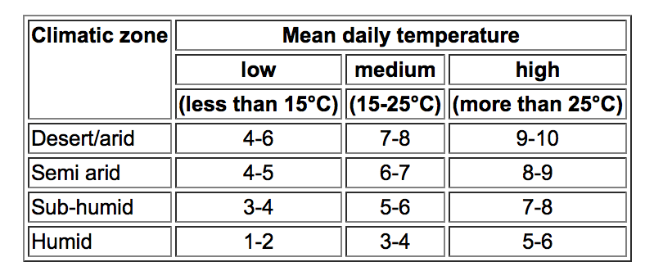
TABLE 1. AVERAGE DAILY WATER NEEDS (MM) OF
STANDARD GRASS DURING IRRIGATION SEASON

Slide 14
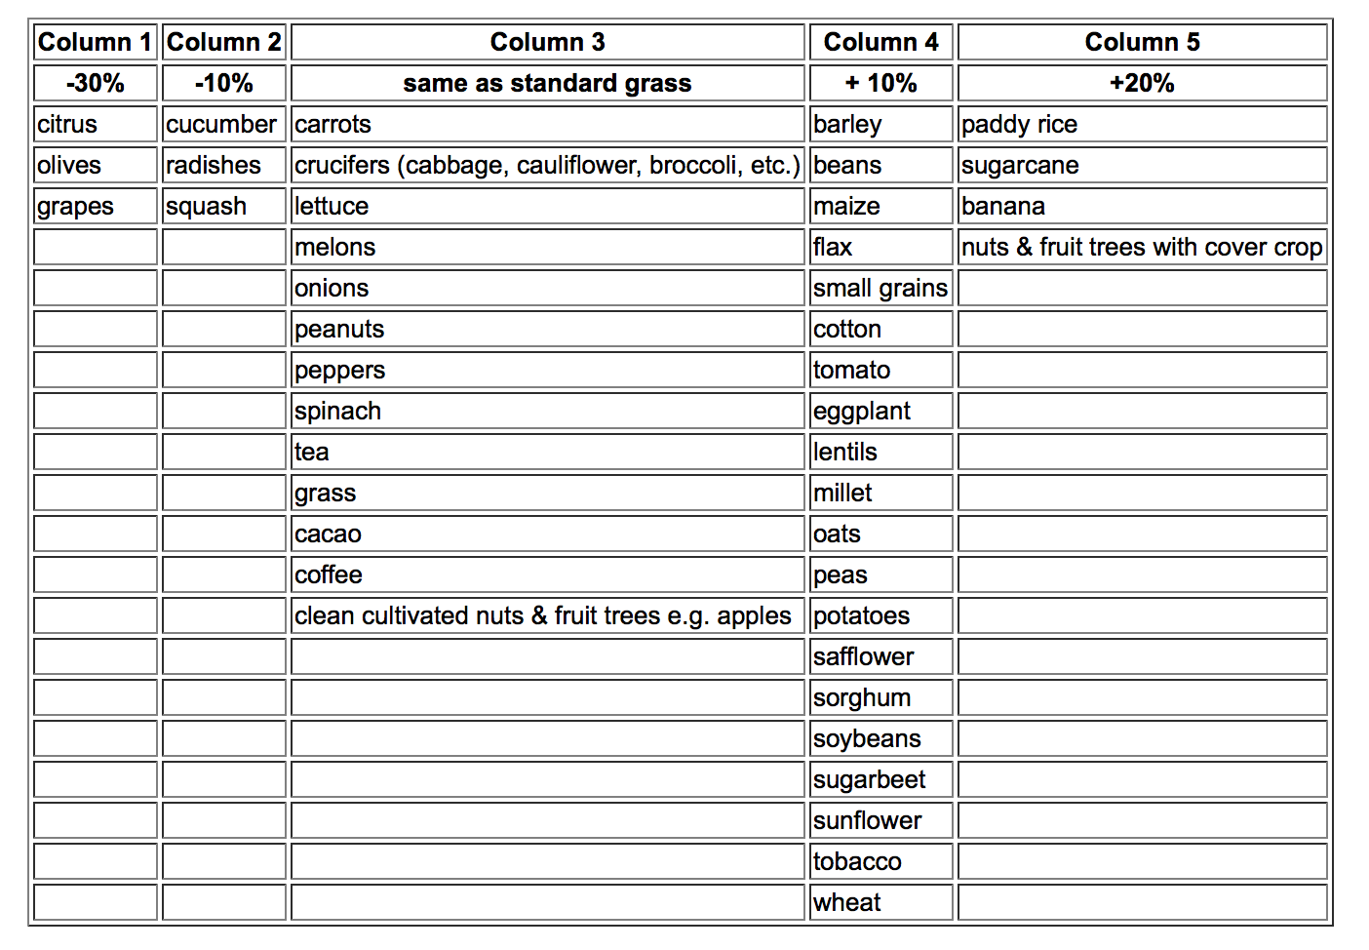
CROP WATER NEEDS IN PEAK PERIOD OF VARIOUS FIELD CROPS AS COMPARED TO STANDARD GRASS

Slide 15
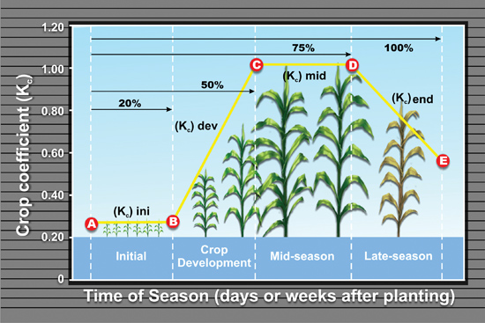
http://www.ianrpubs.unl.edu/epublic/live/g1994/build/graphics/g1994-2.jpg

Slide 16
Example of simple ET method
Crop: Sugar cane
Location: Aguada, Puerto Rico
Area: 50 cuerda
Determine the irrigation requirement for one week during the peak of the growing season.
Pump flow rate is 1000 gpm
Assume irrigation system is 75% efficient

Slide 17
TABLE 1. AVERAGE DAILY WATER NEEDS (MM) OF
STANDARD GRASS DURING IRRIGATION SEASON

Slide 18
CROP WATER NEEDS IN PEAK PERIOD OF VARIOUS FIELD CROPS AS COMPARED TO STANDARD GRASS

Slide 19
Calculations
From Table 1: Water need for standard grass is 7 mm
From table 2: add 20%.
  1.2 x 7 mm/day x 7 days = 59 mm
Calculate total gallons:
  59 mm x 50 cuerda x 1044 / 0.75
  = 4,090,000 million gallons
Pumping time:
  4,090,000 gal/1000 gal/min *60 min/hr = 68 hours

Slide 20
Evapotranspiration Method
2. Web-based ET method
http://pragwater.com/daily-reference-evapotranspiration-eto-for-puerto-rico-hispaniola-and-jamaica/

Slide 21
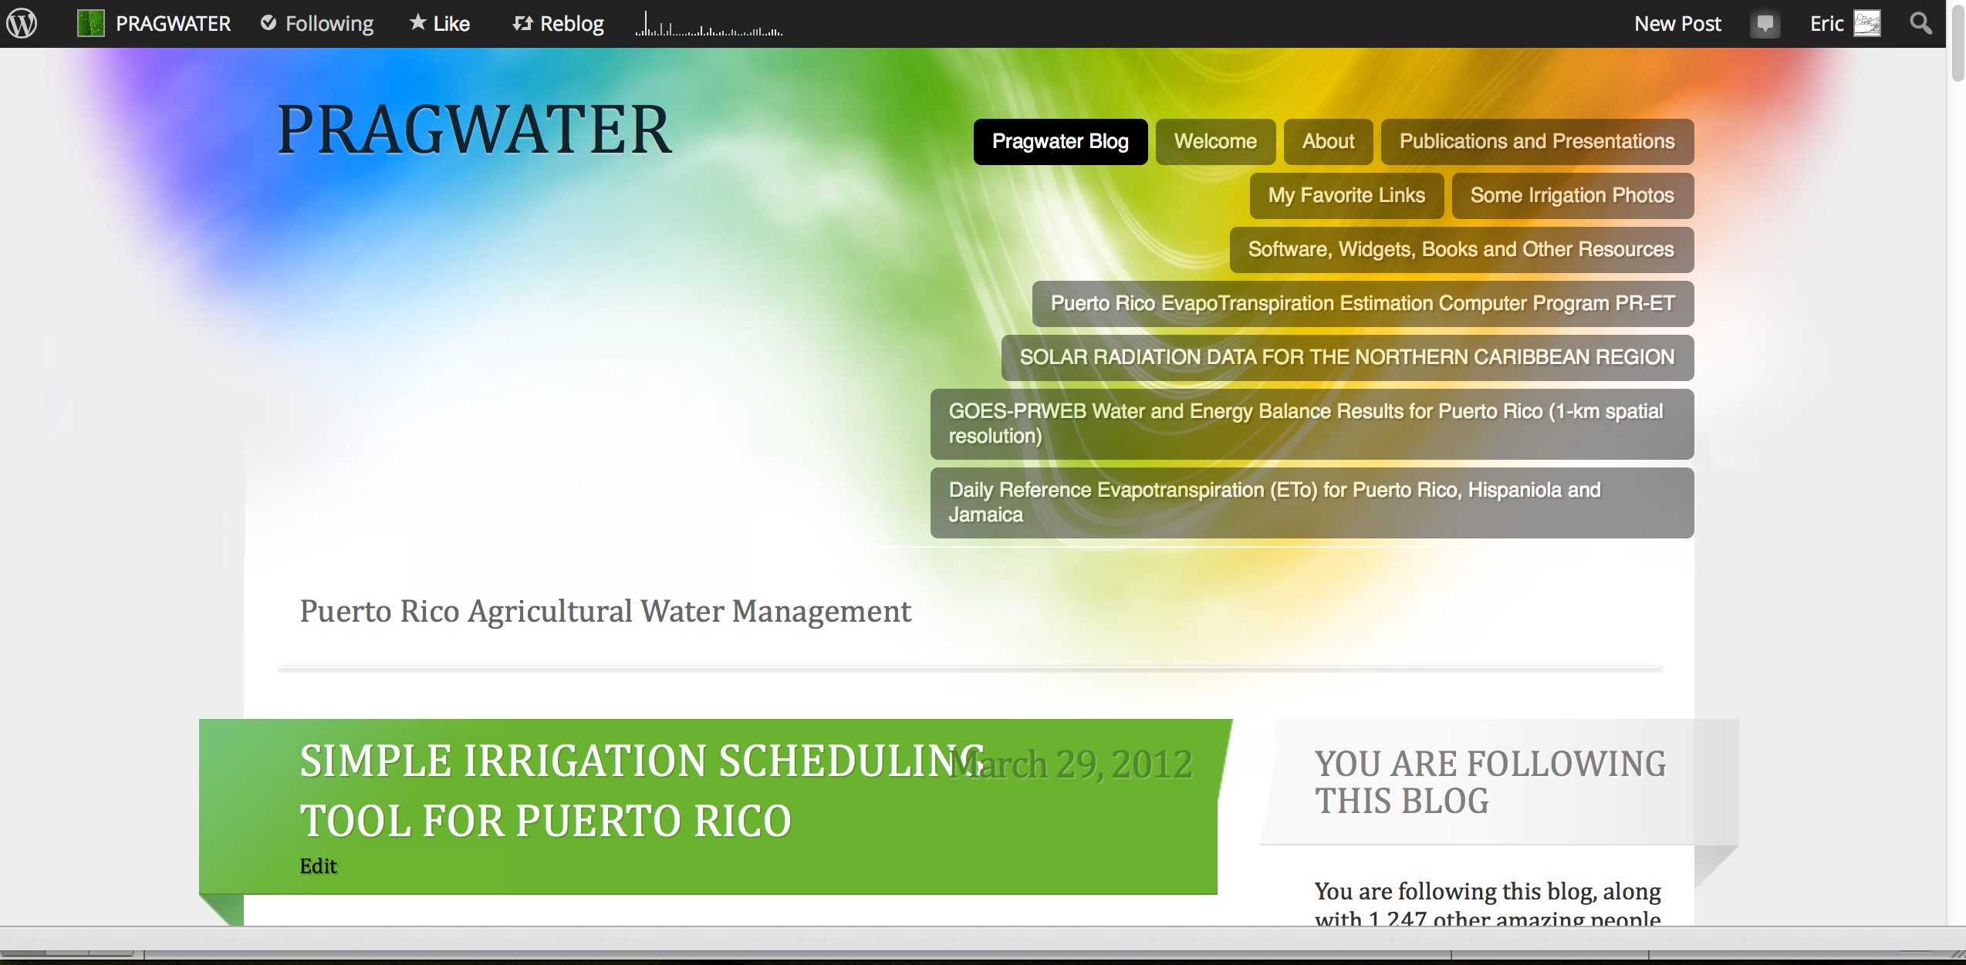
http://pragwater.com/2012/03/29/simple-irrigation-scheduling-tool-for-puerto-rico/

Slide 22
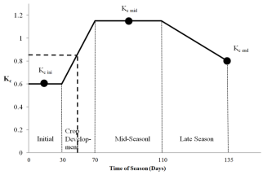
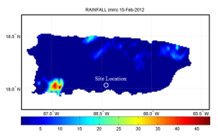
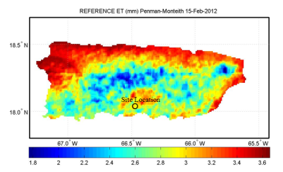
Web-based method for irrigation scheduling in PR
Determine average K_{c} for the time period
Define problem (location, farm size, crop, etc.)
Determine rainfall
from onsite gauge or NEXRAD
Start
Determine ET_{o}
Estimate Crop Water Requirement
ET_{c} = K_{c} ET_{o}
Harmsen E.W., 2012. TECHNICAL NOTE: A Simple Web-Based Method for Scheduling Irrigation in Puerto Rico J. Agric. Univ. P.R. 96 (3-4) 2012.
Estimate Irrigation Requirement and required hours of pumping

Slide 23
Detailed Example
Determine the irrigation requirement for the 5 day period, February 15-19, 2012, for a tomato crop in Juana Diaz, Puerto Rico.
Required Hyperlinks
Length of Growth Stages (Table 11) and Crop Coefficients (Table 12) | http://www.fao.org/docrep/X0490E/x0490e00.htm
Daily Reference Evapotranspiration (ETo) | http://academic.uprm.edu/hdc/GOES-PRWEB_RESULTS/rainfall
Daily NEXRAD Rainfall for Puerto Rico | http://academic.uprm.edu/hdc/GOES-PRWEB_RESULTS/reference_ET/

Slide 24
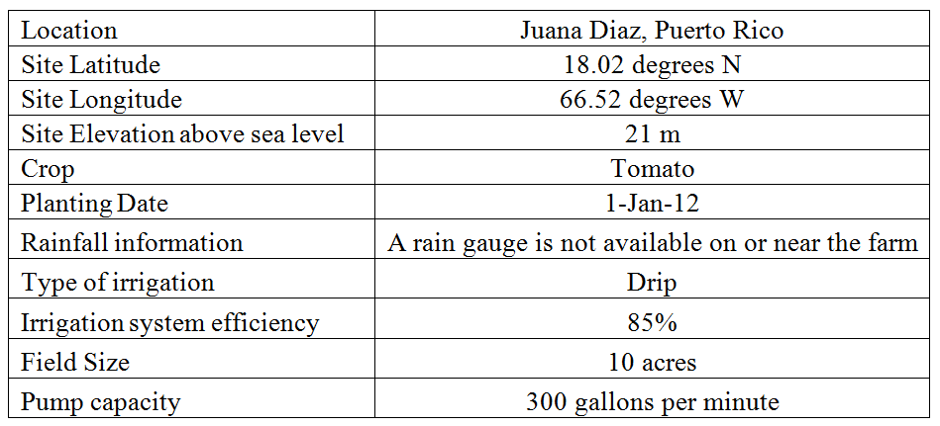
Step 1. Information used in example problem.

Slide 25
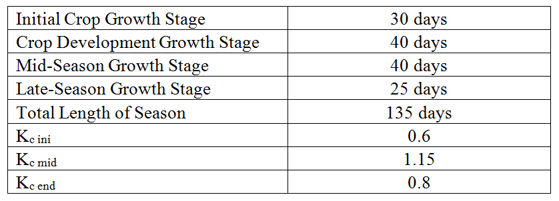
Step 2. Crop growth stage and crop coefficient data for example problem.
http://www.fao.org/docrep/X0490E/x0490e00.htm
Tomato Growth Stages and Crop Coefficients

Slide 26

Crop Coefficient
The averge K_{c} value of 0.85 for the five day period was obtained.
Crop coefficient curve for the example problem. The heavy dashed line applies to the example problem with day of season 46-50 (i.e., Feb 15-19) corresponding to an approximate crop coefficient of 0.85 (vertical axis).

Slide 27

Step 3. Rainfallhttp://academic.uprm.edu/hdc/GOES-PRWEB_RESULTS/rainfall/
Inspection of the rainfall maps at the URL provided indicates that there was no rainfall during the five day period.

Slide 28

Step 4. Reference Evapotranspiration (ET_{o}) http://academic.uprm.edu/hdc/GOES-PRWEB_RESULTS/reference_ET/
Inspection of the ET_{o} maps at the URL provided above indicates that there was 16.1 mm of ET_{o} during the five day period.

Slide 29
Step 5. Crop Water Requirement
The crop water requirement (ET_{c}) for the five day period can now be estimated as follows:
ET_{c} = K_{c} ET_{o} = (0.85)(16.1 mm) = 13. 7 mm

Slide 30
Step 6. Calculation of Irrigation Requirement and duration of pumping
Using D = ET_{c} = 13.7 mm
A = 10 acres
Q = 300 gallons per minute
eff = 0.85, yields:
Irrigation Requirement (volume)
13.7 mm x 10 cuerda x 1044 / 0.85
  = 168,260 gallons
Pumping time:
168,260 gal/300 gal/min *60 min/hr = 9.35 hours

Slide 31
Web-based Irrigation Scheduling Tool
Students from the Computer Engineering Department are developing desktop and mobile apps of the web-based irrigation scheduling procedure.
The user will be able to create an account, which will remember the user irrigation history
Everything will be automated
The apps should be ready for use in approximately 3 months.

Slide 32
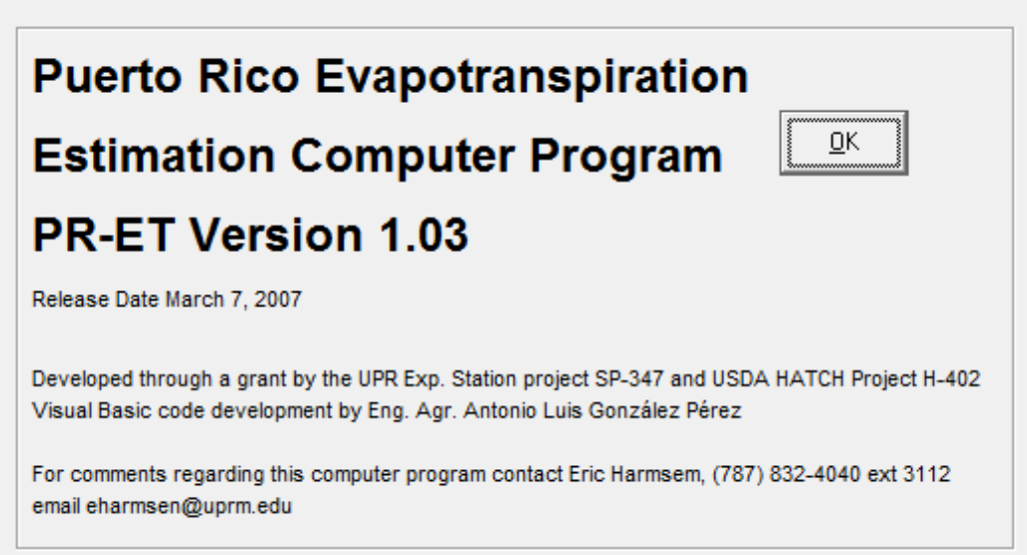
Puerto Rico Evapotranspiration Computer Program
http://pragwater.com/crop-water-use/

Slide 33
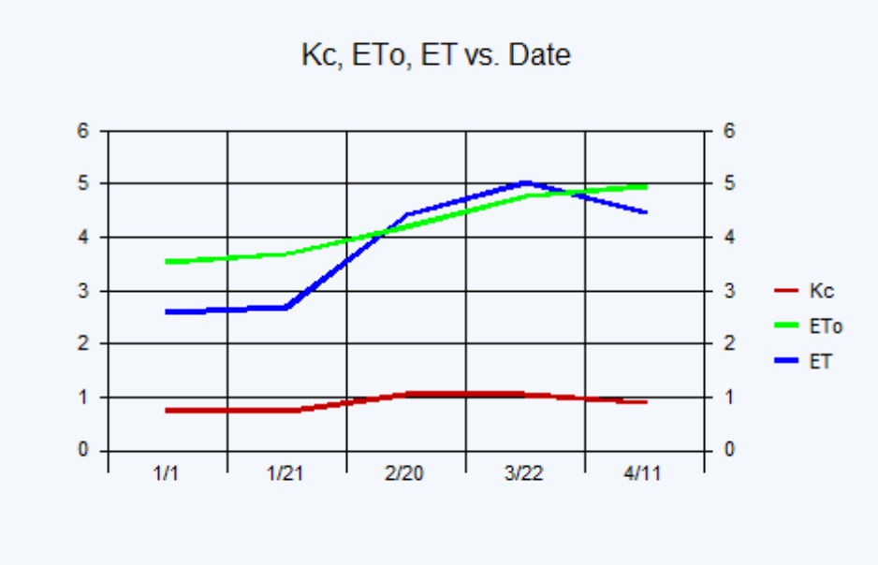
PRET

Slide 34
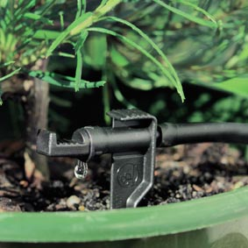
Soil Moisture Methods
Maintain soil water between
θ_{FC} and θ_{t}

Slide 35
Soil Water Reservoir
AIR VOLUME
WATER VOLUME
SOLID VOLUME

Slide 36
Water Volume
DRAINABLE WATER
TOTAL
AVAILABLE WATER
IMMOBILE
WATER

Slide 37
Total Available Water
READILY
AVAILABLE
WATER
TOTAL
AVAILABLE
WATER

Slide 38
The Soil Water Characteristic Curve
Soil Water
Pressure
TOTAL AVAILABLE WATER
Volumetric Soil Moisture Content (θ)

Slide 39
Total Available Water
TAW = θ_{FC} - θ_{WP}
where
θ_{FC} = Volumetric moisture content a the field capacity
θ_{WP} = Wilting point volumetric moisture content.

Slide 40
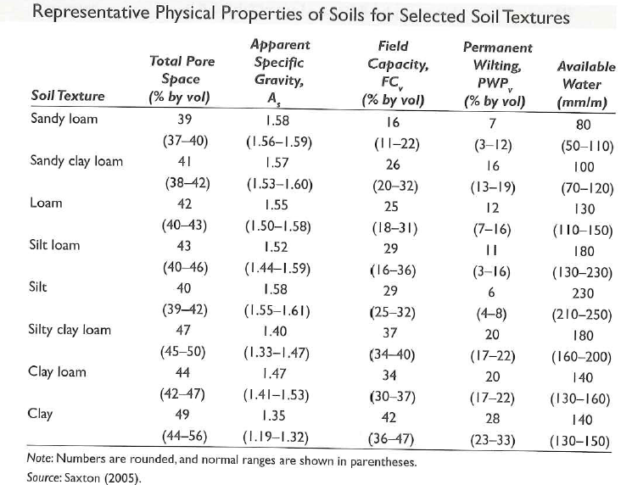
Representative Physical Properties of Soils

Slide 41
The Soil Water Characteristic Curve
Soil Water
Pressure
RAW
Threshold
Volumetric Soil Moisture Content (θ)

Slide 42
Readily Available Water
Plants can only remove a portion of the available water before growth and yield are affected. This portion is the “readily available water” (RAW).
For most crops RAW is between 20% to 65%
RAW is estimated from the following formula:
RAW = (MAD) (TAW)

Slide 43
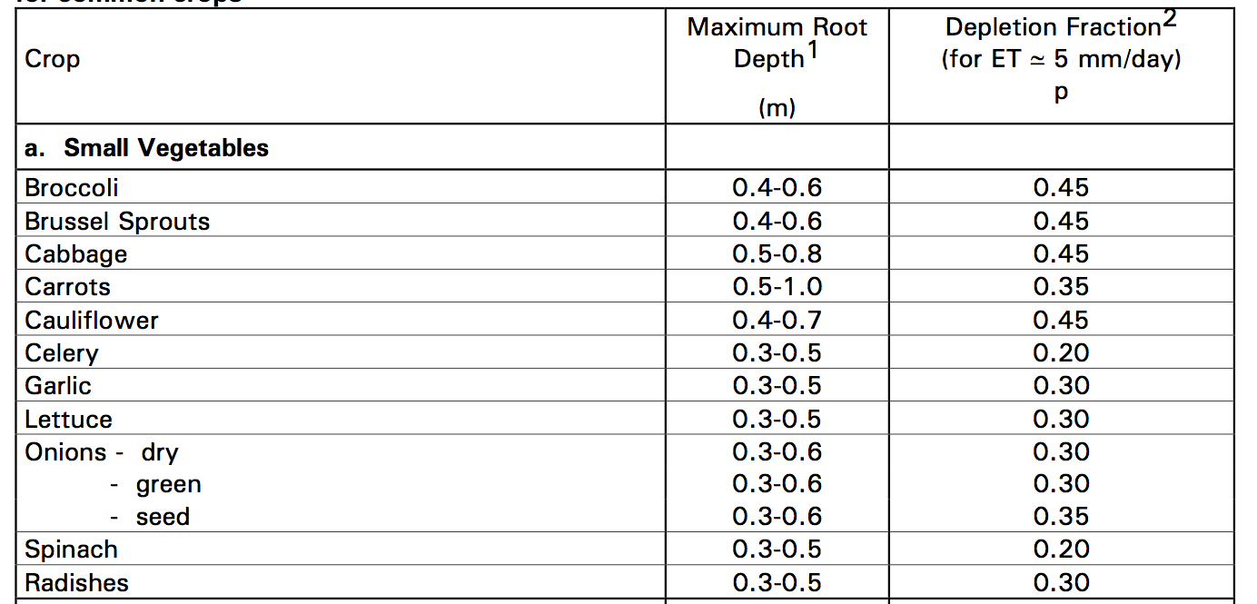
Management Allowed Deficit (MAD)
MAD

Slide 44
Threshold Moisture Content, θ_{t}
If the soil moisture content falls below θ_{t} , the crop will go into stress and you will loss crop yield!
θ_{t} = θ_{FC} – RAW
where
θ_{t} = threshold moisture content
θ_{FC} = field capacity moisture content
RAW = readily available water

Slide 45
The Soil Water Characteristic Curve
Soil Water
Pressure
STRESS
NO
STRESS
LOST
Threshold
Volumetric Soil Moisture Content (θ)

Slide 46
Maintain soil water between
θ_{FC} and θ_{t}

Slide 47
Soil Moisture Method
Perhaps the best method because it considers the readily available water in the soil.
Gravimetric method
Tensiometers
Electrical method
Water balance method

Slide 48
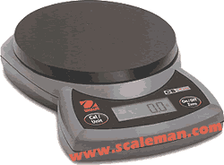
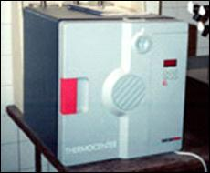
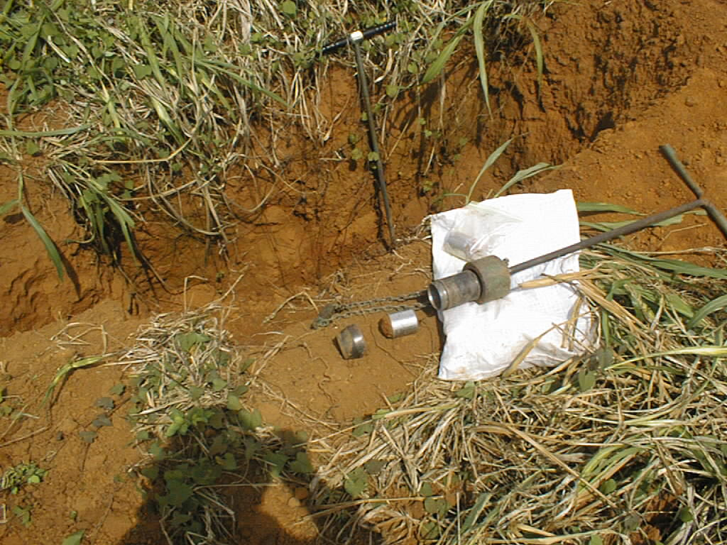
Gravimetric Soil Sampling

Slide 49
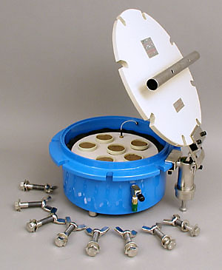
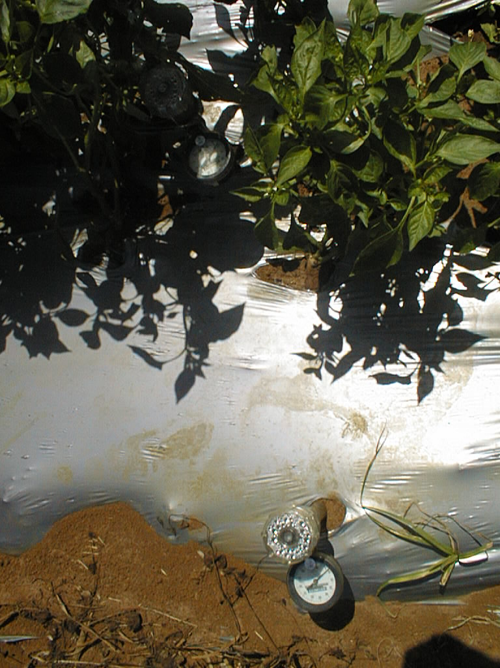
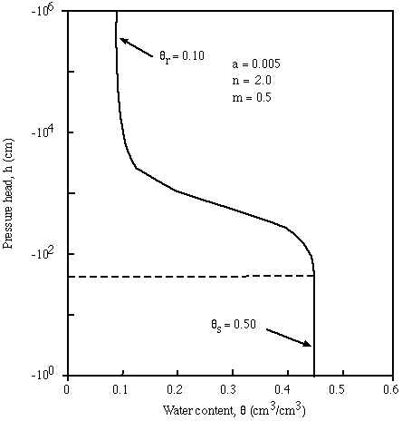
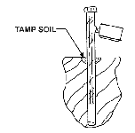
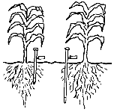
Tensiometers

Slide 50
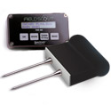


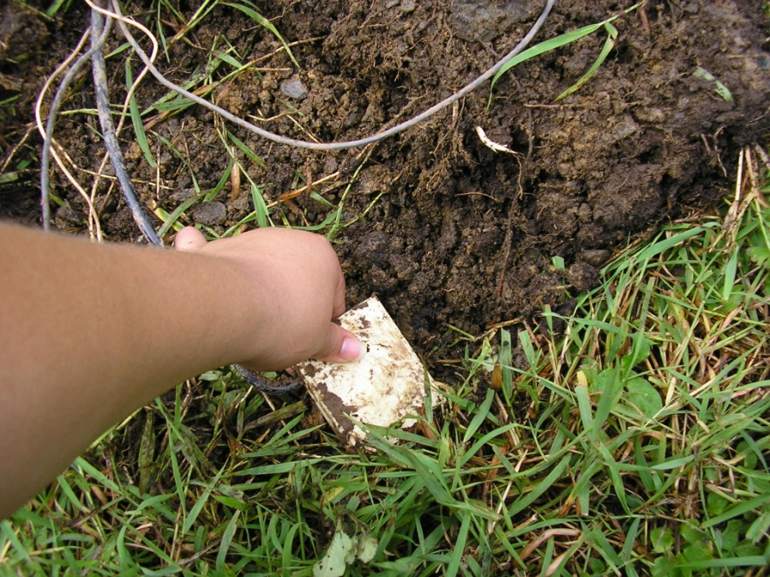
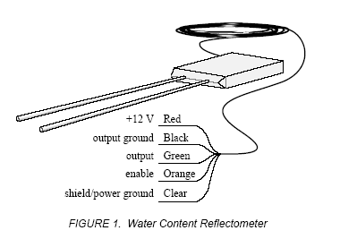
TDR
Time Domain Reflectometry

Slide 51
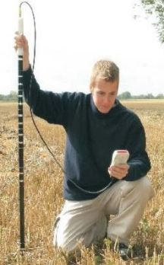
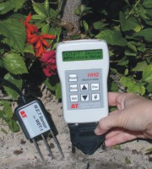
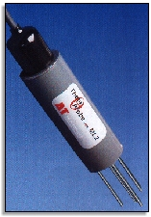
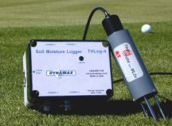
Capacitance Method

Slide 52
Maintain soil water between
θ_{FC} and θ_{t}

Slide 53
Water Balance Method
θ_{t2} = R + Irr – RO – ET_{c adj} – PERC + θ_{t1}
θ_{t2} = volumetric moisture content at time 2
θ_{t1} = volumetric moisture content at time 1
R = effective rainfall
RO = runoff
PERC = water that percolates past the root zone

Slide 54
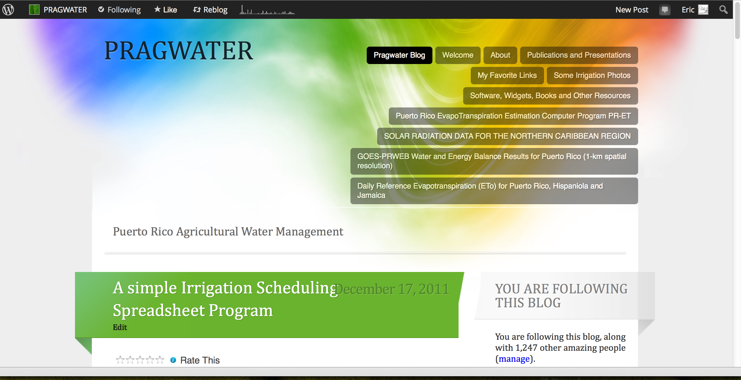
http://pragwater.com/2011/12/17/a-simple-irrigation-scheduling-spreadsheet-program/

Slide 55
Soil Water Management Spreadsheet
http://pragwater.com/2011/12/17/a-simple-irrigation-scheduling-spreadsheet-program/
User must enter the yellow spreadsheet cells

Slide 59
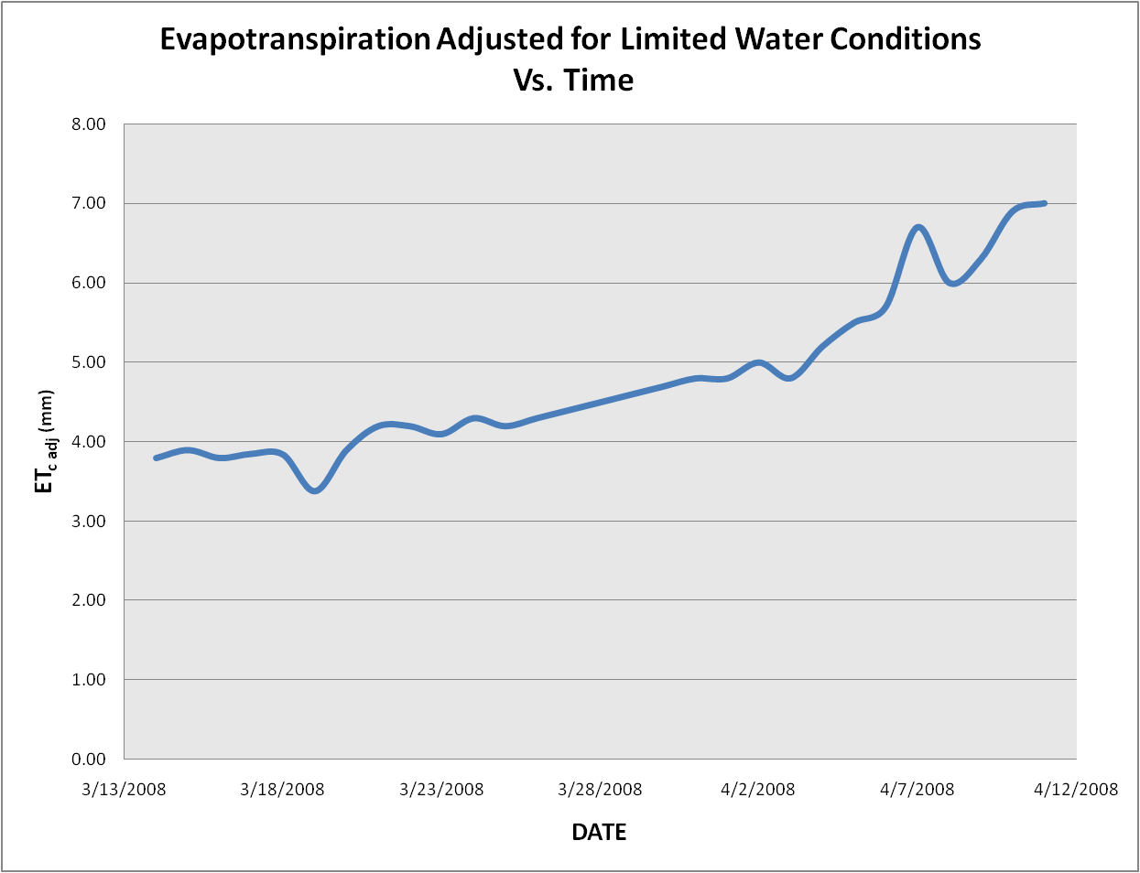

Slide 60
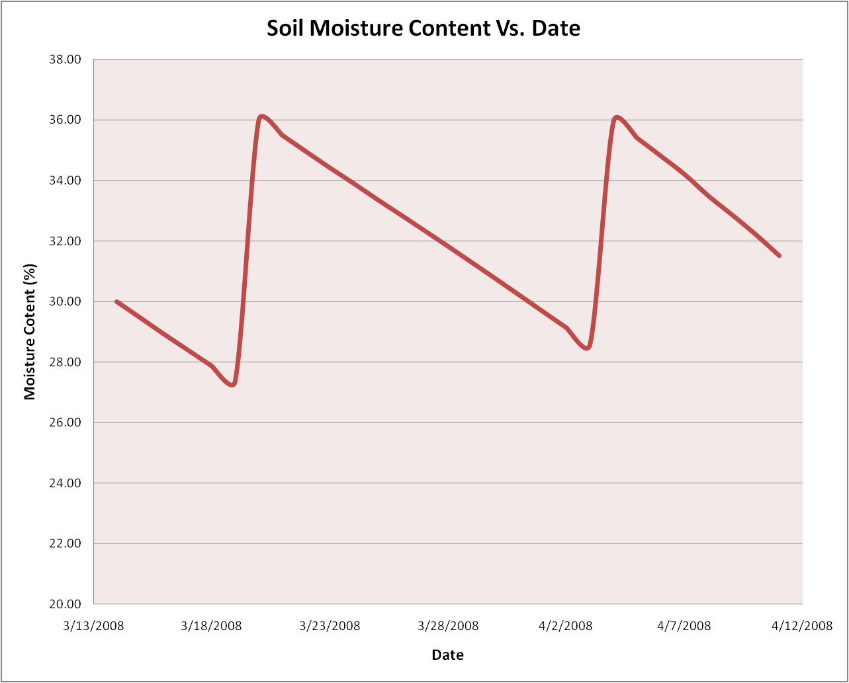
Field Capacity
Moisture Content, θ_{FC}
Crop is in stress
When moisture Content
is below this line!!

Slide 61
Crop
Stress!

Slide 62
Irrigation Application Rate and Timing

Slide 63
Conclusion
Maintain soil water between
θ_{FC} and θ_{t}

Slide 64
Gracias!
For help with any of the methods covered in today’s presentation, please contact me by email at eric.harmsen@upr.edu

