Slide 1
Agroclimatología y el Riego sustentable
Eric Harmsen, Ph.D.
Professor, Dept. of Agricultural and Biosystems Engineering
UPR-RUM
This presentation is available at the following web address:
http://academic.uprm.edu/hdc/http://academic.uprm.edu/hdc/documents/Eric_Harmsen_5-17-2003

Slide 2
What is the problem and why do I care?
There is antidotal evidence that many farmers throughout the world do not employ scientific methods for scheduling irrigation for their crops.
Instead, the water supply is turned on for an arbitrary amount of time without knowing whether the amount of water applied is too much or too little.
Over application of water can lead to the waste of water, energy, chemicals and money, and also may lead to the contamination of ground and surface waters. Over application of water can further lead to leaching of fertilizers past the root zone and water logging, which will result in lower crop yields.
Under-application of irrigation water can lead to water stress with reduced crop yields and a loss of revenue to the grower.

Slide 3
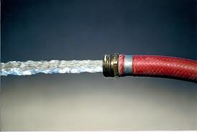
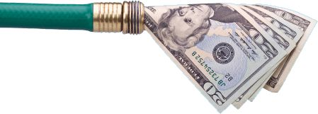
How much water and money are we talking about?

Slide 4
The Cost of Over-Applying Irrigation Water
Assume the following:
Small 10-acre farm grows pumpkin
Estimated consumptive use (CU) for season = 500 mm
Actual potential CU for season = 400 mm
Overall cost of water = $30/acre-ft (considering only: cost of water and electricity)
Assume the normalized yield vs. CU curve in the next slide is applicable.
Value of a typical Calibaza crop (net income)* = $1,243/acre.
*Conjunto Tecnológico para la producción de Calabaza, UPR Experment Station, Publication 155, revised 2012

Slide 6
Example continued
Results:
Excess water applied = 100 mm = 1.07million gallons = 3 acre-ft (lost to groundwater)
Normalized CU = 1.25, therefore normalized yield = 0.9 (or 0.1 loss)
Potential $ LOST = cost of water + lost yield = 3 ac-ft x $30/ac-ft + [0.1*$1,243/ac] x 10 ac = $1,333
Agr. Chemicals are leached to groundwater (cost was not included in calcluation). Groundwater was potentially contaminated

Slide 7
Cost of Under-Applying Irrigation Water
Assume the following:
Same pumpkin farm (10-acres)
Estimated CU for season = 300 mm
Actual potential CU for season = 400 mm
Assume the normalized yield vs. CU curve is applicable.
Value of a typical Calibaza crop* = $1,243/acre.
*Conjunto Tecnológico para la producción de Calabaza, UPR Experment Station, Publication 155, revised 2012

Slide 8
Example continued
Results
Water deficit = 100 mm
With a normalized CU of 0.75, the normalized yield = 0.85 (or 0.15 loss)
Potential $ LOST = lost yield = [0.15*$1,243/ac] x 10 ac = $1,864
$1,864 could pay your daughter’s university tuition or pay her rent for 6 months

Slide 9
How can I apply water to my plants?
Different types of irrigation systems
Surface Irrigation
Sprinkler Irrigation
Drip Irrigation
Subsurface Irrigation
Condensation Method

Slide 10
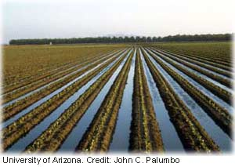
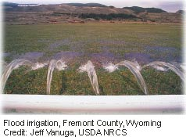
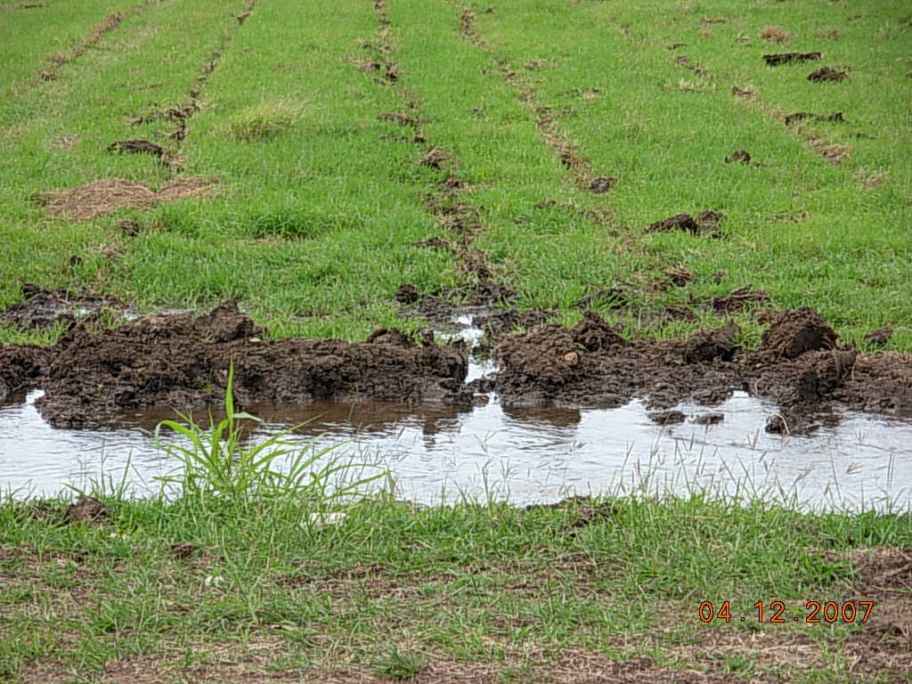
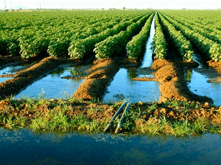
Surface

Slide 11
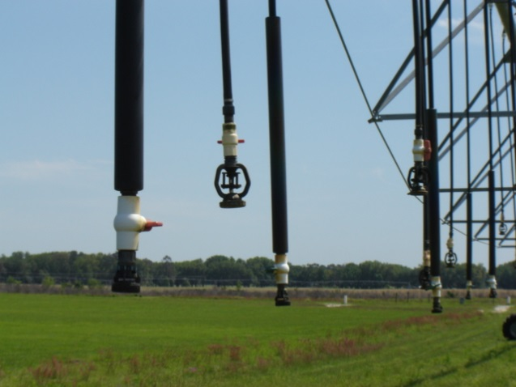
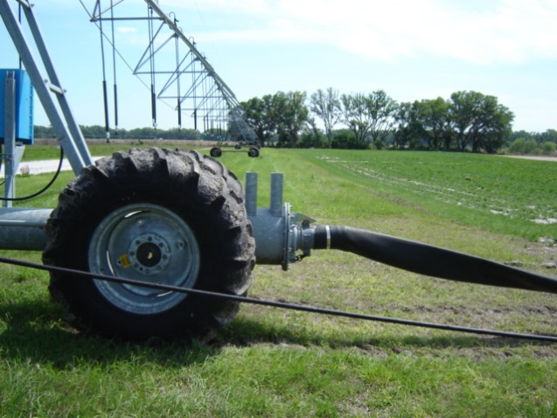
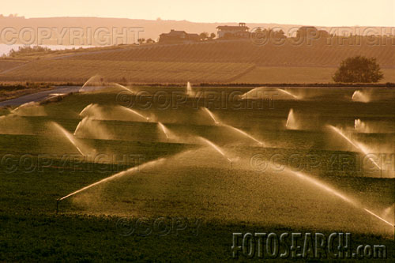
Sprinkler

Slide 12
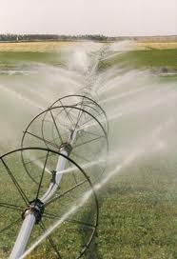
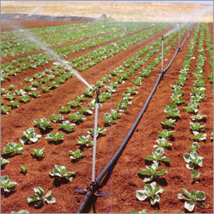
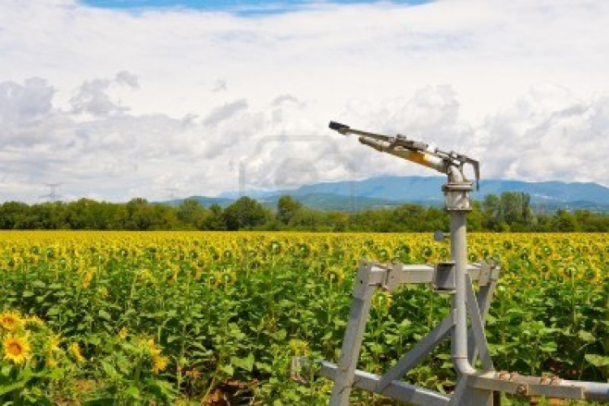
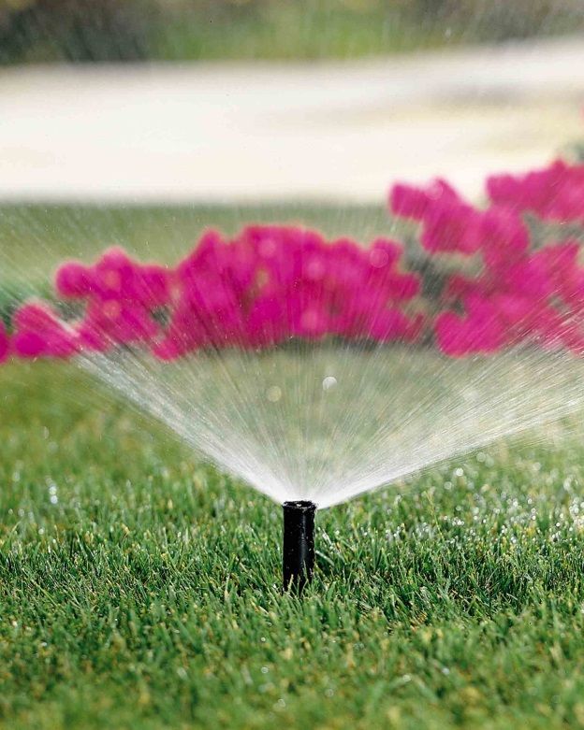
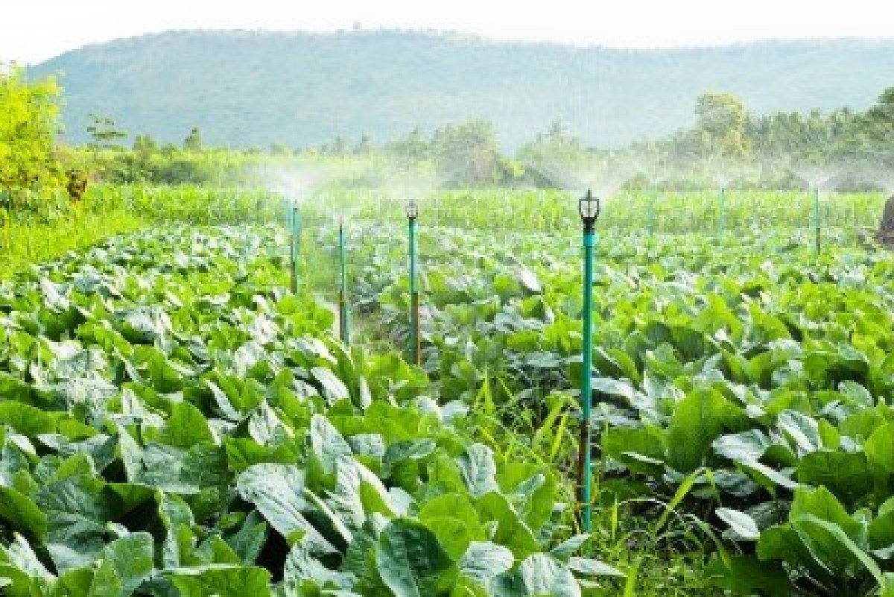

Slide 13
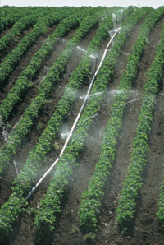
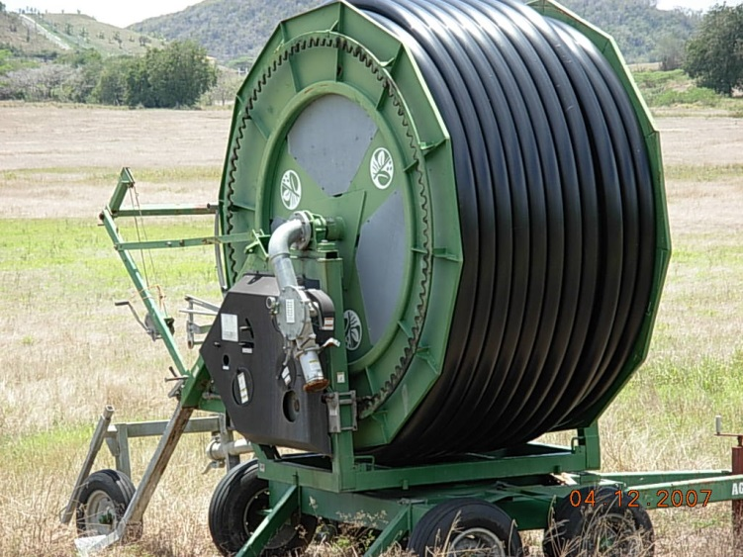
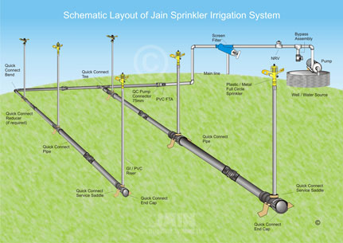
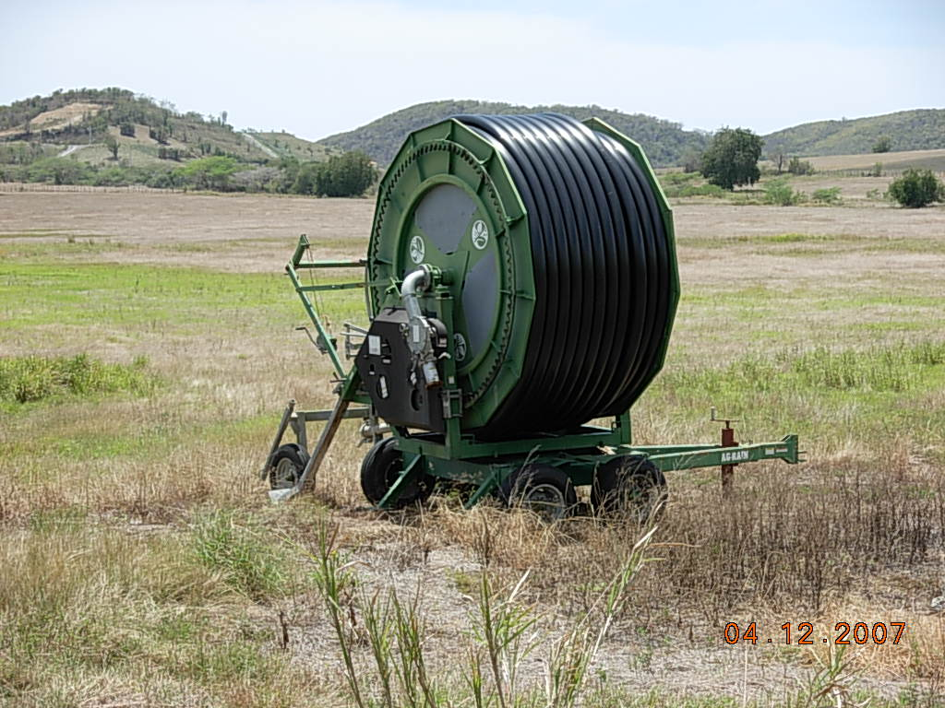

Slide 14
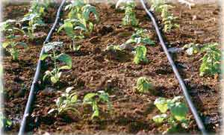
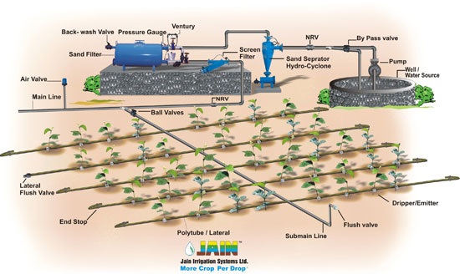
Drip

Slide 15
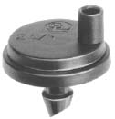
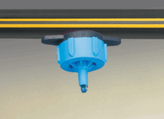
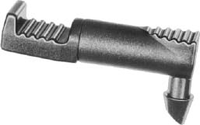
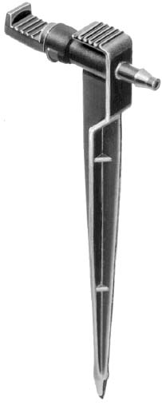
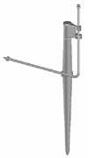
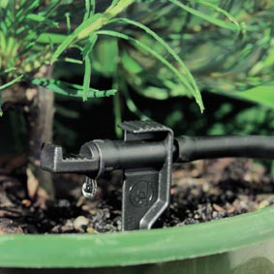
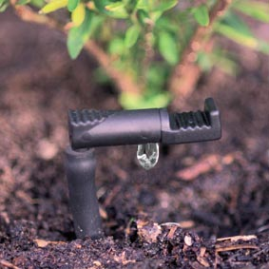

Slide 16
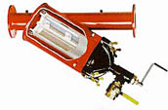
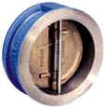
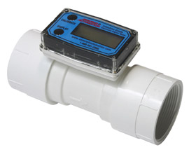
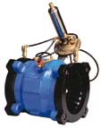
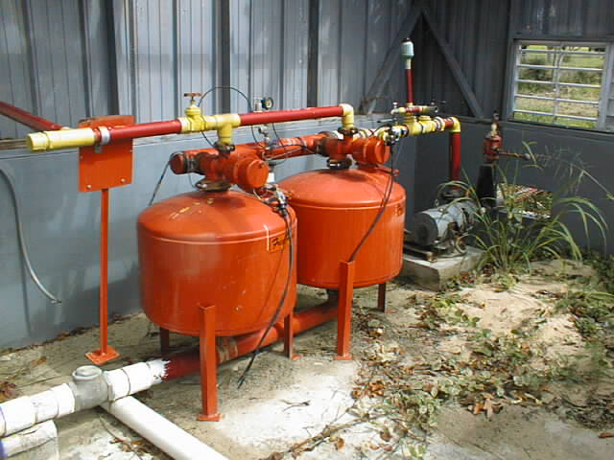
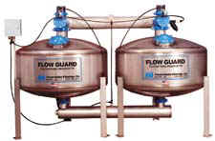
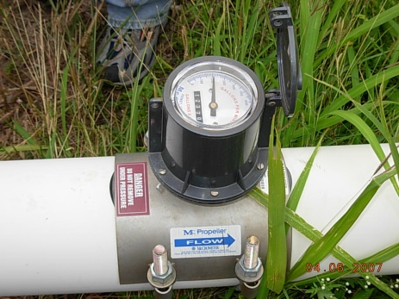
Irrigation system accessories

Slide 17
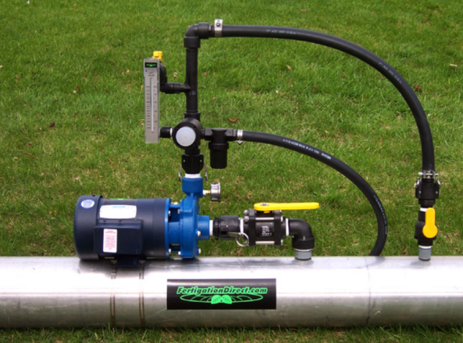
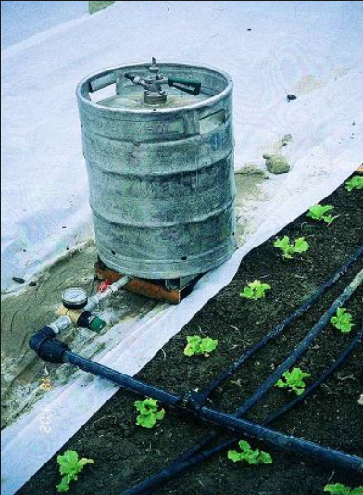
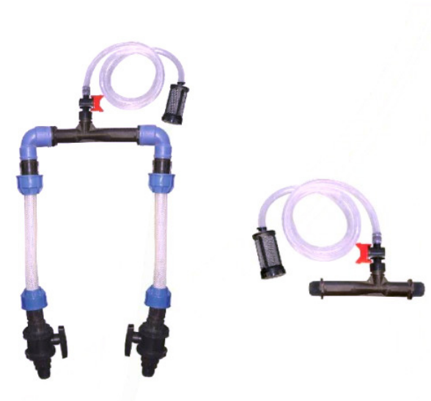
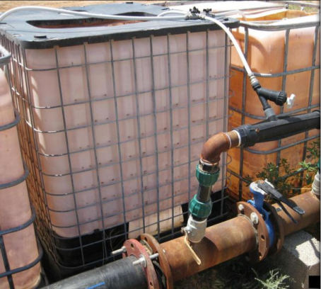
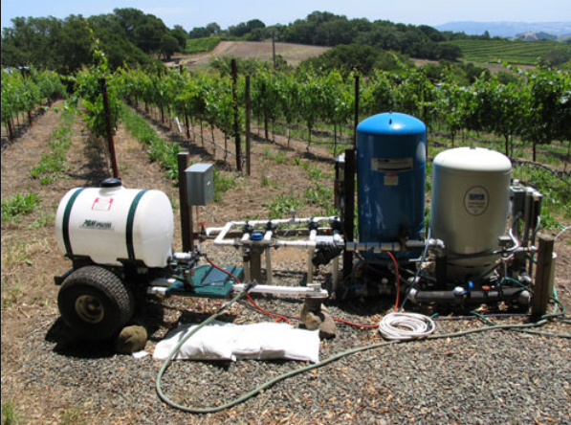
Fertigation

Slide 18
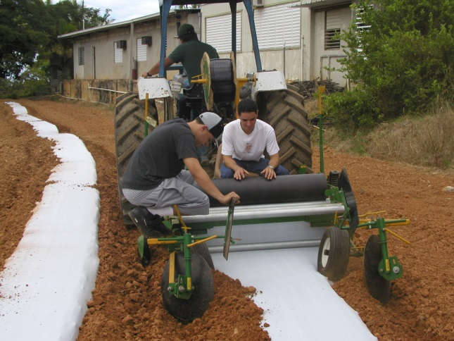
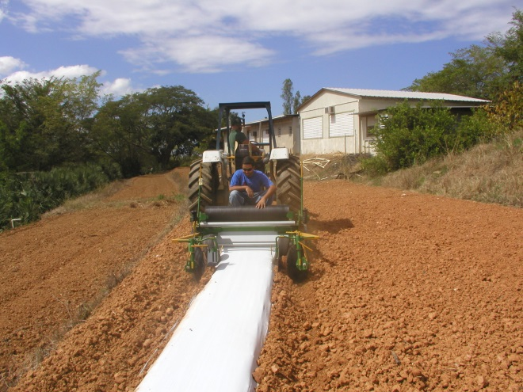
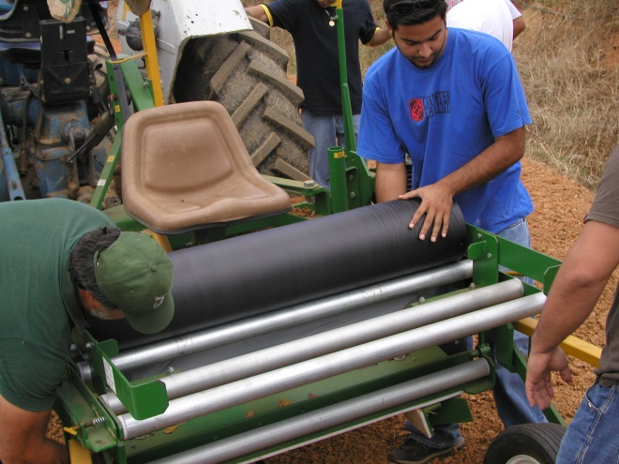
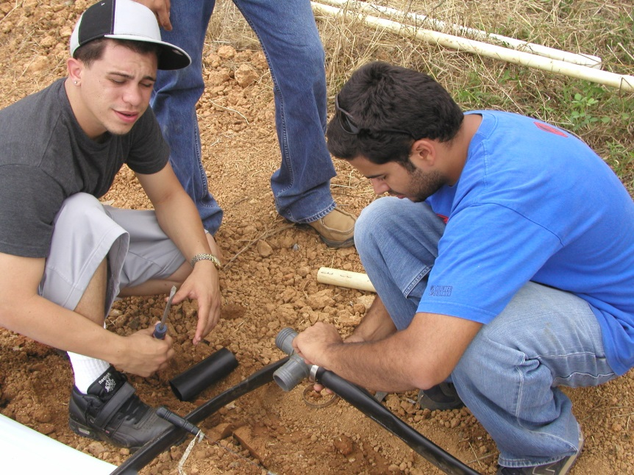
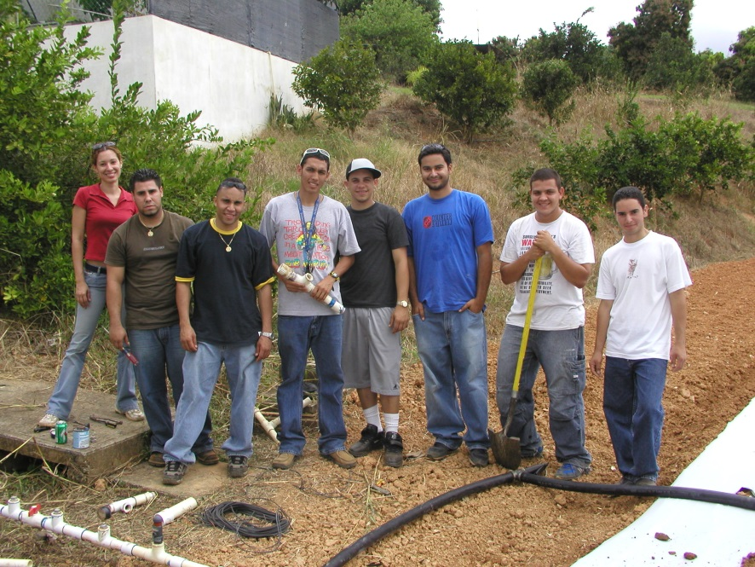
Drip Irrigation Laboratory at UPRM

Slide 19
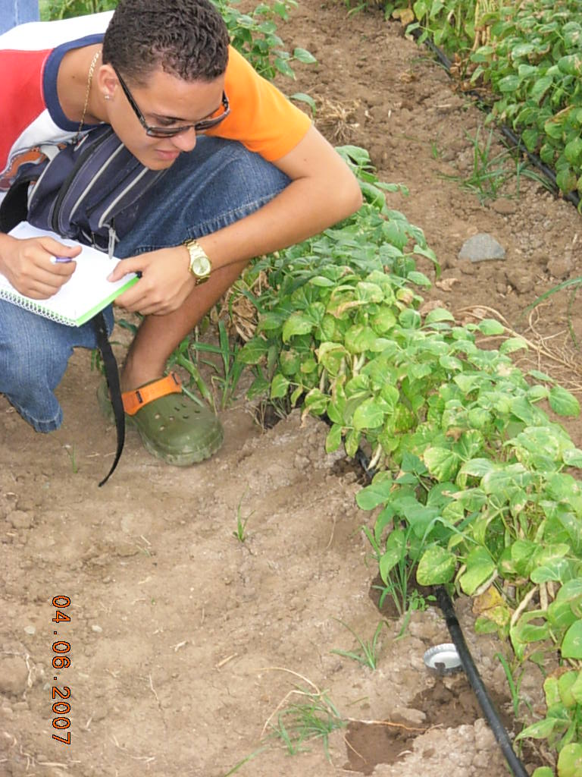
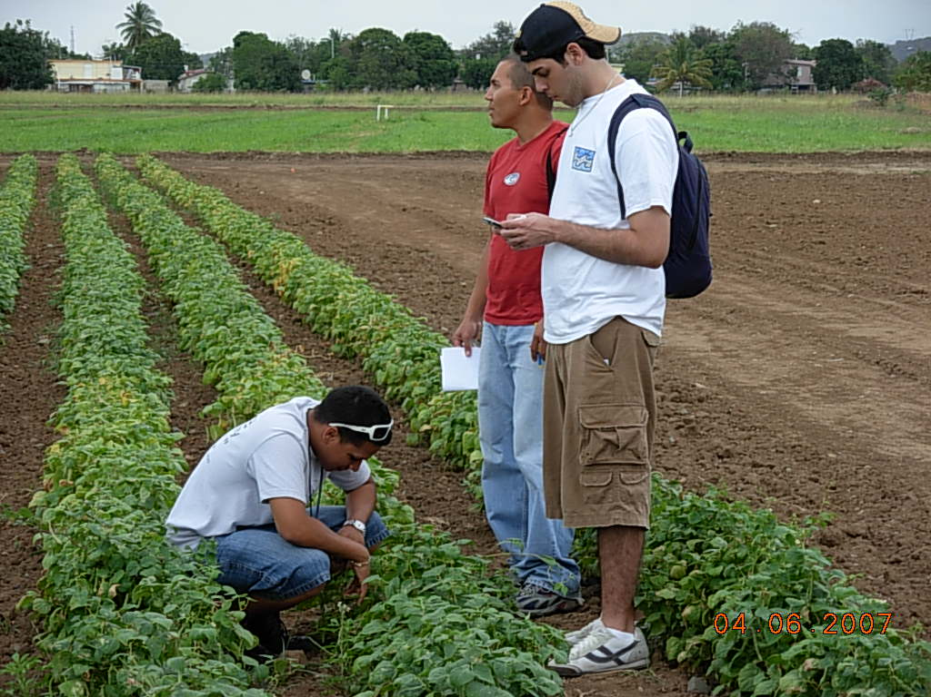
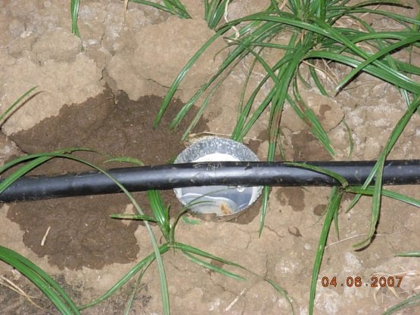
Drip Distribution Uniformity
Distribution Uniformity is critically important in Drip Irrigation
Why?
Sometimes a plant only has one emitter. If the emitter is plugged, then the plant may die.
If water is applied non-uniformly, then fertilizer will also be applied non-uniformly.

Slide 20
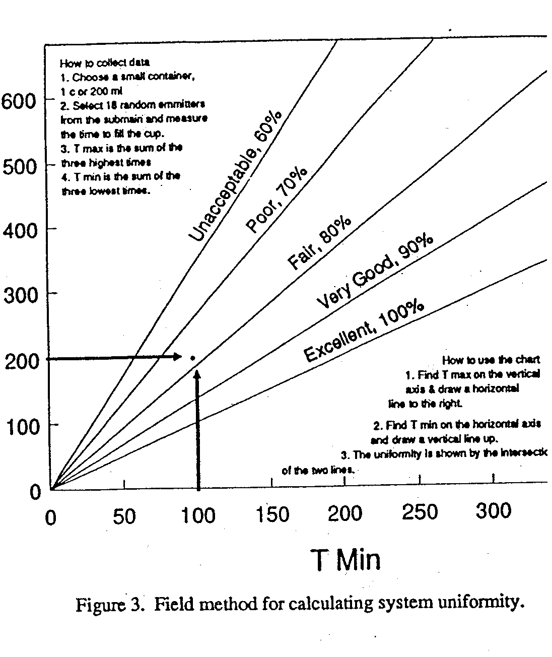

Slide 21
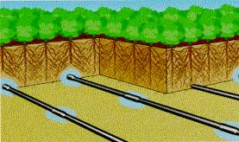
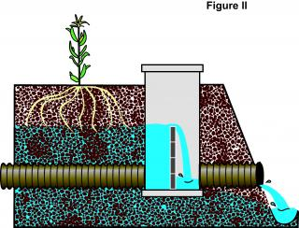
Subsurface

Slide 22
Condensation

Slide 23
Commercial dew condensation in (Israel)
To reduce the amount of irrigation water by as much as 50 to 90%
Tal-Ya Water Technologies, Inc. info@tal-ya.com

Slide 24
Commercially available dew condenser (Holland)
Broasis waterboxx www.aquaproholland.com

Slide 25
Fog collection projects
www.foguest.org
Chile ( fanel 150 to 750 liters of water a day) with 100 fog collectors = 15, 000 L/ year
Peru ( 2271 liters of water a day )with 7 fog collectors.

Slide 26
Appropriate Technology

Slide 29
Water Supply

Slide 30
Groundwater
Pumps

Slide 31
Irrigation Ponds

Slide 32
Other Technologies

Slide 33
How much water should I apply?
Evapotranspiration = evaporation from soil and wet surfaces + transpiration from leaves
Evapotranspiration = plant water requirement

Slide 34
Why Do I Care? (reminder)
Over application of water
Waste of
Water
energy
chemicals
money,
may lead to the contamination of ground and surface waters.
leaching of fertilizers past the root zone
water logging
lower crop yields.
Under-application of water
Lead to
Crop water stress
reduced crop yields
loss of revenue to the grower
“I wish I would have applied more irrigation.”

Slide 35
Intro to Agroclimatology
Definition of climate, weather meteorology
Weather parameters
Temperature
Humidity
Wind speed and direction
Solar radiation
Optional parameters that can be measured by weather stations
Soil moisture, leaf wetness, net radiation, soil heat flux

Slide 36
Weather Station Sensors

Slide 38
Many weather stations will calcuate the daily Evapotranspiration

Slide 39
Natural Resource Conservation Service SCAN Stations
http://www.wcc.nrcs.usda.gov/scan/Puerto_Rico/puerto_rico.html

Slide 40
National Weather Service – San Juan http://www.srh.noaa.gov/sju/

Slide 41
Soils
Clay
Sand
High Water Holding Capacity
Low Water Holding Capacity

Slide 42
So how can I determine the crop water requirement and then apply the correct amount of irrigation?
Here is a web-based method that can be used anywhere within Puerto Rico
The method will be introduced by way of an example
Detailed Example : Determine the irrigation requirement for the 5 day period, February 15-19, 2012, for a tomato crop in Juana Diaz, Puerto Rico. Table 1 summarizes the information used in the example problem. Table 2 provides the important web addresses necessary for obtaining data for use in the example problem. Table 3 shows the crop growth stage and crop coefficient (K_{c}) data for the example problem.

Slide 43
Table 1. Information used in example problem.
Table 2. Internet URLs for example problem.
Table 3. Crop growth stage and crop coefficient data for example problem.

Slide 44
Determine Crop Water Requirement
ET = K_{c} ET_{o}
where
ET = evapotranspiration = crop water requirement
K_{c} = Crop Coefficient (unique for every crop)
ET_{o} = Reference Evapotranspiration

Slide 45
Rainfall
A rain gauge is not available on or near the farm; therefore, it is necessary to obtain rainfall information from the NEXRAD radar. Inspection of the rainfall maps at the URL provided in Table 2 indicates that there was no rainfall during the five day period. Therefore, all of the crop water requirement will have to be satisfied with irrigation.

Slide 46
Reference Evapotranspiration (ET_{o})
The next step is to determine the reference evapotranspiration (ET_{o}) for the five day period. The next slide shows the estimated reference evapotranspiration for Puerto Rico on February 15, 2012 obtained from the web address provided in Table 2.
The estimated ET_{o} for the site location on 15 Feb., 2012 is 2.95 mm.
Using a similar procedure, the ET_{o} values for Feb. 16, 17, 18 and 19 are 2.8 mm, 3.1 mm, 3.5 mm and 3.7 mm, respectively. Summing up the ET_{o} values comes to a total reference evapotranspiration (for the five days) of 16.1 mm.

Slide 47
Reference Evapotranspiration

Slide 48
Crop Coefficient
The K_{c} value of 0.85 was obtained from the figure in the next slide.
Crop coefficient curve for the example problem. The heavy dashed line applies to the example problem with day of season 46-50 (i.e., Feb 15-19) corresponding to an approximate crop coefficient of 0.85 (vertical axis).

Slide 49
Crop Water Requirement
ET = K_{c} ET_{o}
The crop water requirement (ET) for the time period can now be estimated as follows: ET_{c} = K_{c} ET_{o} = (0.85)(16.1 mm) = 13. 7 mm.

Slide 50
Crop Coefficient Curve for Tomato
Crop coefficient curve for the example problem. The heavy dashed line applies to the example problem with day of season 46-50 (i.e., Feb 15-19) corresponding to an approximate crop coefficient of 0.85 (vertical axis).

Slide 51
Number of hours to run the pump to satisfy the crop water requirement
The final step is to determine the number of hours that the pump should be run to apply the 13.7 mm of water.
A form of the well-known irrigation equation (Fangmeier et al., 2005) can be used:
T = 17.817 x [D x A]/[Q x eff]
where T is time in hours, D is depth of irrigation water in mm, A is effective field area in acres, Q is flow rate in gallons per minute and eff is irrigation system efficiency.
Using D = 16.1 mm, A = 10 acres, Q = 300 gallons per minute and eff = 0.85, yields: T = 17.817 x [16.1 x 10] / [300 x 0.85] = 11.25 hours.

Slide 52
In Conclusion
Operating the pump for 11.25 hours will satisfy the crop water requirement.
The approach presented here is relatively simple and the near-real time data is available to any farmer in Puerto Rico with internet access.

