Slide 1
Dr. Eric Harmsen
Professor, Dept. of Agricultural and Biosystems Eng., Univ. of Puerto Rico-Mayaguez
Eric.harmsen@upr.edu
(787)955-5102
Saving Water, Energy and Money using Irrigation Scheduling

Slide 2
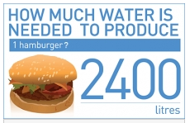
The cost of our food in water
= 634 gallons

Slide 3
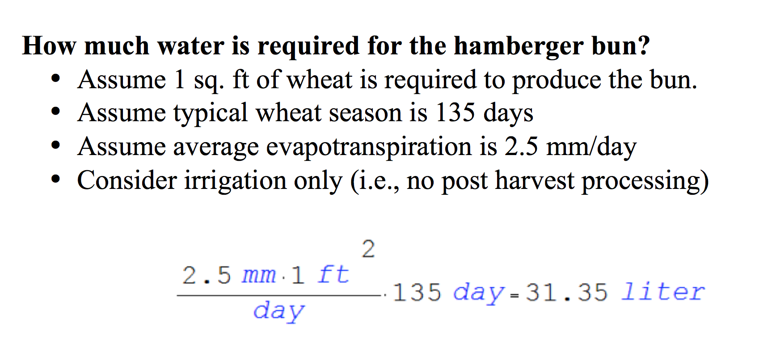
= 8.26 gallons

Slide 4
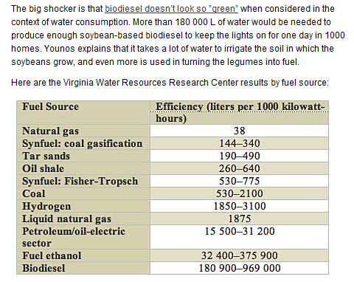
Water Use for Alternative Fuels
Energy used
by 2 house-holds
in one month
http://spectrum.ieee.org/energy/environment/how-much-water-does-it-take-to-make-electricity

Slide 5
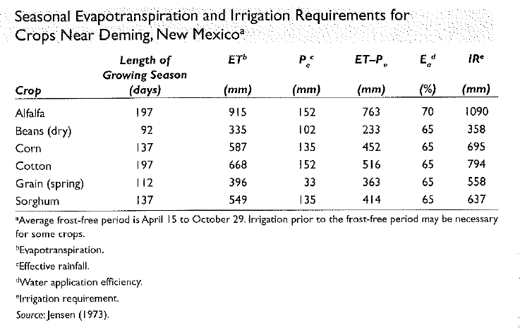
Beans: Average farm size in PR = 13 cuerda
335mm/0.75 x 0.003281 ft/mm * 43,560 cuerda/ft2 *7.48 gal/ft3
= 6.6 million gallons

Slide 6
Cost of irrigation water by source
PR Irrigation System (canals): $2 to $3 /acre-ft for farmers
PRASA $84/acre ft
Farmers are exempt from paying the Department of Natural and Environmental Resources fees if they have their own wells
Municipal water: $2,400/acre-ft
Municipal water is not an option for a farm!!
(Pricing information obtained from Ferdinand Quiñones)

Slide 7
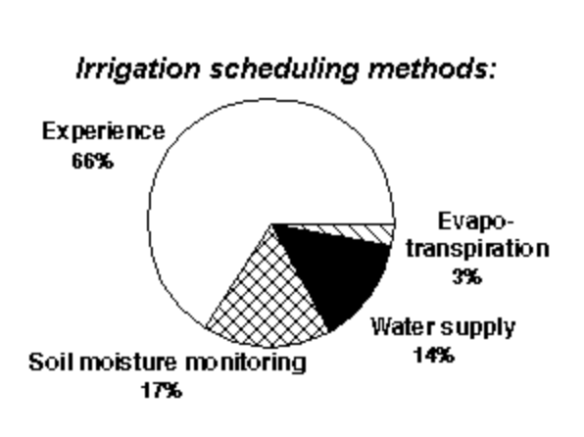
Irrigation Scheduling - What is the problem?
There is anecdotal evidence that most farmers do not use scientific methods for scheduling irrigation
Data from Idaho, USA
http://www.webpages.uidaho.edu/~karenl/wq/wqbr/wqbr26.html

Slide 8
Definition
What is irrigation scheduling? Irrigation Scheduling is the process used by irrigation system managers (farmers) to determine the correct frequency and duration of watering. (wikipedia.org)

Slide 9
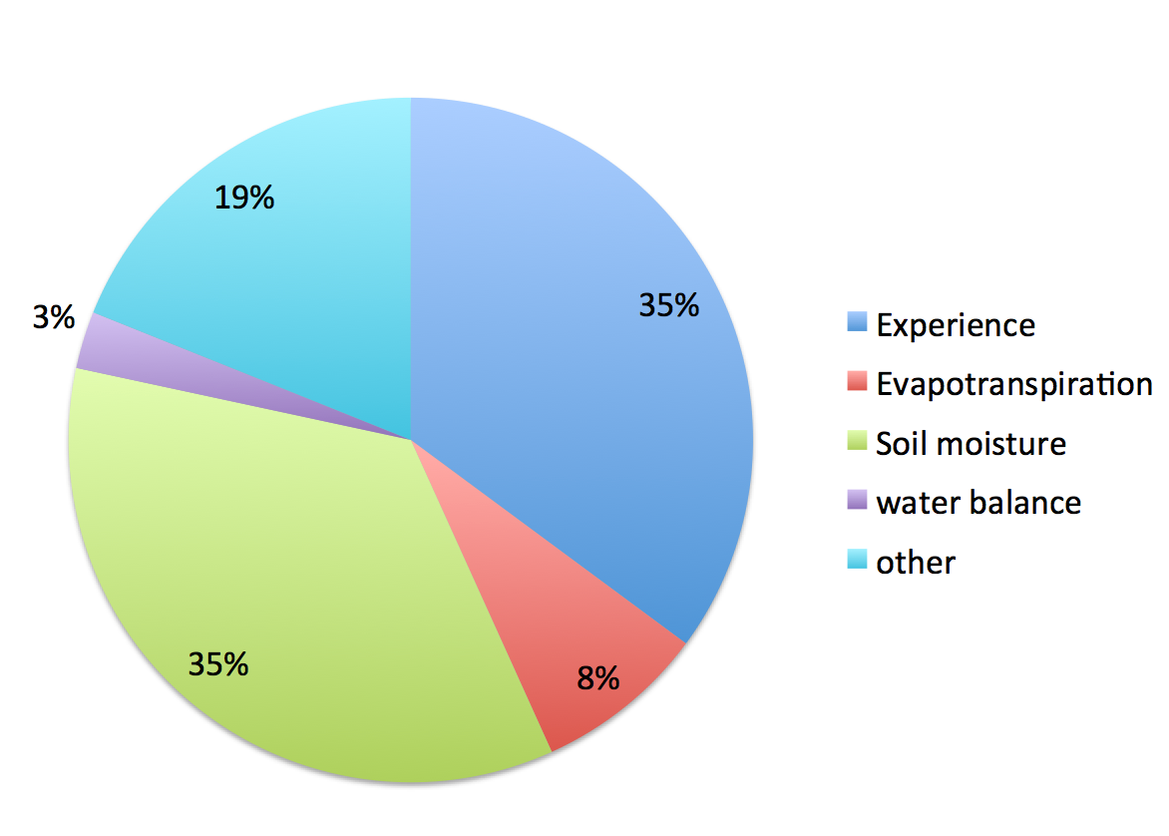
Irrigation Scheduling Methods used in Puerto Rico (preliminary data)

Slide 10
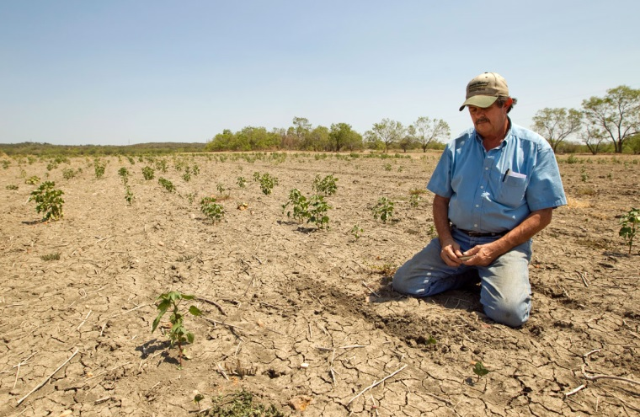
Why do we care?
Over application of water
Leads to the waste of
water
energy
chemicals
money
may lead to the contamination of ground and surface waters.
leaching of fertilizers past the root zone
water logging
lower crop yields.
Under-application of water
Leads to
crop water stress
Reduced crop yield
loss of revenue to the grower

Slide 11
How much money are we talking about?
 | Relative Irrigation Applied
 | 0.4 | 0.5 | 0.8 | 1.0 | 1.3 | 1.5 | 1.8
Cultivo* | $ Lost / Cuerda
Gandules | 47 | 32 | 10 | 0 | 12 | 35 | 69
Pepinillo | 111 | 76 | 25 | 0 | 15 | 56 | 124
Repollo | 256 | 174 | 57 | 0 | 21 | 103 | 247
Sandia | 293 | 199 | 65 | 0 | 23 | 114 | 277
Platanos y Guineos, Plantilla | 318 | 216 | 71 | 0 | 24 | 122 | 299
Calabaza | 390 | 265 | 87 | 0 | 27 | 146 | 359
Cebolla | 543 | 369 | 121 | 0 | 34 | 195 | 490
Pimiento | 578 | 393 | 129 | 0 | 36 | 206 | 519
Barenjena | 757 | 514 | 169 | 0 | 44 | 264 | 670
Platanos y Guineos, Reton~o | 1,006 | 684 | 225 | 0 | 76 | 388 | 945
Melon, Cantaloupe y Honeydew | 1,027 | 698 | 229 | 0 | 56 | 352 | 899
Raices y Tuberculos | 1,041 | 707 | 232 | 0 | 57 | 356 | 911
*Based model budget data from the Conjunto Tecnológico, UPR Experment Station

Slide 12
Experience Method
“I apply 1 inch of water to my crop every week.”
“The soil looks dry so I am going to irrigate.”
“The crop looks stressed so I am going to irrigate.”

Slide 13
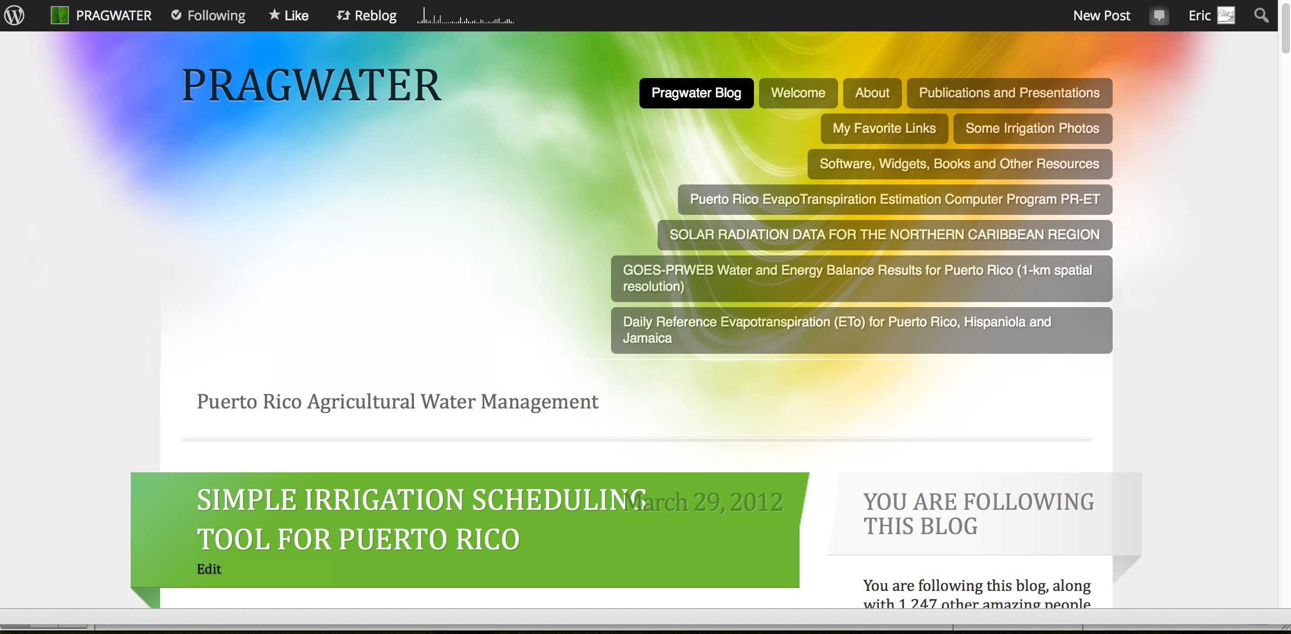
IRRIGATION SCHEDULING TOOL
http://pragwater.com/2012/03/29/simple-irrigation-scheduling-tool-for-puerto-rico/

Slide 14
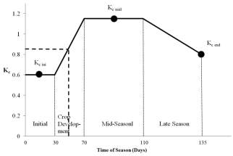
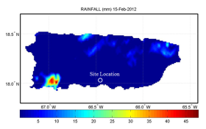
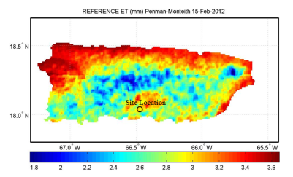
Web-based method for irrigation scheduling in PR
Determine average K_{c} for the time period
Define problem (location, farm size, crop, etc.)
Determine rainfall
from onsite gauge or NEXRAD
Start
Determine ET_{o}
Estimate Crop Water Requirement
ET_{c} = K_{c} ET_{o}
Harmsen E.W., 2012. TECHNICAL NOTE: A Simple Web-Based Method for Scheduling Irrigation in Puerto Rico J. Agric. Univ. P.R. 96 (3-4) 2012.
Estimate Irrigation Requirement and required hours of pumping

Slide 16
Detailed Example
Determine the irrigation requirement for the 5 day period, February 15-19, 2012, for a tomato crop in Juana Diaz, Puerto Rico.
Required Hyperlinks
Length of Growth Stages (Table 11) and Crop Coefficients (Table 12) | http://www.fao.org/docrep/X0490E/x0490e00.htm
Daily Reference Evapotranspiration (ETo) | http://academic.uprm.edu/hdc/GOES-PRWEB_RESULTS/rainfall
Daily NEXRAD Rainfall for Puerto Rico | http://academic.uprm.edu/hdc/GOES-PRWEB_RESULTS/reference_ET/

Slide 17
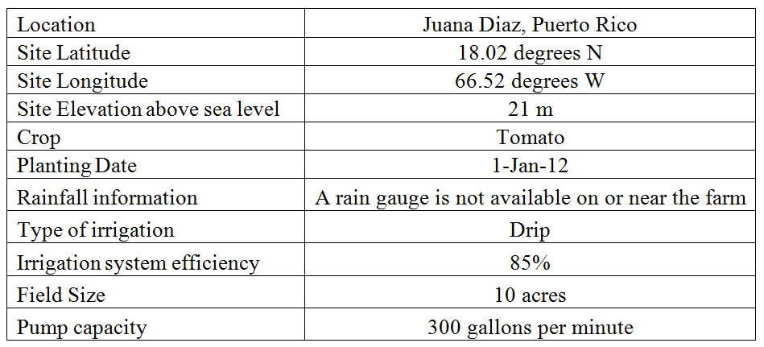
Step 1. Information used in example problem.

Slide 18
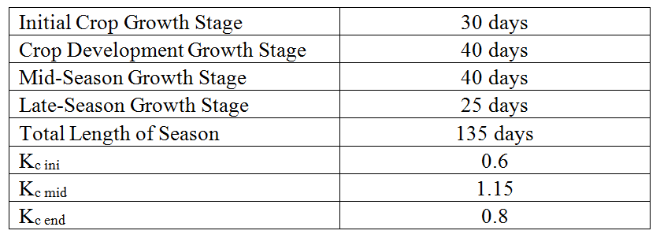
Step 2. Crop growth stage and crop coefficient data for example problem.
http://www.fao.org/docrep/X0490E/x0490e00.htm
Tomato Growth Stages and Crop Coefficients

Slide 19
Crop Coefficient
The averge K_{c} value of 0.85 for the five day period was obtained.
Crop coefficient curve for the example problem. The heavy dashed line applies to the example problem with day of season 46-50 (i.e., Feb 15-19) corresponding to an approximate crop coefficient of 0.85 (vertical axis).

Slide 20
Step 3. Rainfallhttp://academic.uprm.edu/hdc/GOES-PRWEB_RESULTS/rainfall/
Inspection of the rainfall maps at the URL provided indicates that there was no rainfall during the five day period.

Slide 21
Step 4. Reference Evapotranspiration (ET_{o}) http://academic.uprm.edu/hdc/GOES-PRWEB_RESULTS/reference_ET/
Inspection of the ET_{o} maps at the URL provided above indicates that there was 16.1 mm of ET_{o} during the five day period.

Slide 22
Step 5. Crop Water Requirement
The crop water requirement (ET_{c}) for the five day period can now be estimated as follows:
ET_{c} = K_{c} ET_{o} = (0.85)(16.1 mm) = 13. 7 mm

Slide 23
Step 6. Calculation of Irrigation Requirement and duration of pumping
Using D = ET_{c} = 13.7 mm
A = 10 acres
Q = 300 gallons per minute
eff = 0.85, yields:
Irrigation Requirement (volume)
13.7 mm x 10 cuerda x 1044 / 0.85
= 168,260 gallons
Pumping time:
168,260 gal/300 gal/min *60 min/hr = 9.35 hours

Slide 24
Web-based Irrigation Scheduling Tool
Students from the Computer Engineering Department are developing desktop and mobile apps of the web-based irrigation scheduling procedure.
The user will be able to create an account, which will remember the user’s irrigation history
Everything will be automated
The apps should be ready for use in approximately 3 months.

Slide 25
Assignment
Determine the irrigation requirement for the 2-day period, June 1 and 2, 2014, for a pepper crop. Assume the following:
Farm area is 20 acres
Pump flow rate is 500 gallons per minute.
Planting date is Jan 2, 2013
Irrigation efficiency 70%
Perform the analysis for a pueblo with the same letter as your first name. For example, Pedro could use Ponce, Peñuelas, etc. Jomira could use Juana Diaz, Juncos, etc.

Slide 26
Use the web-based irrigation schedule tool presented in class on Nov. 13, 2013.
Length of Growth Stages and Crop Coefficients
http://www.fao.org/docrep/X0490E/x0490e00.htm
Daily Reference ET Results for Puerto Rico
http://academic.uprm.edu/hdc/GOES-PRWEB_RESULTS/reference_ET/
Daily NEXRAD Rainfall For Puerto Rico
http://academic.uprm.edu/hdc/GOES-PRWEB_RESULTS/rainfall/

