Slide 1
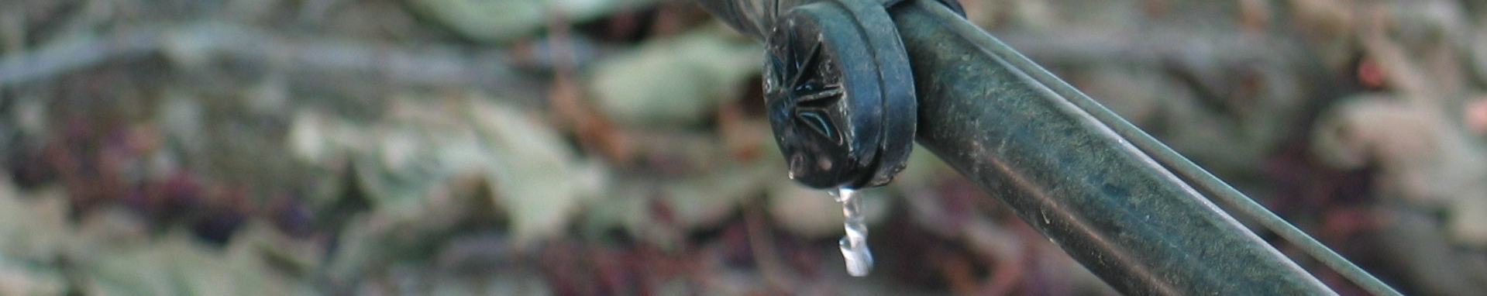
Dr. Eric Harmsen¹, Pedro Gonzalez Macias², Estefanía Álvarez³,
Ada L. Vilches Ortega³, Christian Lugo Pérez³ and Mauricio Álvarez Melendez³
¹Professor, Dept. of Agricultural and Biosystems Eng., Univ. of Puerto Rico-Mayaguez, Eric.harmsen@upr.edu, (787)955-5102
²Graduate Research Assistant, Dept. of Civil Eng., UPRM
³Undergraduate students, UPRM
Recent Evapotranspiration Research Activities in Puerto Rico

Slide 2
Some Recent ET Reserch Projects
1. Climate parameter estimation procedure for PR
2. ET measurement station
3. ET crop coefficients for two bean varieties
4. ET under climate change conditions
4. Water and energy balance algorithm for PR
5. Irrigation Scheduling tools a. PRET b. Spreadsheet water balance c. Satellite/Radar approach http://pragwater.com

Slide 3
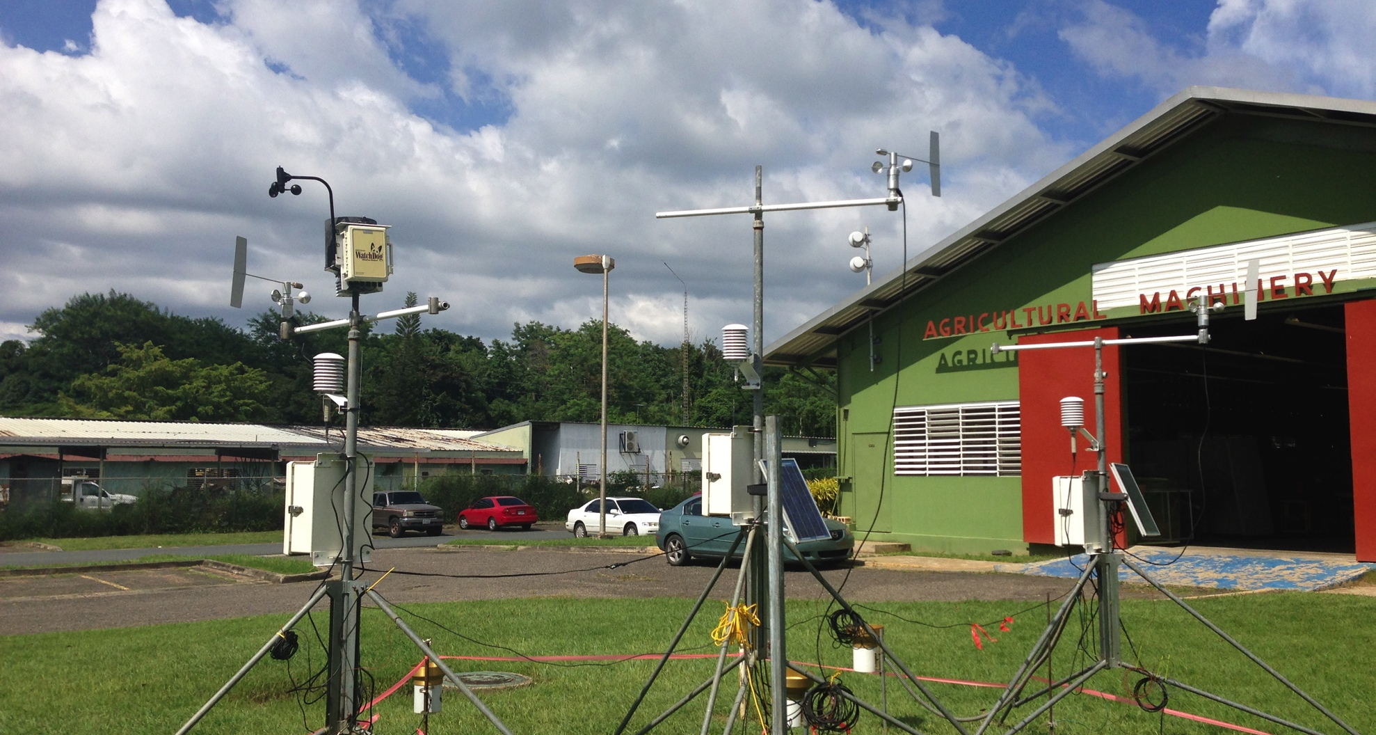
CALIBRATION GOES-PRWEB REFERENCE EVAPOTRANSPIRATION

Slide 4
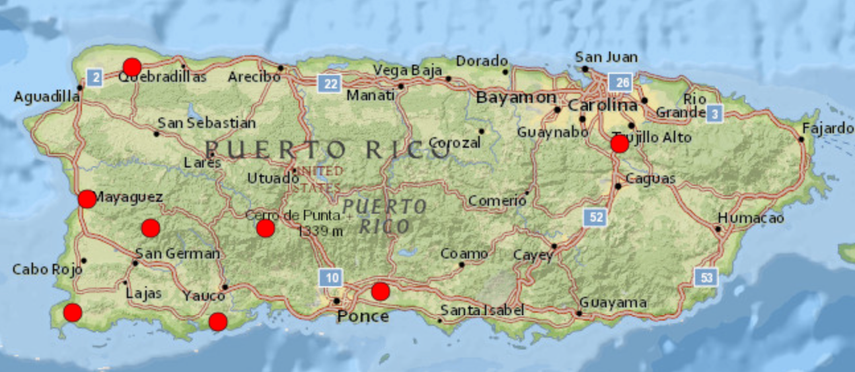
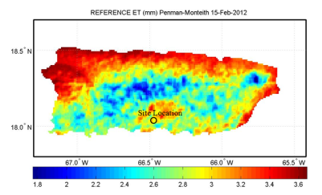
CIAG 4999
UNDERGRADUATE RESEARCH COURSE
Calibrate weather Parameters used in GOES-PRWEB with NRCS SCAN data.
Select reliable
Weather Station
Sensors
Start
Calibrate Weather
Station Equipment
Install stations at Isabela and Lajas
Compare ETo with NRCS SCAN stations and Stations at Isabela and Lajas
Student Reports
And Presentations

Slide 5
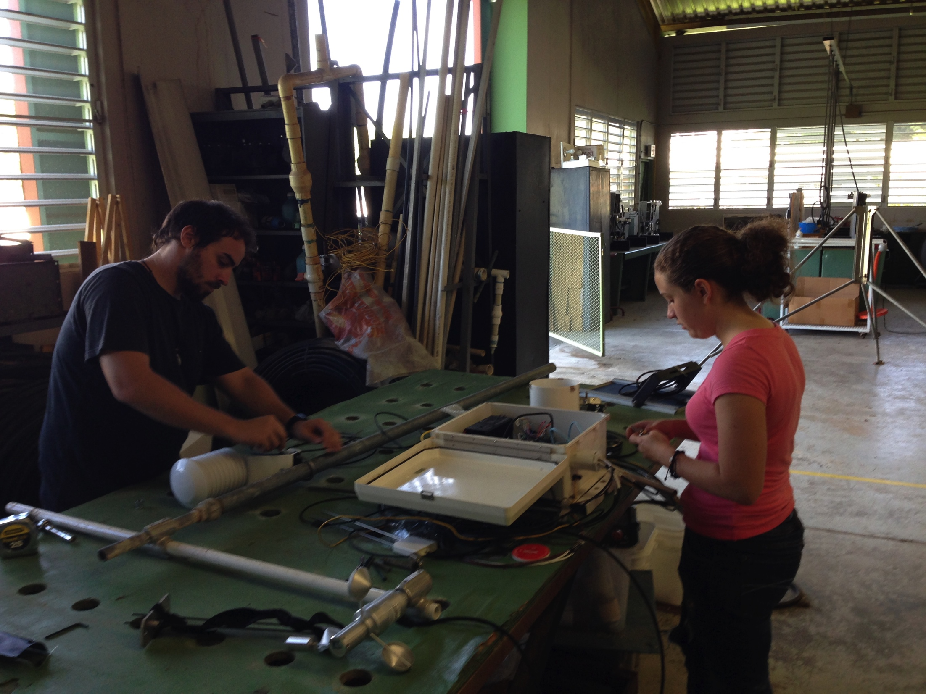
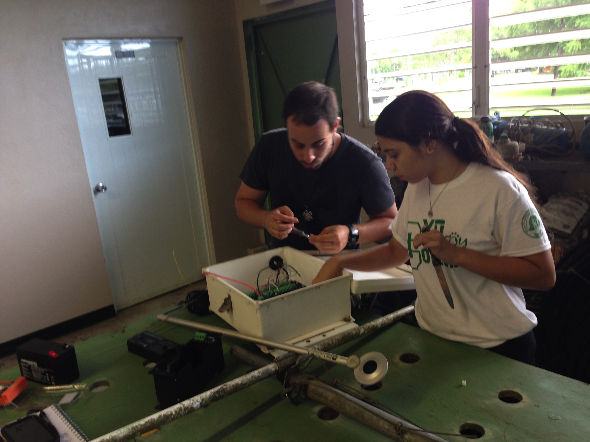
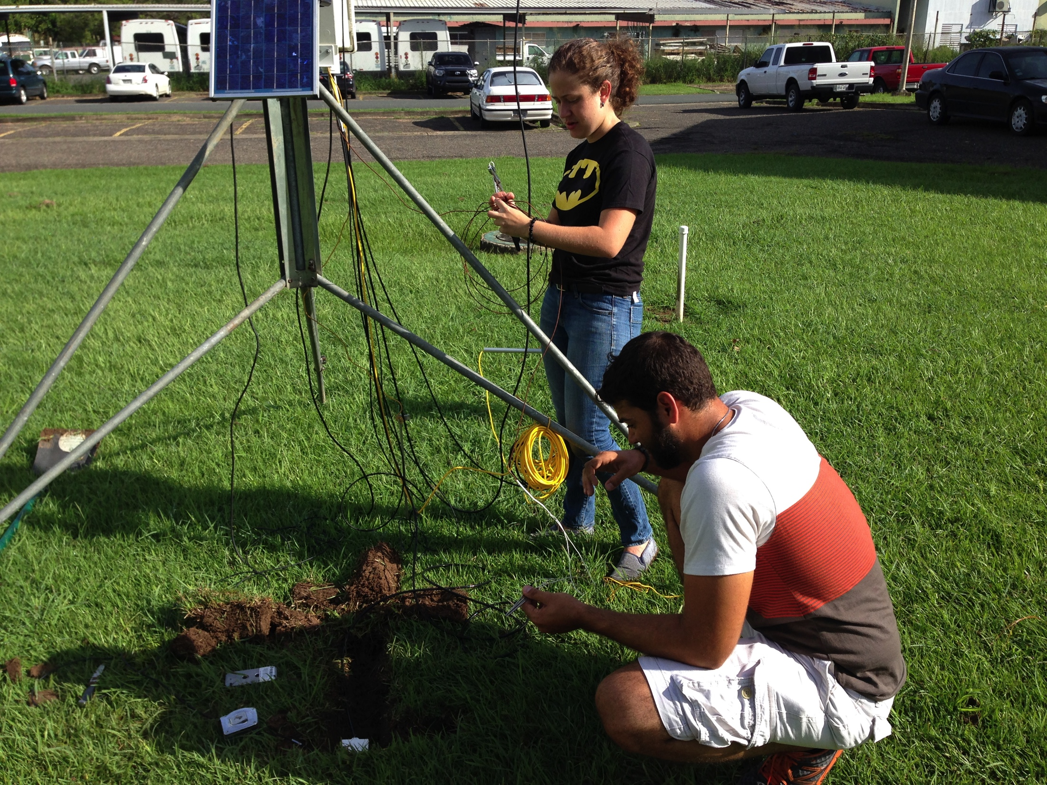
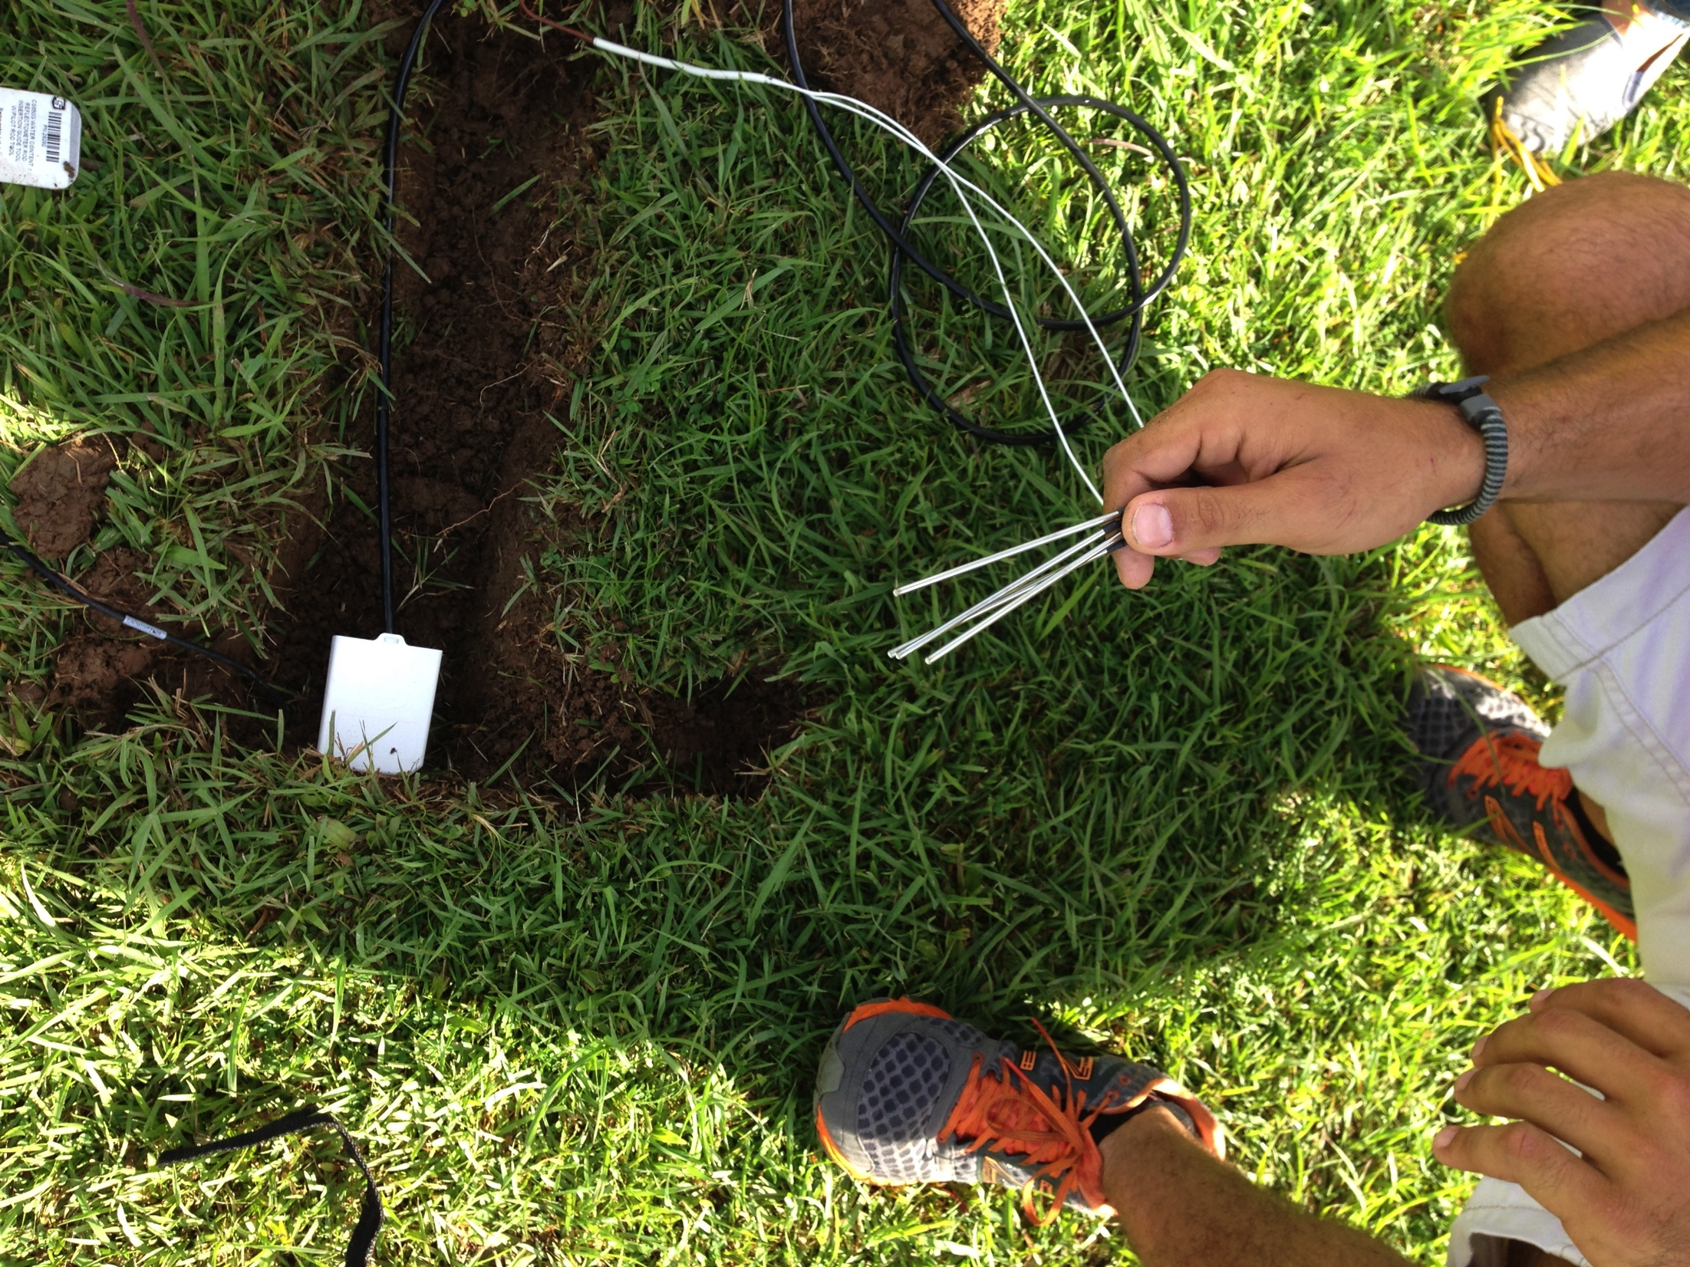

Slide 6
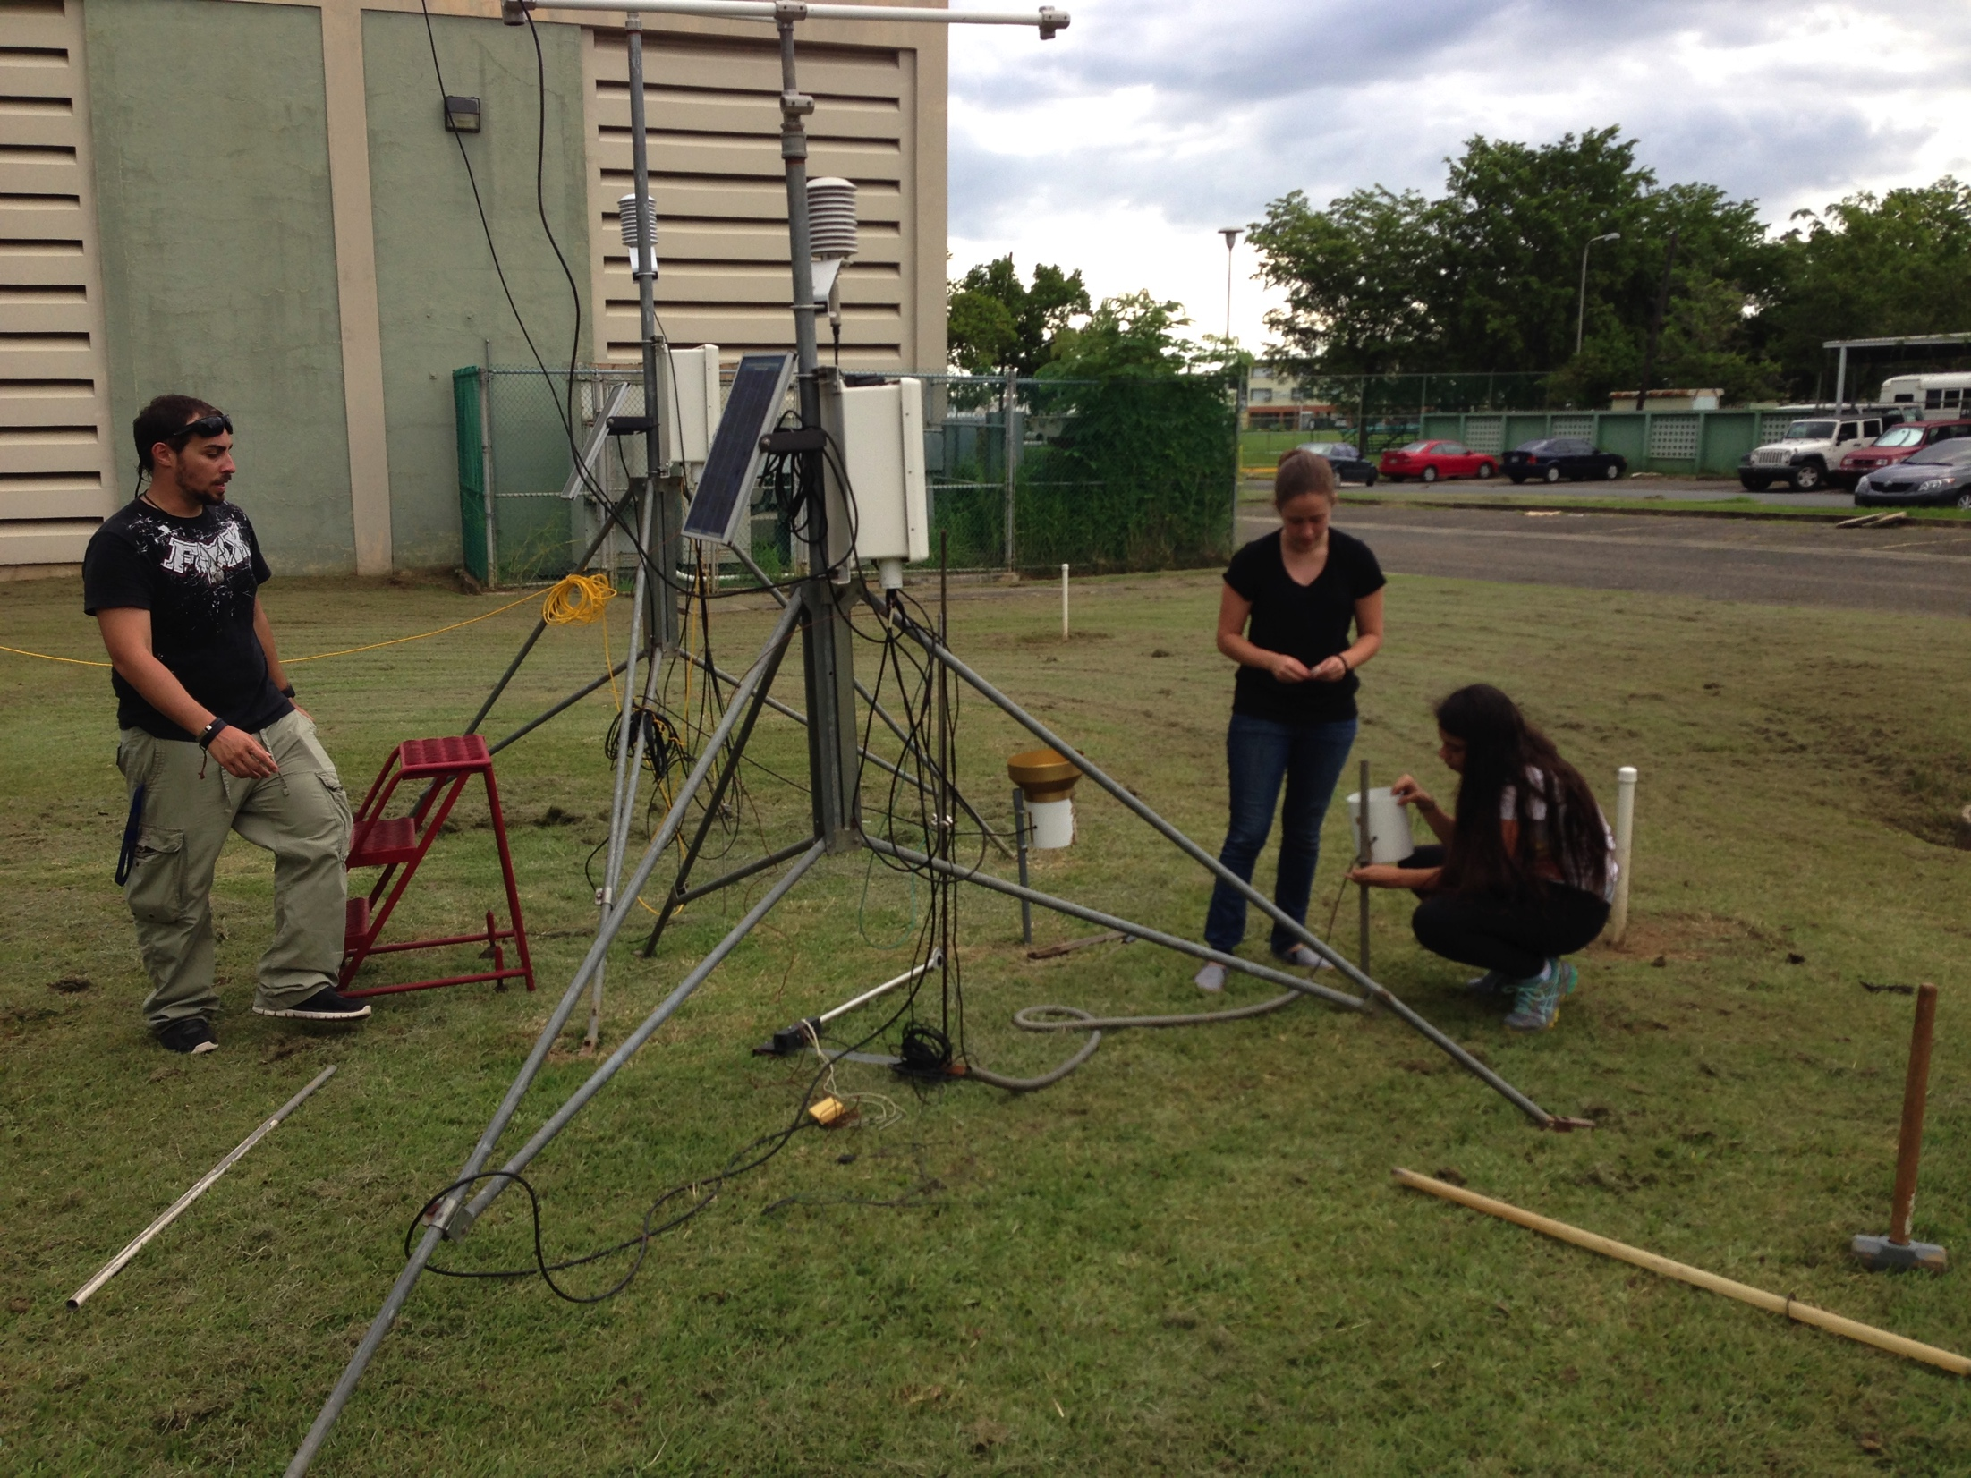

Slide 7
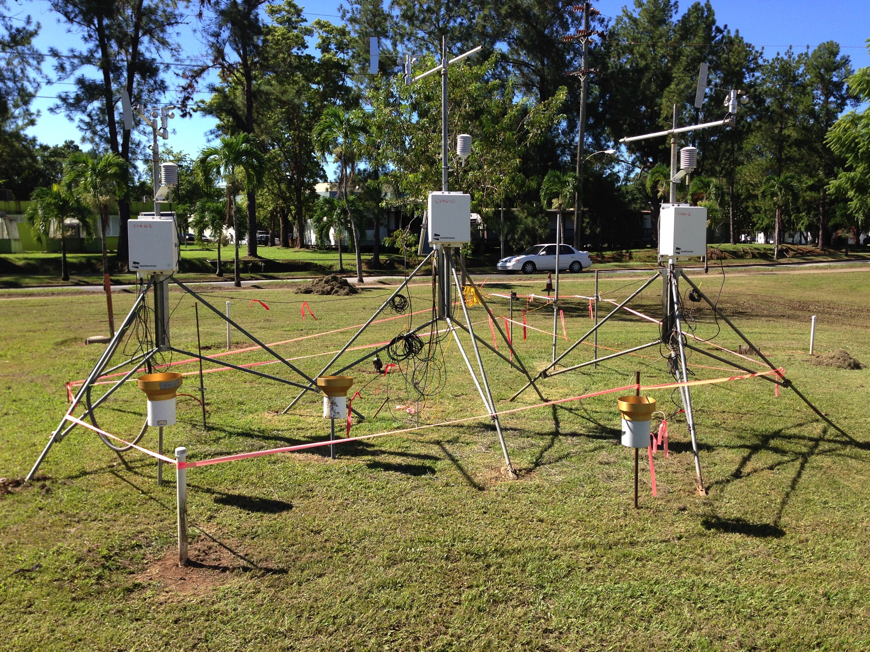

Slide 8
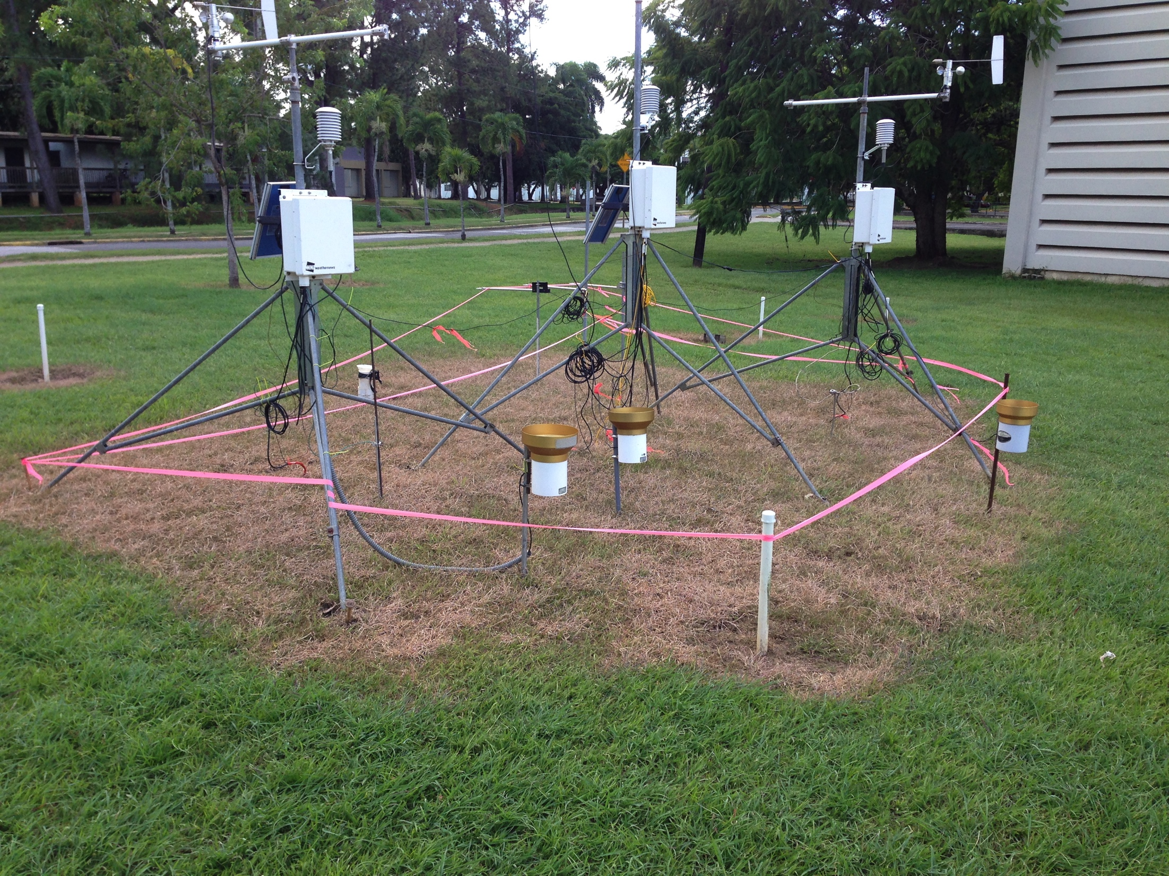

Slide 16
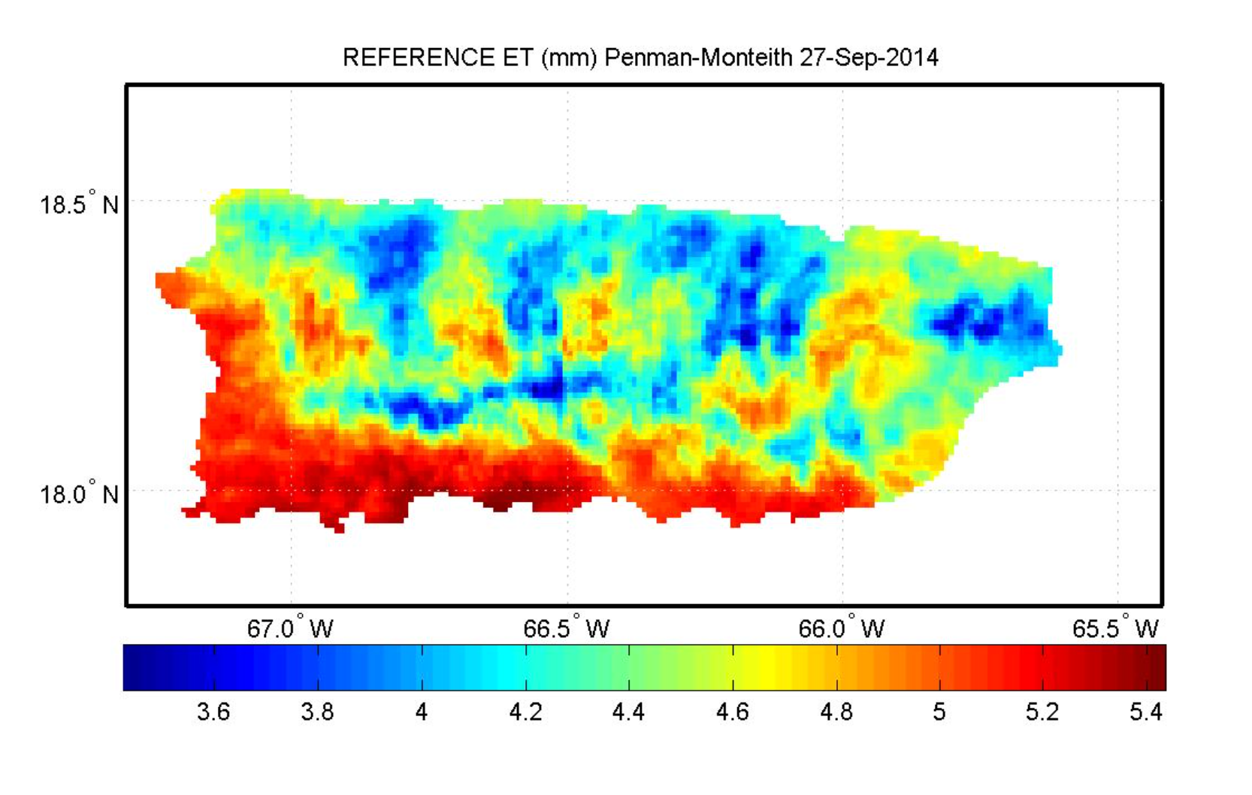
GOES-PRWEB Reference Evapotranspiration

Slide 18
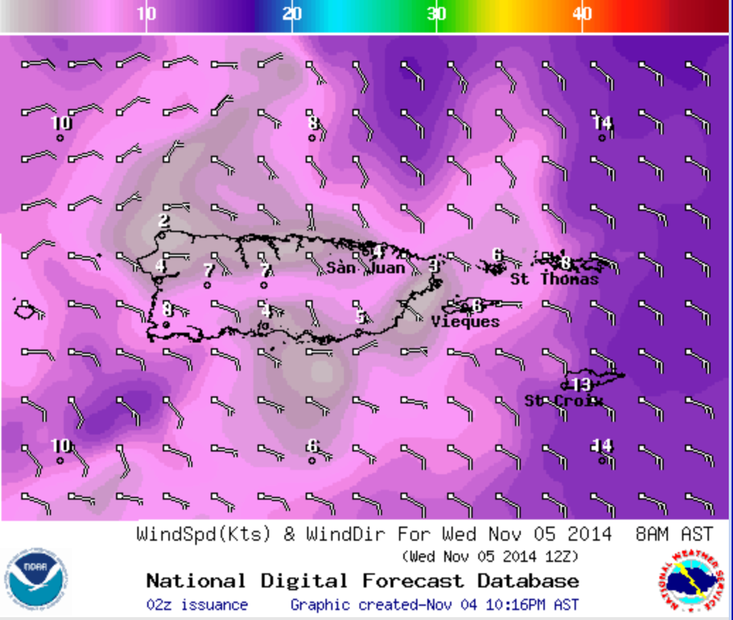
National Weather Service (NWS) Wind Speed
used in GOES-PRWEB

Slide 19
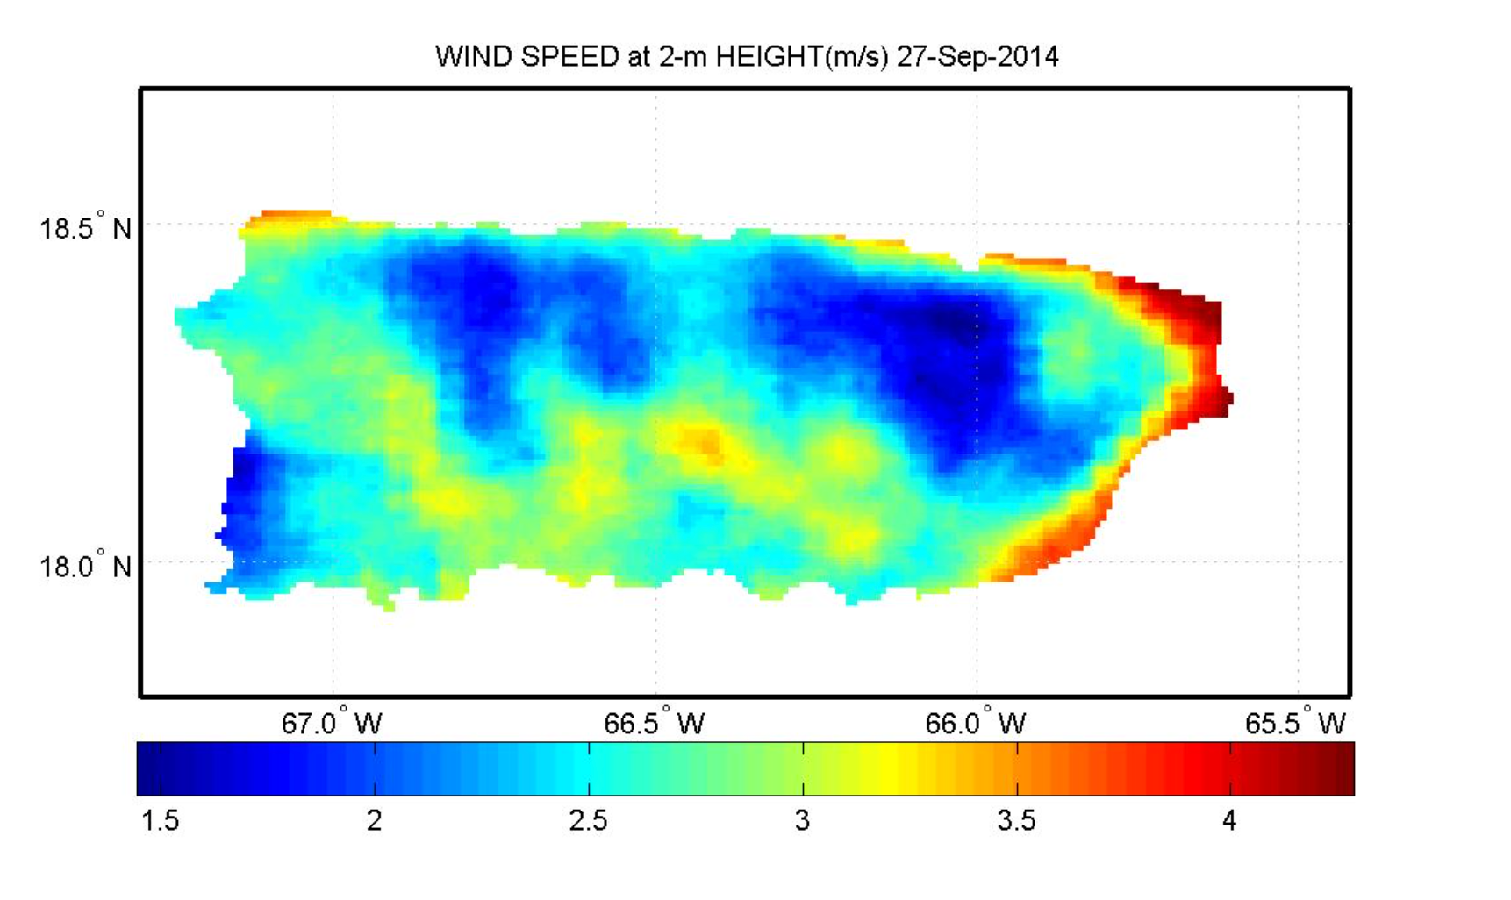
NWS Wind Speed Used in GOES-PRWEB

Slide 20
With Corrected Wind Speed

Slide 21
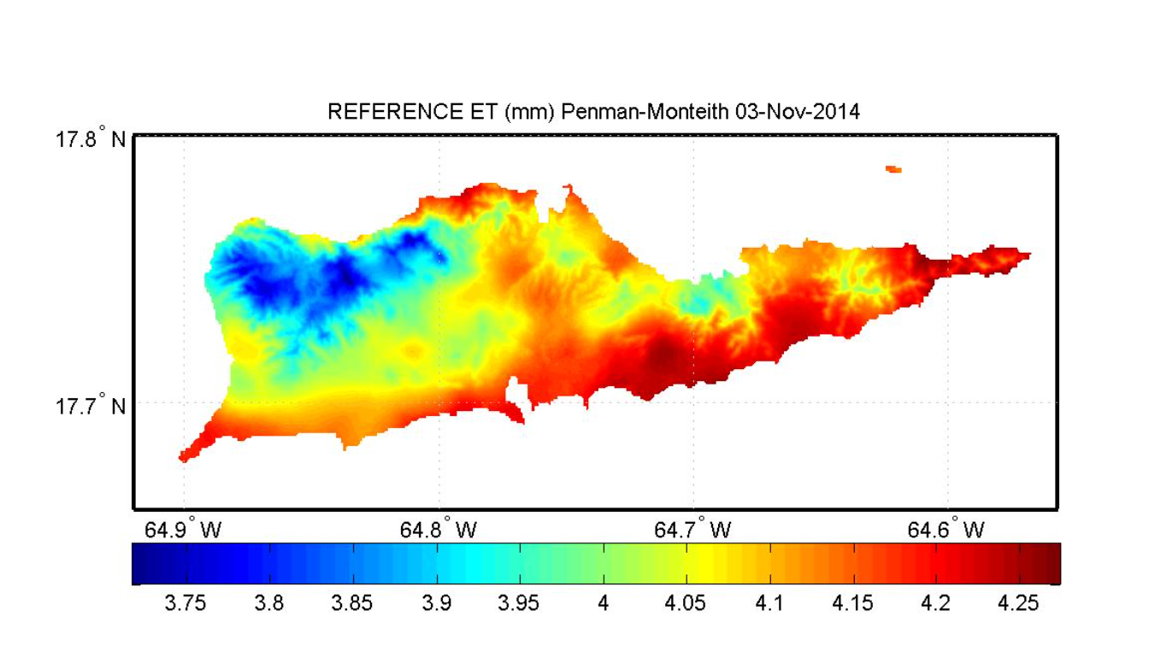
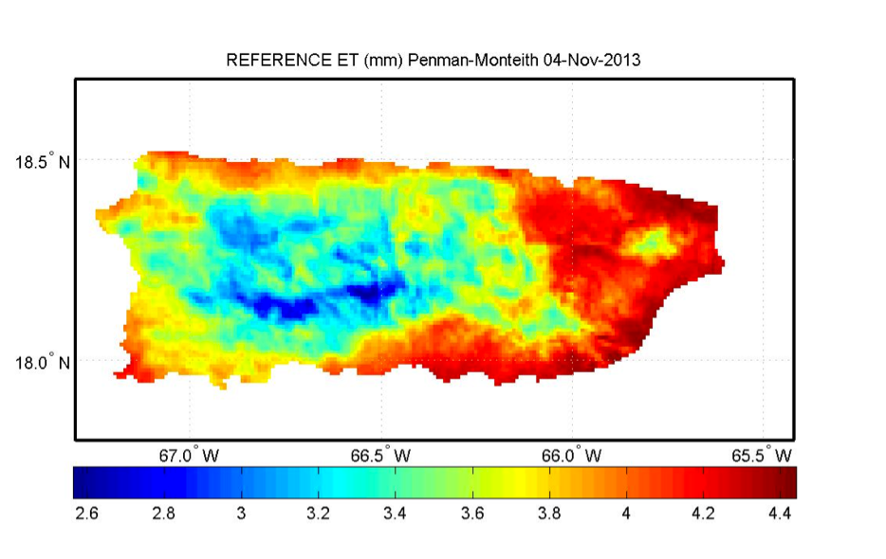
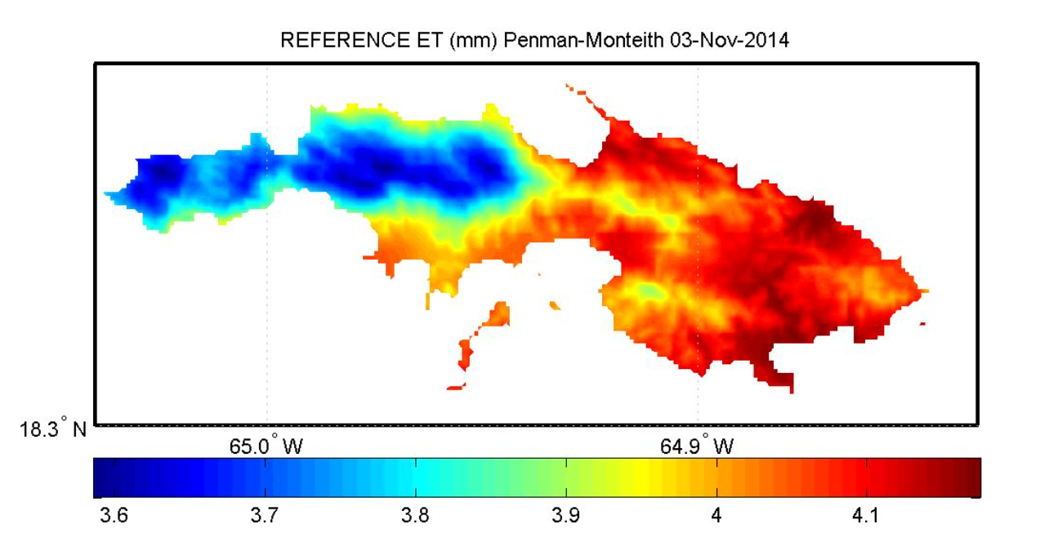
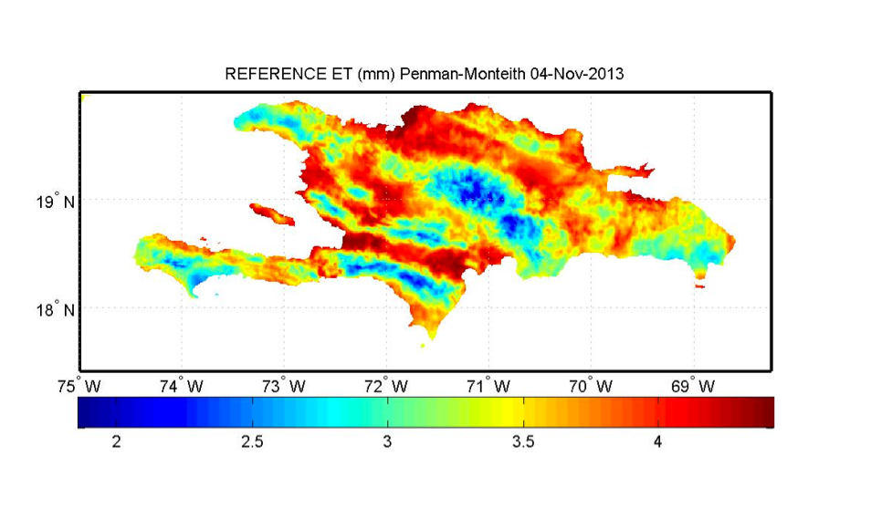
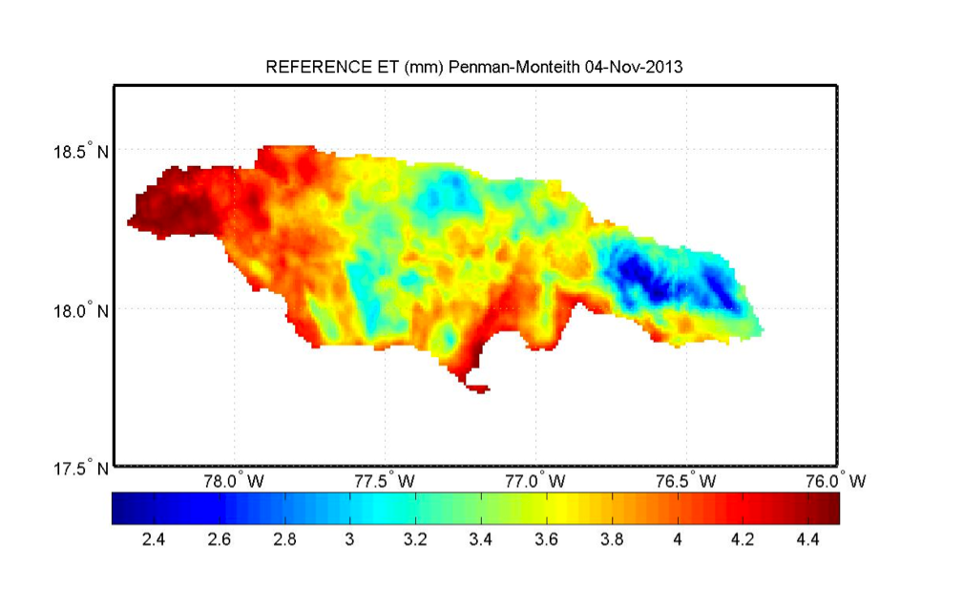
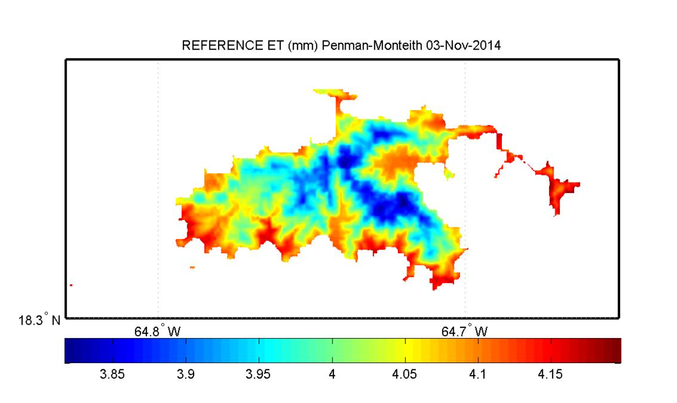
Real-Time and Archived Reference ET for Puerto Rico, USVI, Hispaniola and Jamaica
(http://pragwater.com)
Puerto Rico
St. Thomas
St. Croix
Hispaniola
Jamaica
St. John
Jamaica

Slide 22
Natural Resource Conservation Service (NRCS)
Soil Climate Analysis Network (SCAN)
Weather Stations

Slide 23
Comparison of NWS Wind Speed and NRCS SCAN Stations
BIAS = 0.18
BIAS = 0.24
BIAS = 0.60
BIAS = 0.11

Slide 24
Comparison of NWS Wind Speed and NRCS SCAN Stations
BIAS = 0.09
BIAS = 0.12
BIAS = 0.63
BIAS = 0.56

Slide 25
BIAS = Mean SCAN Weather Station Wind Speed
Mean NWS Wind Speed
NRCS SCAN Data Pairs Evaluated:
Maricao Forest = 1,740, Guilarte Forest = 1,828,
Isabela = 1,368, Combate = 587, Bosque Seco = 593,
TARS= 1,013, Fortuna = 1,818, Corozal = 752
Weather Underground Data Pairs Evaluated:
San Juan = 1095, Roosevelt Roads = 885
Jobos Bay National Estuarine Research Reserve = 1,826
Total Data Pairs = 13,505

Slide 26
WIND SPEED BIAS CORRECTION
NRCS SCAN Weather Underground Jobos Bay
0.6
0.7
0.8
0.6
0.6
0.79
0.4
0.2
0.56
0.8
0.12
0.24
0.76
0.18
0.7
0.63
0.11
0.09
0.6
0.1
0.3
0.4
0.1
0.2
0.4
0.4
0.6

Slide 27
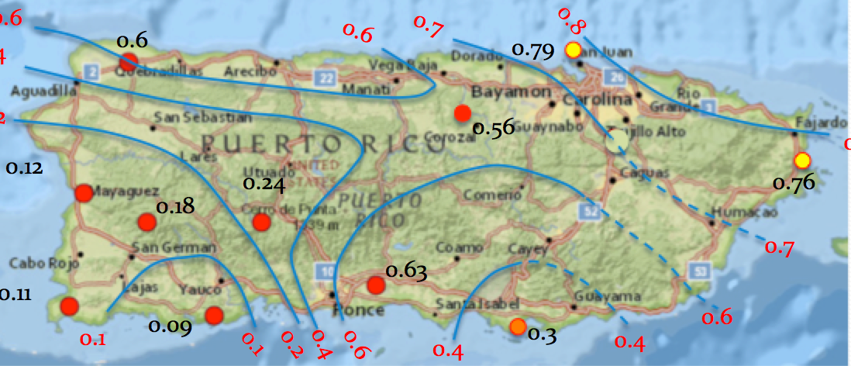
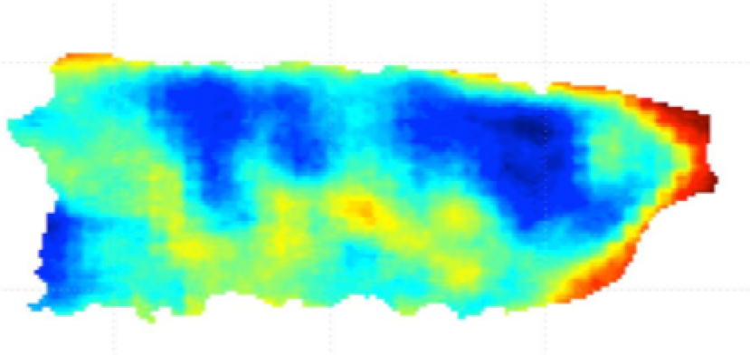
Implementation of the Bias Correction Map
Bias Correction Map NWS Wind Speed
x
= Improved wind
daily wind speed
estimates

Slide 28
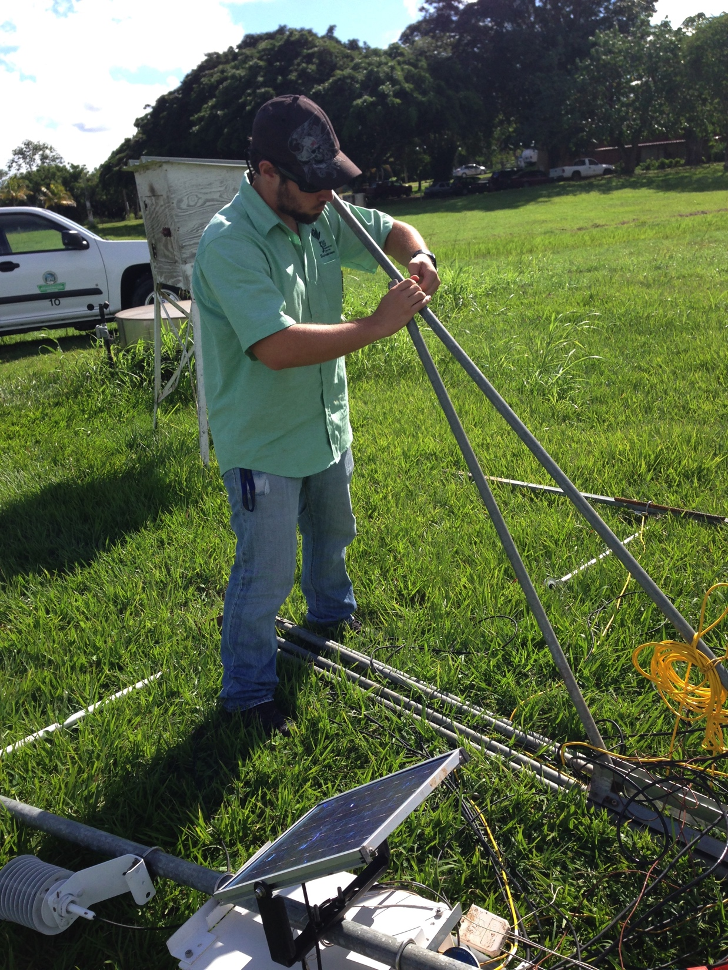
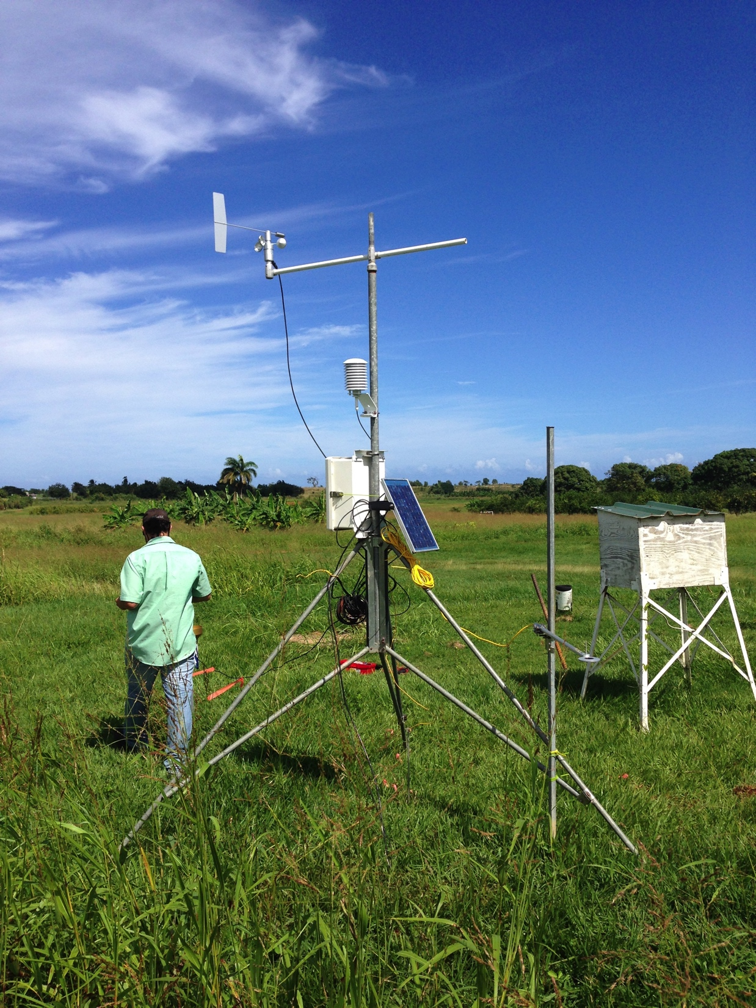
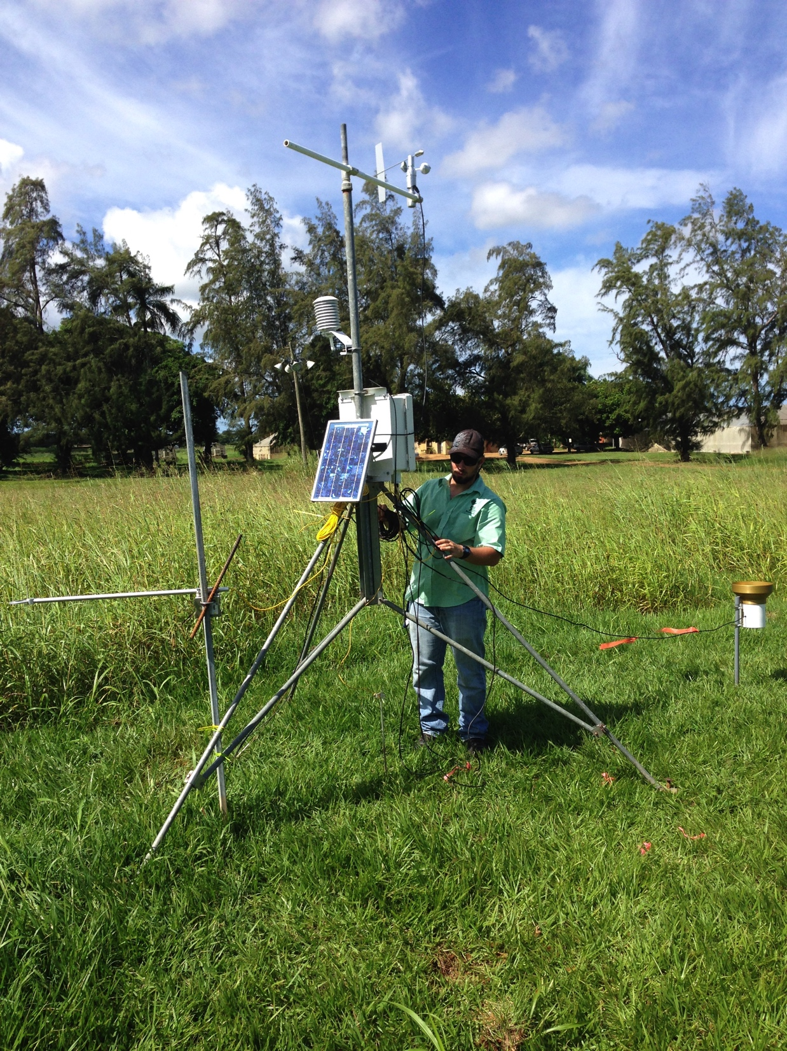
ISABELA SUBSTATION

Slide 29
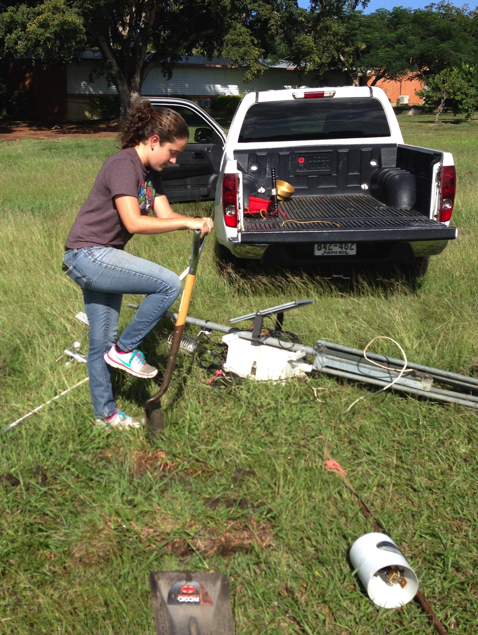
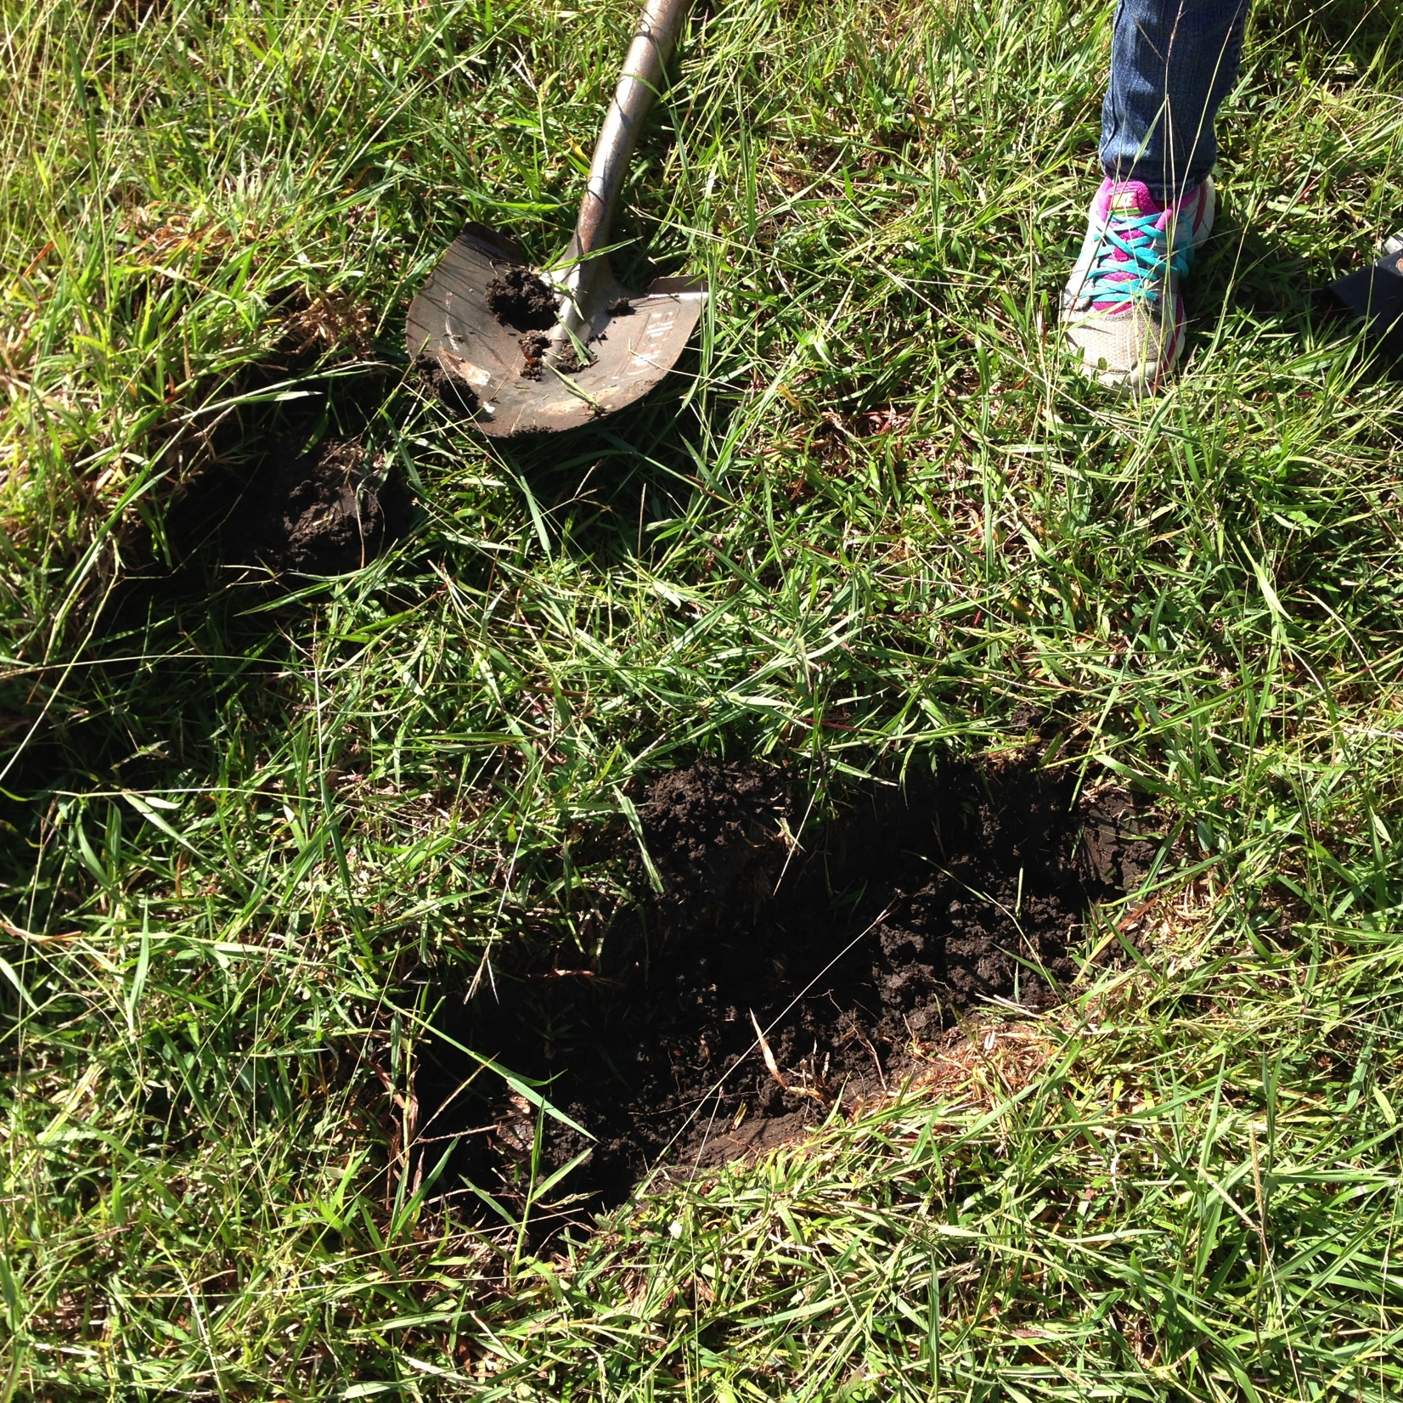
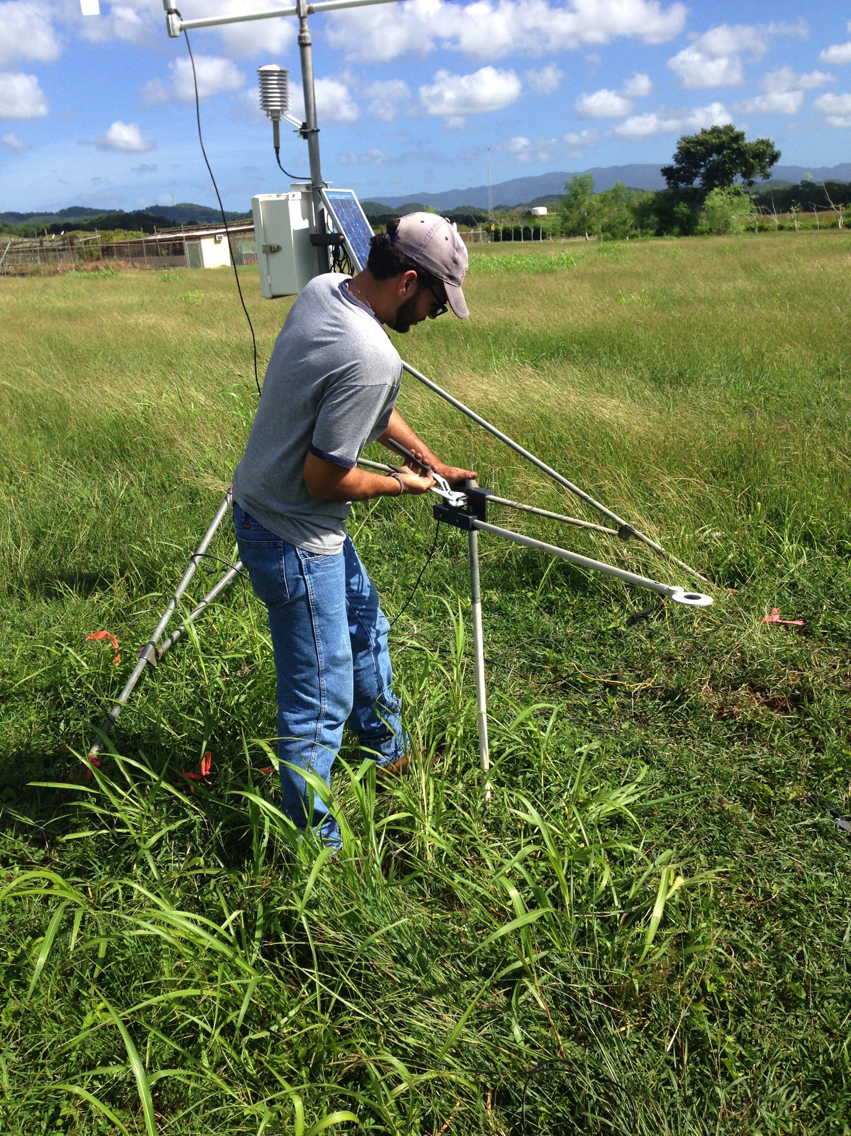
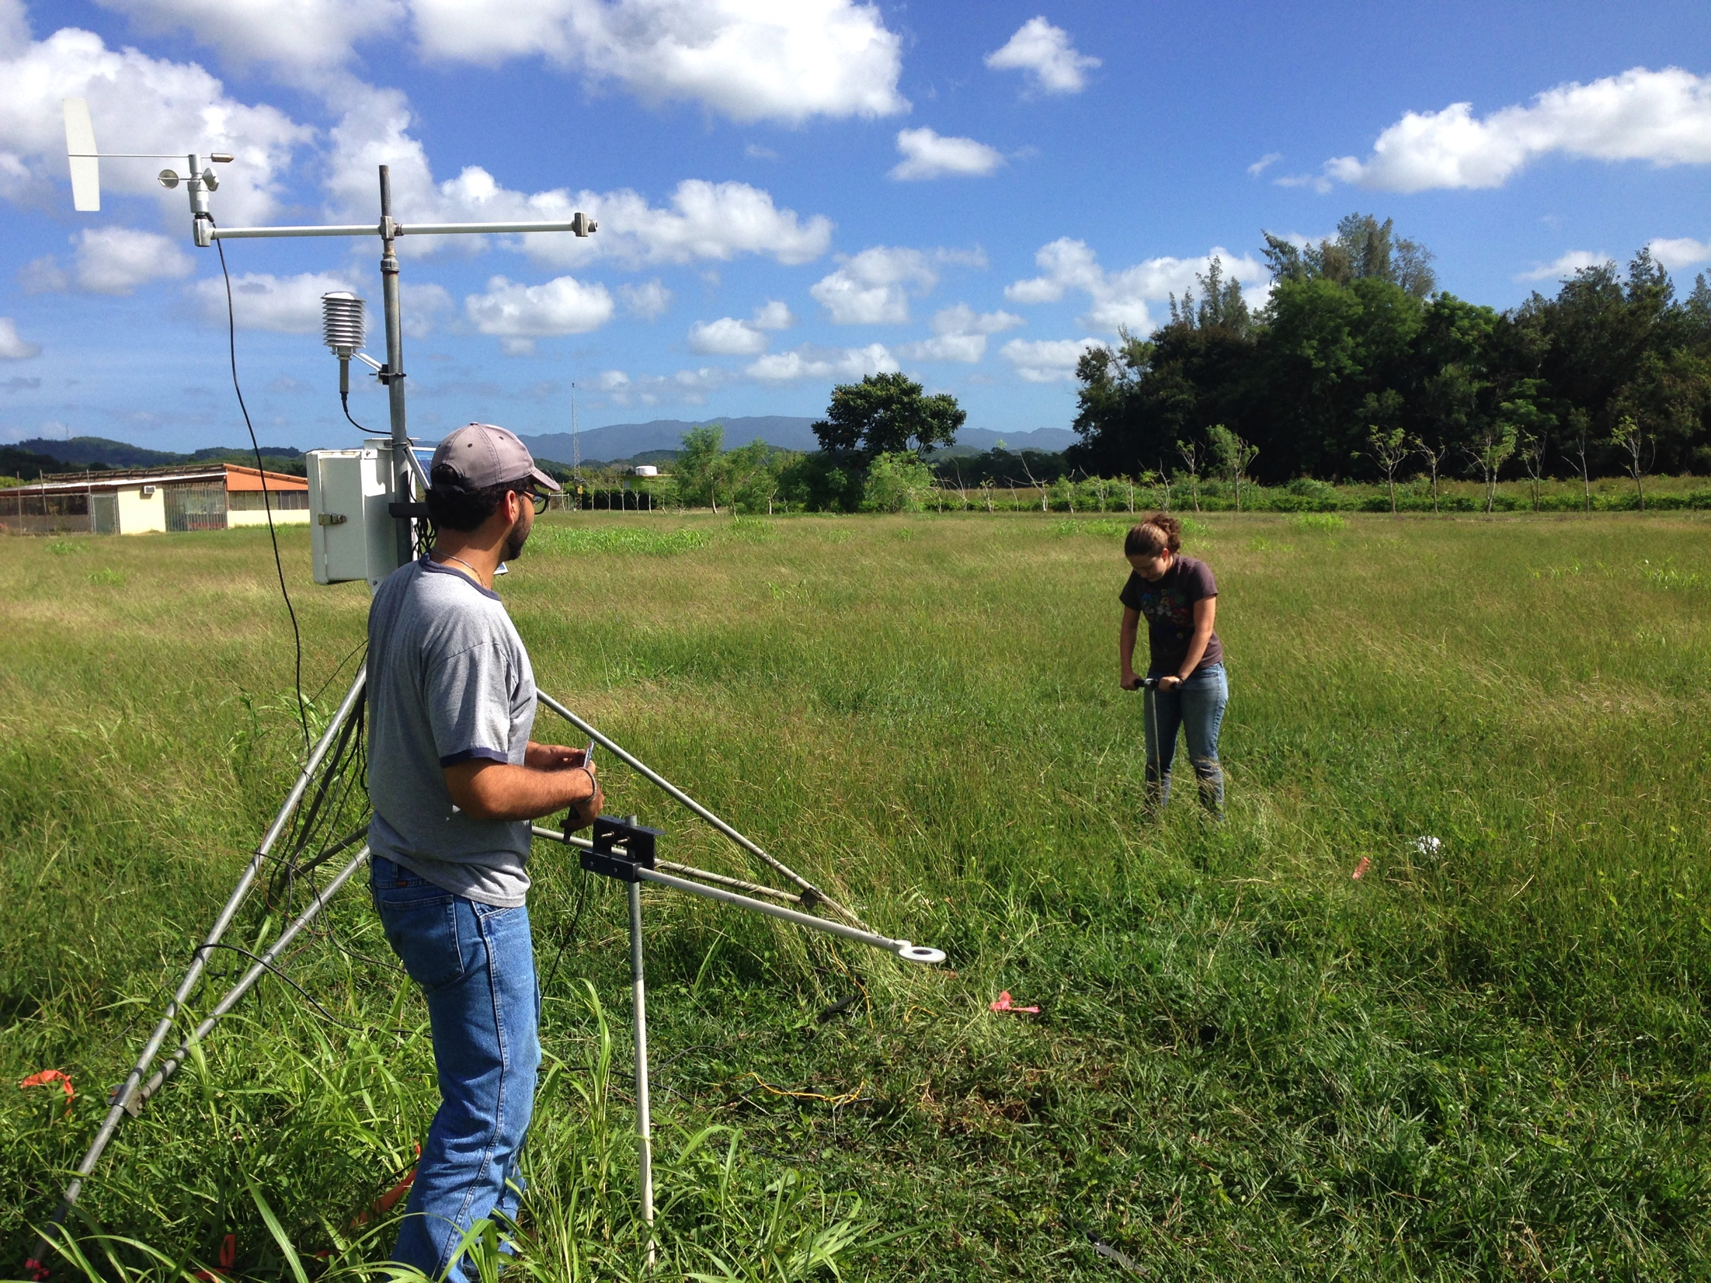
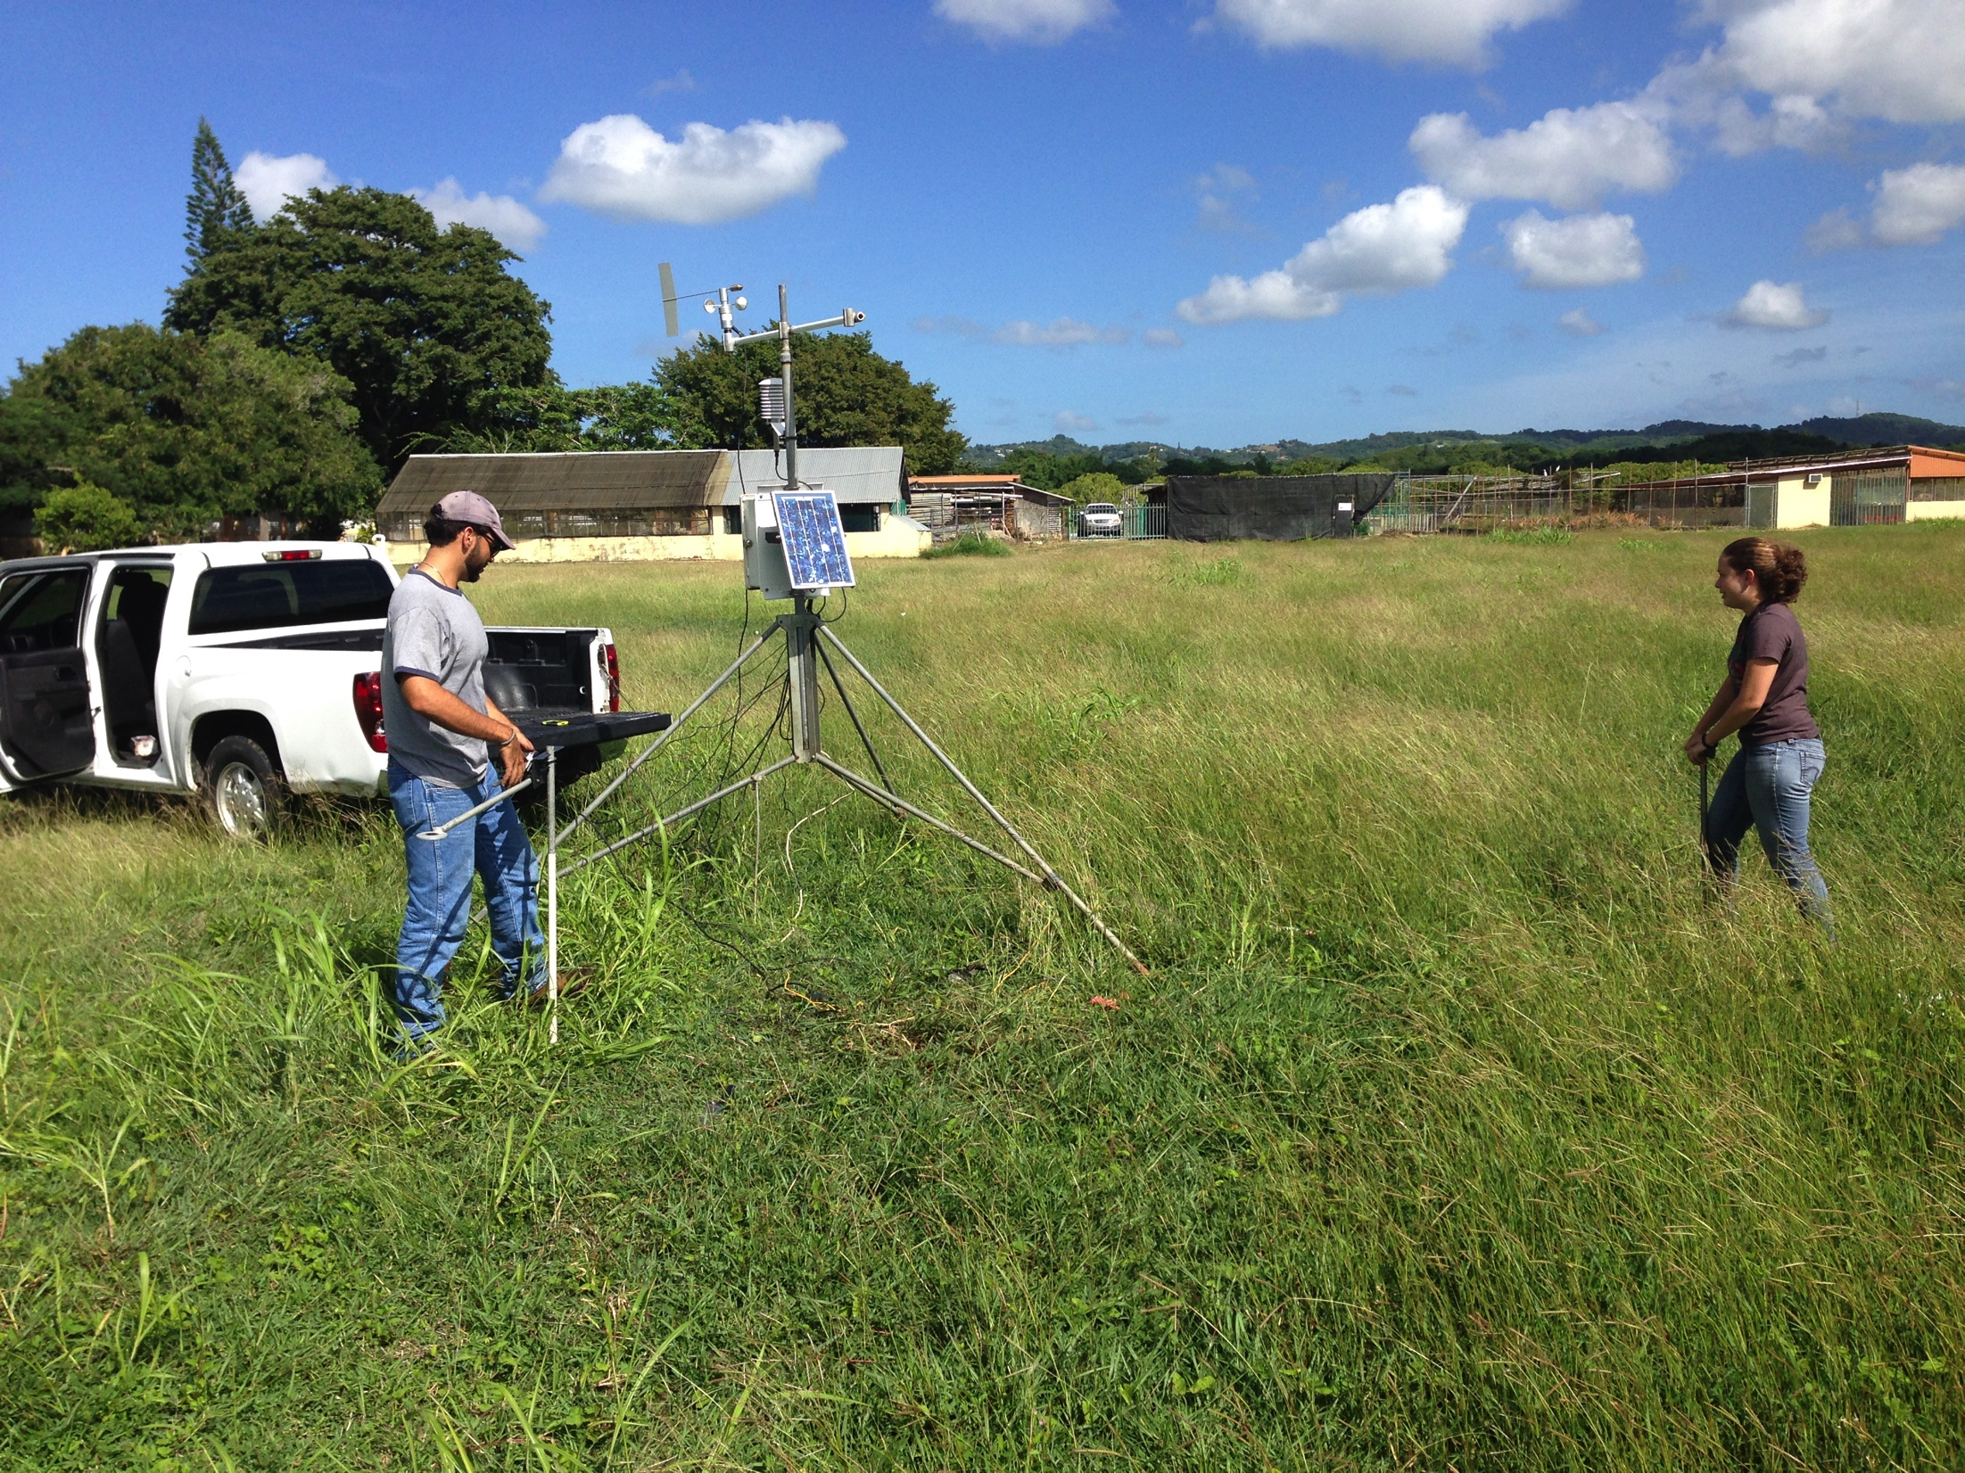
LAJAS SUBSTATION

Slide 30
Preliminary Conclusions
The NWS wind product from the National Digital Forecast Database (NDFD) produces unreliable results for Puerto Rico.
Using the NWS wind speeds cause GOES-PRWEB to overestimate ETo.
Errors in wind speed were not spatially constant. The largest errors for a five year period occurred in the southwest.
The FAO recommendation of using the world-wide average wind speed of 2 m/s with the absence of measured data will lead to significant errors in ETo in Puerto Rico.
Reliable wind speed is needed to obtain reliable estimates of ETo in Puerto Rico.
A goal of the undergraduate research project is to produce a reliable ETo product by the end of the semester.

Slide 31



ACKNOWLEDGEMENT
Colegio de Ciencias Agrícolas, Universidad de Puerto Rico
USDA Hatch Project (H-402)
NOAA-CREST Project

Slide 32
