Slide 1



Eric Harmsen
Professor, Dept. of Agricultural and Biosystems Eng., Univ. of Puerto Rico-Mayaguez
Eric.harmsen@upr.edu
(787)955-5102
Water Resource Managment

Slide 2
Current and Future Situation
The situation in Puerto Rico
  Threatened water supplies
  Inefficient water use
  Water competition
  Potential expansion of agriculture in future
  Climate change
Recommendations are needed at the
  Farm scale
  Institutional level

Slide 3
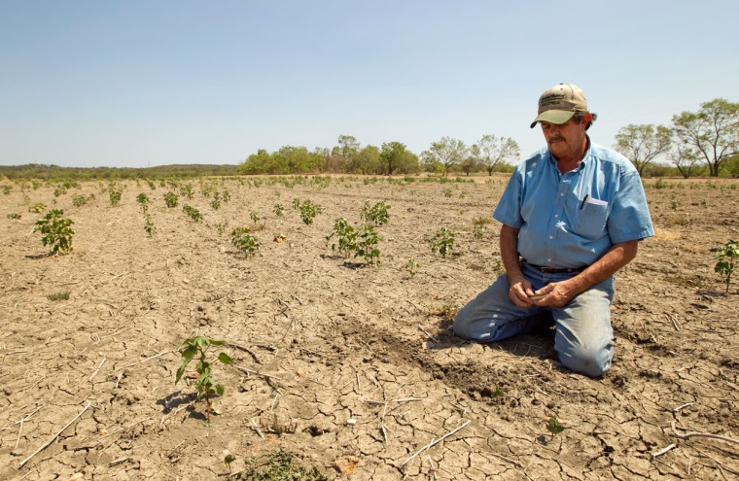

Why do we care?
Over application of water
Leads to the waste of
  water
  energy
  chemicals
  money
  may lead to the contamination of ground and surface waters.
  leaching of fertilizers past the root zone
  water logging
  lower crop yields.
Under-application of water
Leads to
  crop water stress
  Reduced crop yield
  loss of revenue to the grower

Slide 4
How much money are we talking about?
 | Percent of Crop Water Requirement Applied as Irrigation
 | 40% | 50% | 80% | 100% | 130% | 150% | 180%
Cultivo* | $ Lost / Cuerda
Gandules | 47 | 32 | 10 | 0 | 12 | 35 | 69
Pepinillo | 111 | 76 | 25 | 0 | 15 | 56 | 124
Repollo | 256 | 174 | 57 | 0 | 21 | 103 | 247
Sandia | 293 | 199 | 65 | 0 | 23 | 114 | 277
Platanos y Guineos, Plantilla | 318 | 216 | 71 | 0 | 24 | 122 | 299
Calabaza | 390 | 265 | 87 | 0 | 27 | 146 | 359
Cebolla | 543 | 369 | 121 | 0 | 34 | 195 | 490
Pimiento | 578 | 393 | 129 | 0 | 36 | 206 | 519
Barenjena | 757 | 514 | 169 | 0 | 44 | 264 | 670
Platanos y Guineos, Reton~o | 1,006 | 684 | 225 | 0 | 76 | 388 | 945
Melon, Cantaloupe y Honeydew | 1,027 | 698 | 229 | 0 | 56 | 352 | 899
Raices y Tuberculos | 1,041 | 707 | 232 | 0 | 57 | 356 | 911
    *Based model budget data from the Conjunto Tecnológico, UPR Experment Station

Slide 5
Cost of irrigation water by source
PR Irrigation System (canals): $2 to $3 /acre-ft for farmers
PRASA buys unused water from PREPA for $84/acre ft
Farmers are exempt from paying the Department of Natural and Environmental Resources fees if they have their own wells
Municipal water: $2,400/acre-ft
Municipal water is not an option for a farm!!
(Pricing information obtained from Ferdinand Quiñones)

Slide 6
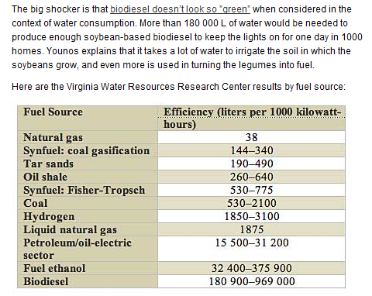
Water Use for Alternative Fuels
http://spectrum.ieee.org/energy/environment/how-much-water-does-it-take-to-make-electricity

Slide 7
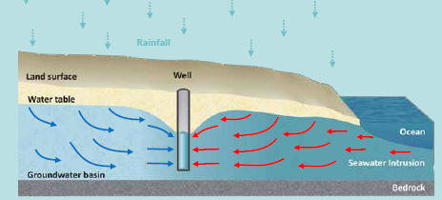
Cross section of water table near ocean with occurance of saltwater intrusion

Slide 8
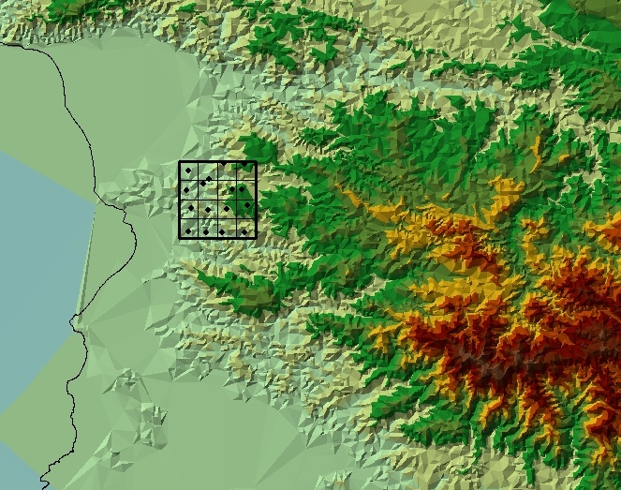
Rainfall Variability Study

Slide 9
Total Storm Rainfall
mm

Slide 10
DRAINAGE
Excess water affects plant growth by reducing soil aeration.
Flooding of plant roots causes a rapid reduction in transpiration, reduced absorption of oxygen and other plant nutrients with a corresponding increase in the carbon dioxide content of the soil, a disturbance of microbiological activity, and a reduced mass of soil from which nutrients can be obtained.
Changes in the oxygen and carbon dioxide balance may affect the growth of disease organisms.

Slide 11

Climate Change in the Caribbean Region
The projected timing of
climate departure from
recent variability,
Nature, Mora et al.,
Oct. 9, 2013
“The tropics are more vulnerable to climate
change than the Arctic, because of their
relatively stable environments. Air and water
temperatures there hardly fluctuate year-round,
so any shift in average temperature will surely tip
the balance quicker than anywhere else.”

Slide 12
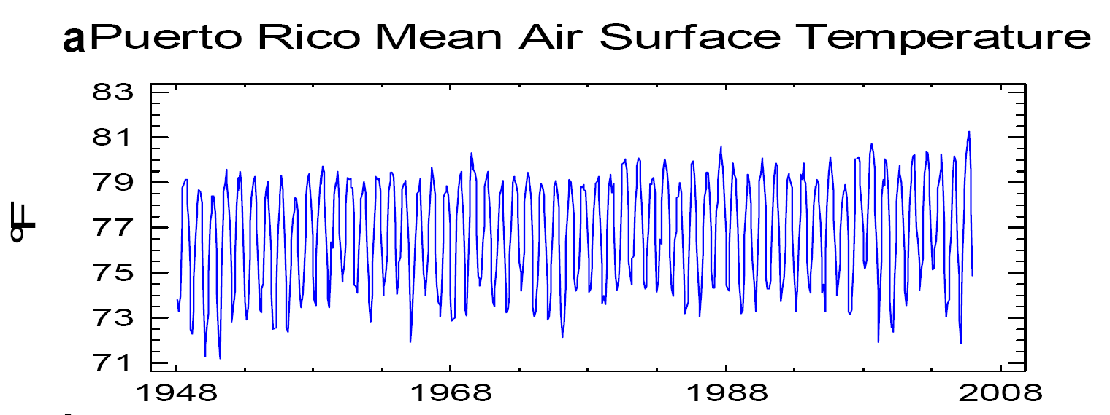
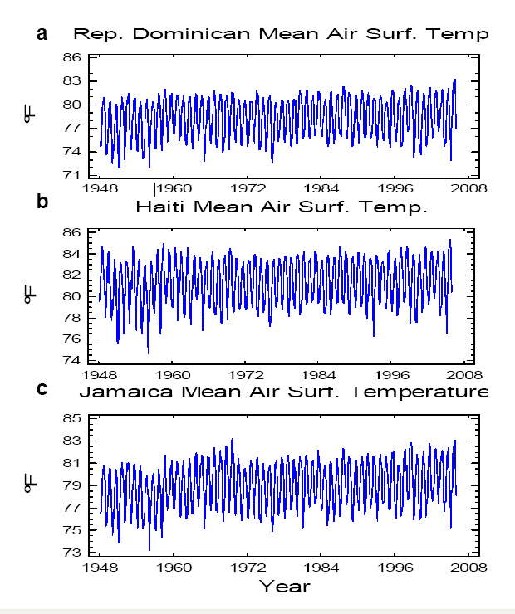
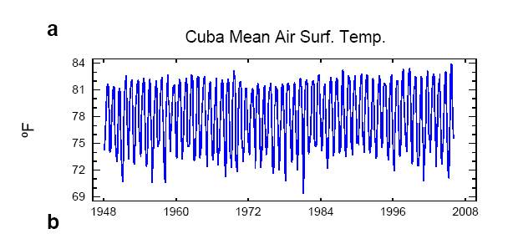
Have we seen a warming trend in the Caribbean? …… Yes!
28
53
1
14
5
Source: Ramirez-Beltran et al., 2007

Slide 13
Downscaled Minimum, Mean and Maximum
Air Temperature (ºC) for Lajas
Scenario A2
AIR TEMPERATURE
2100

Slide 14
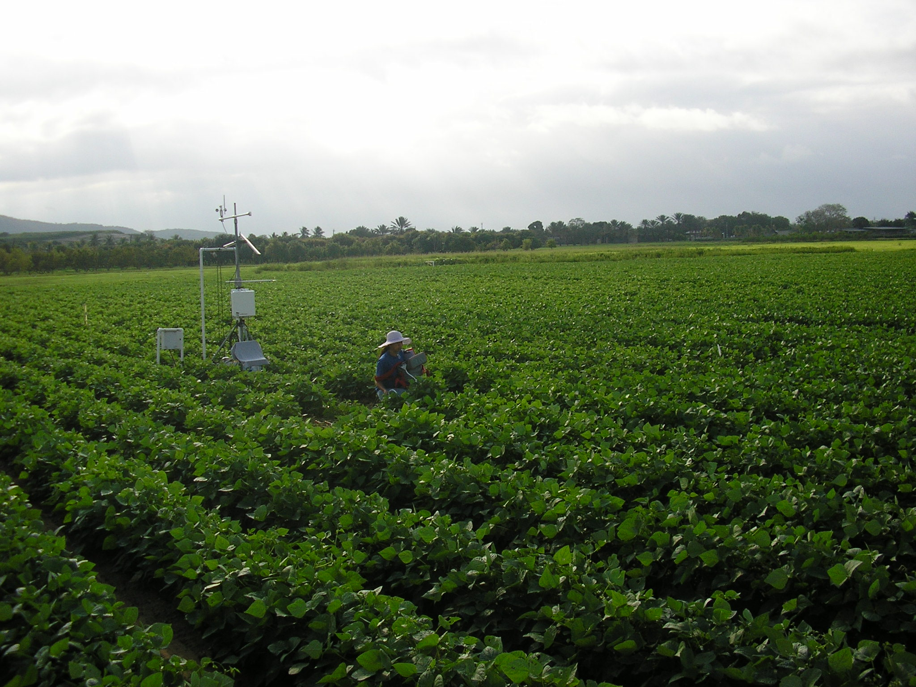
What might Puerto Rico’s agriculture look like in the future?

Slide 15
Possible Consequences of Climate Change
During the dry season, evapotranspiration increases lead to drier soils, which produces crop stress and reduced yields.
Crop water requirements will increase during certain months of the year, therefore the agricultural sector’s demand for water will increase, which may result in water conflicts between different sectors of society.
Fewer, but more intense tropical storms will cause increased soil erosion, reduce surface water quality and fill our reservoirs with sediment.
Loss of top soil results in lower organic matter, lower soil water holding capacity, lower fertility, leading to the need for more irrigation water and fertilizer.
Flooding of fields will increase during the wet season, resulting in the loss of crops.

Slide 16
Downscaled Rainfall (mm) for Lajas
Scenario A2
RAINFALL
3 inch
Drop in
Rainfall

Slide 17
Downscaled Rainfall at Lajas for Scenario A2
February and September
7 in.
Increase
for Sep.
SEASONAL RAINFALL
3-4 in.
drop
for Feb

Slide 18
100-YEAR RAINFALL PREDITION BY MONTH

Slide 19
Daily Reference Evapotranspiration
(ETo) by Month at Lajas, PR
Approximate 0.5 mm/day Increase in ETo.
This is equivalent to an additional 7.18 inches/year of ETo

Slide 20
RAINFALL DEFICIT = RAINFALL - ET_{O}

Slide 21
CROP YIELD REDUCTION

Slide 22
Sea Level Rise

Slide 23
Potential Consequences of Sea Level Rise
Loss of arable land
Increasing salinity levels in groundwater
Moratorium on construction of water supply wells. In November 2013, the Secretary of the DNER issued an order prohibiting the drilling of any new wells east of Juana Diaz to Guayama.
If a farmer is located near the coast, does not have access to irrigation district canal and cannot install a well, what can they do? PRASA water is far too expensive.

Slide 24
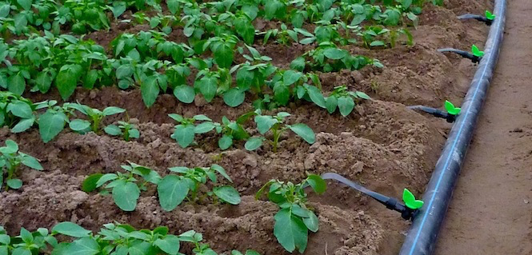
Increasing Irrigation Efficiency Through Irrigation Scheduling
http://www.driptech.com/images/components/system1.jpg

Slide 25
METHODS
Experience Method
Evapotranspiration Method
Soil Moisture Method
Water balance method

Slide 26
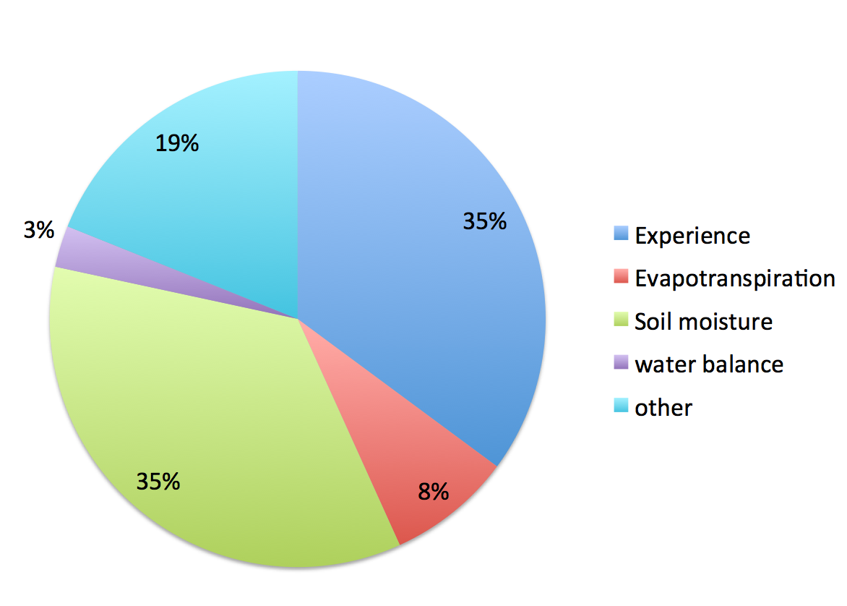
Irrigation Scheduling Methods used in Puerto Rico (preliminary data)

Slide 27
Experience Method
“I apply 1 inch of water to my crop every week.”
“The soil looks dry so I am going to irrigate.”
“The crop looks stressed so I am going to irrigate.”

Slide 28
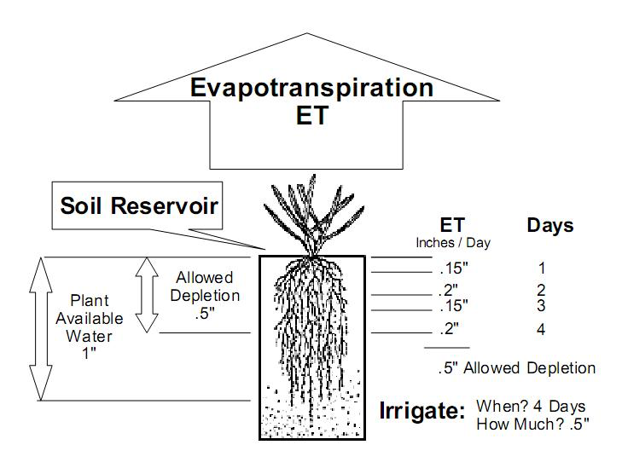
Evapotranspiration Method
http://wiki.universal-devices.com/images/9/98/Irrigation_based_on_ET.jpg

Slide 29
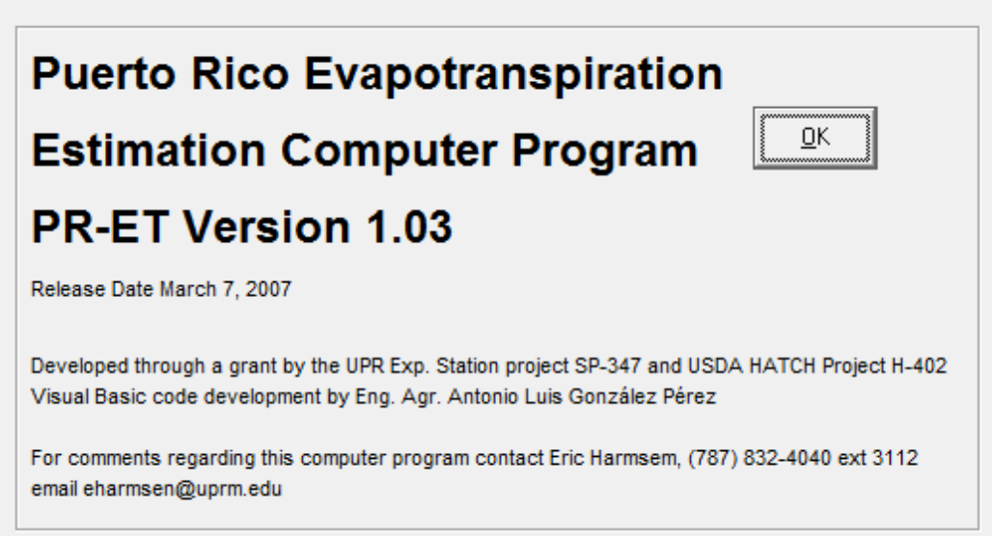
Puerto Rico Evapotranspiration Computer Program
http://pragwater.com/crop-water-use/

Slide 30
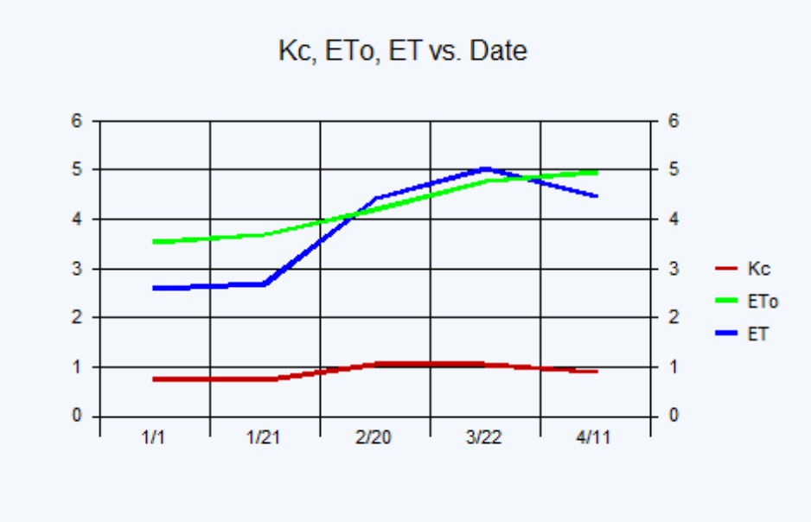
PRET

Slide 32
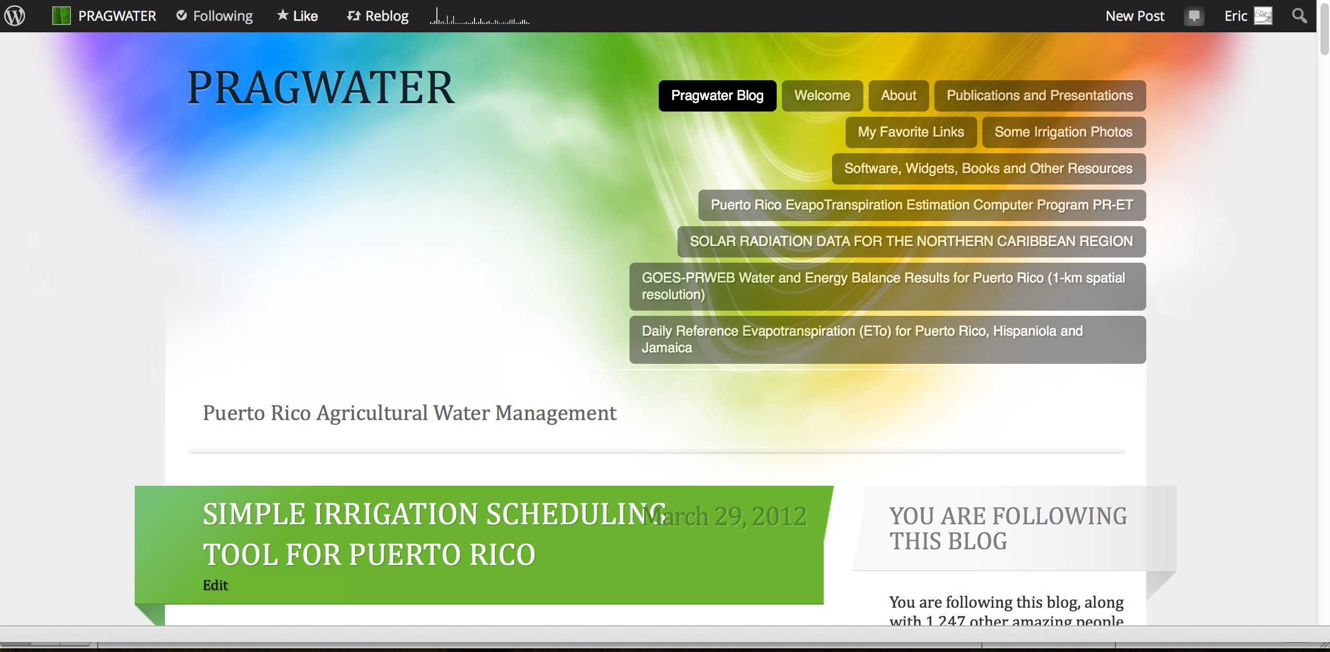
WEB-BASED IRRIGATION SCHEDULING TOOL
http://pragwater.com/2012/03/29/simple-irrigation-scheduling-tool-for-puerto-rico/

Slide 33
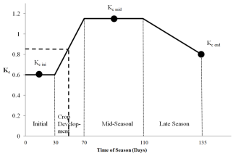
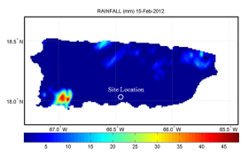
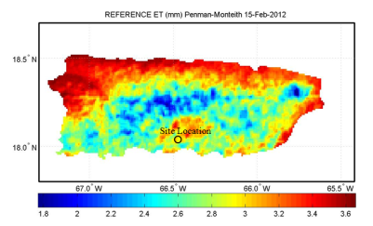
Web-based method for irrigation scheduling in PR
Determine average K_{c} for the time period
Define problem (location, farm size, crop, etc.)
Determine rainfall
from onsite gauge or NEXRAD
Start
Determine ET_{o}
Estimate Crop Water Requirement
ET_{c} = K_{c} ET_{o}
Harmsen E.W., 2012. TECHNICAL NOTE: A Simple Web-Based Method for Scheduling Irrigation in Puerto Rico J. Agric. Univ. P.R. 96 (3-4) 2012.
Estimate Irrigation Requirement and required hours of pumping

Slide 34
Detailed Example
Determine the irrigation requirement for the 5 day period, February 15-19, 2012, for a tomato crop in Juana Diaz, Puerto Rico.
Required Hyperlinks
Length of Growth Stages (Table 11) and Crop Coefficients (Table 12) | http://www.fao.org/docrep/X0490E/x0490e00.htm
Daily Reference Evapotranspiration (ETo) | http://academic.uprm.edu/hdc/GOES-PRWEB_RESULTS/rainfall
Daily NEXRAD Rainfall for Puerto Rico | http://academic.uprm.edu/hdc/GOES-PRWEB_RESULTS/reference_ET/

Slide 35
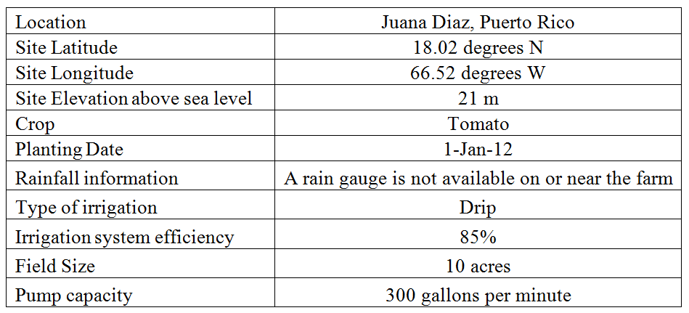
Step 1. Information used in example problem.

Slide 36
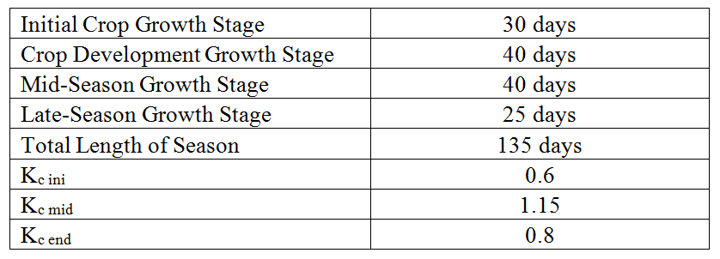
Step 2. Crop growth stage and crop coefficient data for example problem.
http://www.fao.org/docrep/X0490E/x0490e00.htm
Tomato Growth Stages and Crop Coefficients

Slide 37

Crop Coefficient
The averge K_{c} value of 0.85 for the five day period was obtained.
Crop coefficient curve for the example problem. The heavy dashed line applies to the example problem with day of season 46-50 (i.e., Feb 15-19) corresponding to an approximate crop coefficient of 0.85 (vertical axis).

Slide 38

Step 3. Rainfallhttp://academic.uprm.edu/hdc/GOES-PRWEB_RESULTS/rainfall/
Inspection of the rainfall maps at the URL provided indicates that there was no rainfall during the five day period.

Slide 39

Step 4. Reference Evapotranspiration (ET_{o}) http://academic.uprm.edu/hdc/GOES-PRWEB_RESULTS/reference_ET/
Inspection of the ET_{o} maps at the URL provided above indicates that there was 16.1 mm of ET_{o} during the five day period.

Slide 40
Step 5. Crop Water Requirement
The crop water requirement (ET_{c}) for the five day period can now be estimated as follows:
ET_{c} = K_{c} ET_{o} = (0.85)(16.1 mm) = 13. 7 mm

Slide 41
Step 6. Calculation of Irrigation Requirement and duration of pumping
Using D = ET_{c} = 13.7 mm
A = 10 acres
Q = 300 gallons per minute
eff = 0.85, yields:
Irrigation Requirement (volume)
13.7 mm x 10 cuerda x 1044 / 0.85
  = 168,260 gallons
Pumping time:
168,260 gal/300 gal/min *60 min/hr = 9.35 hours

Slide 42
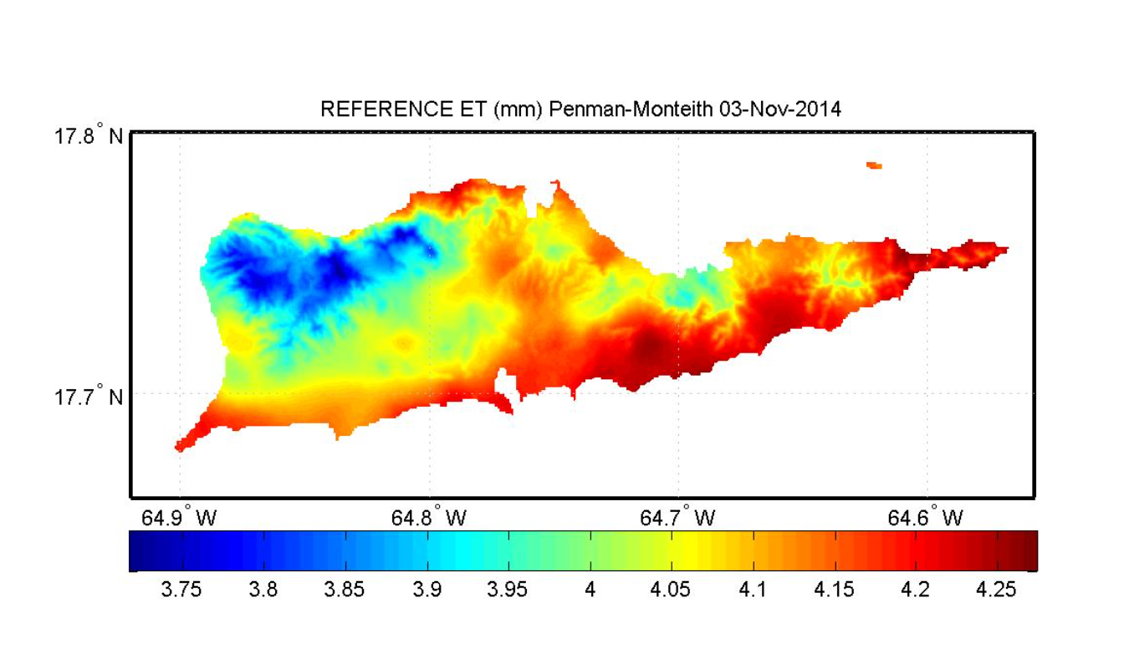
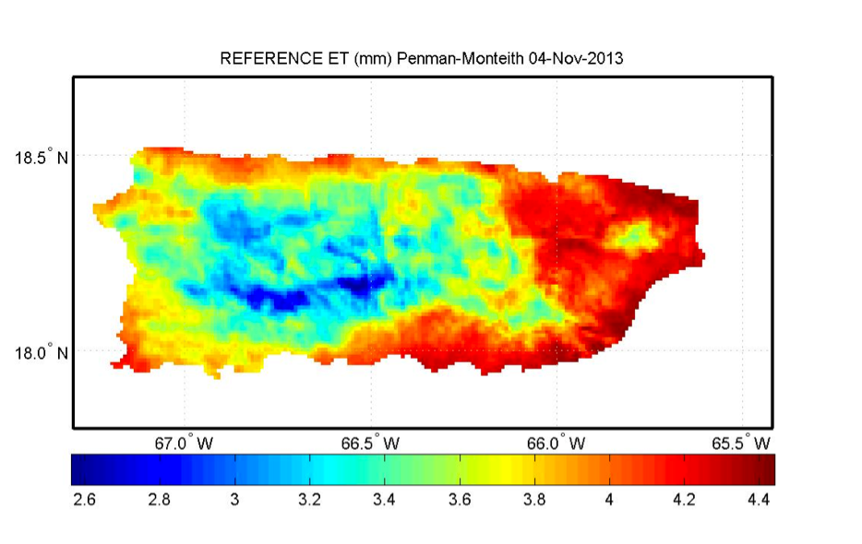
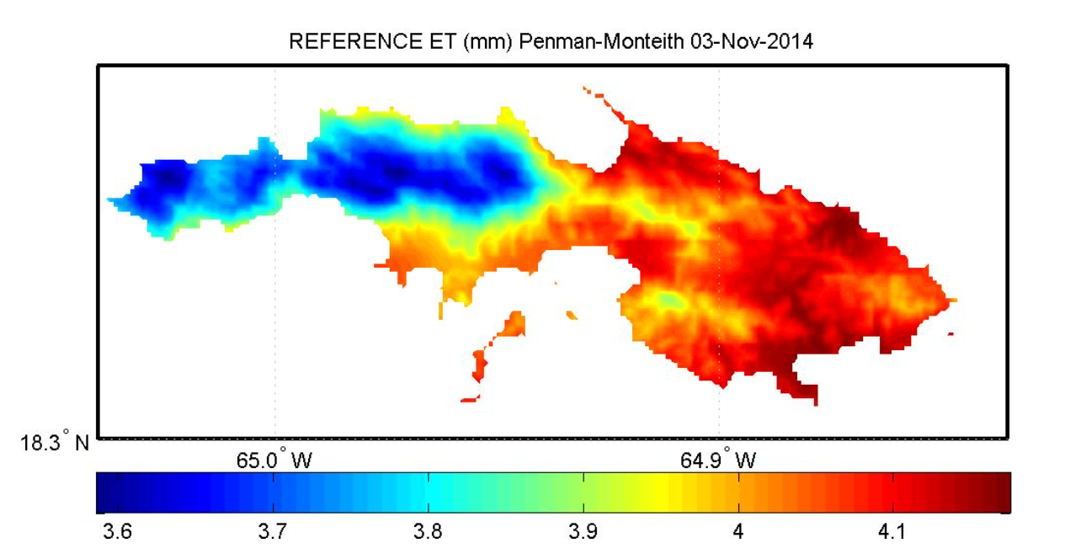
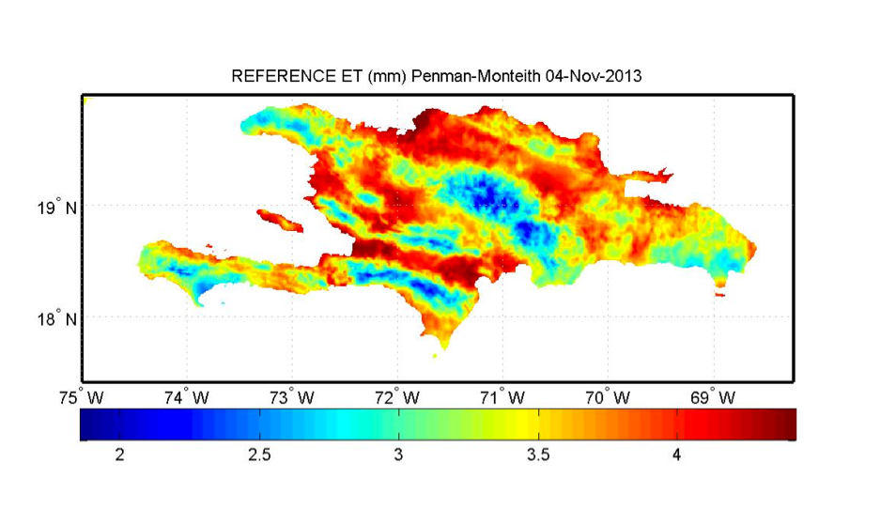
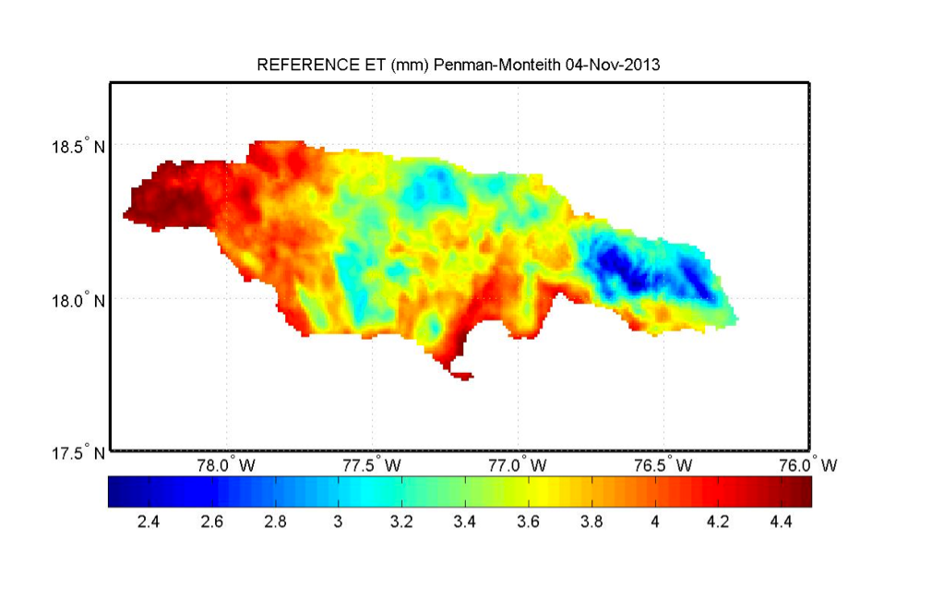
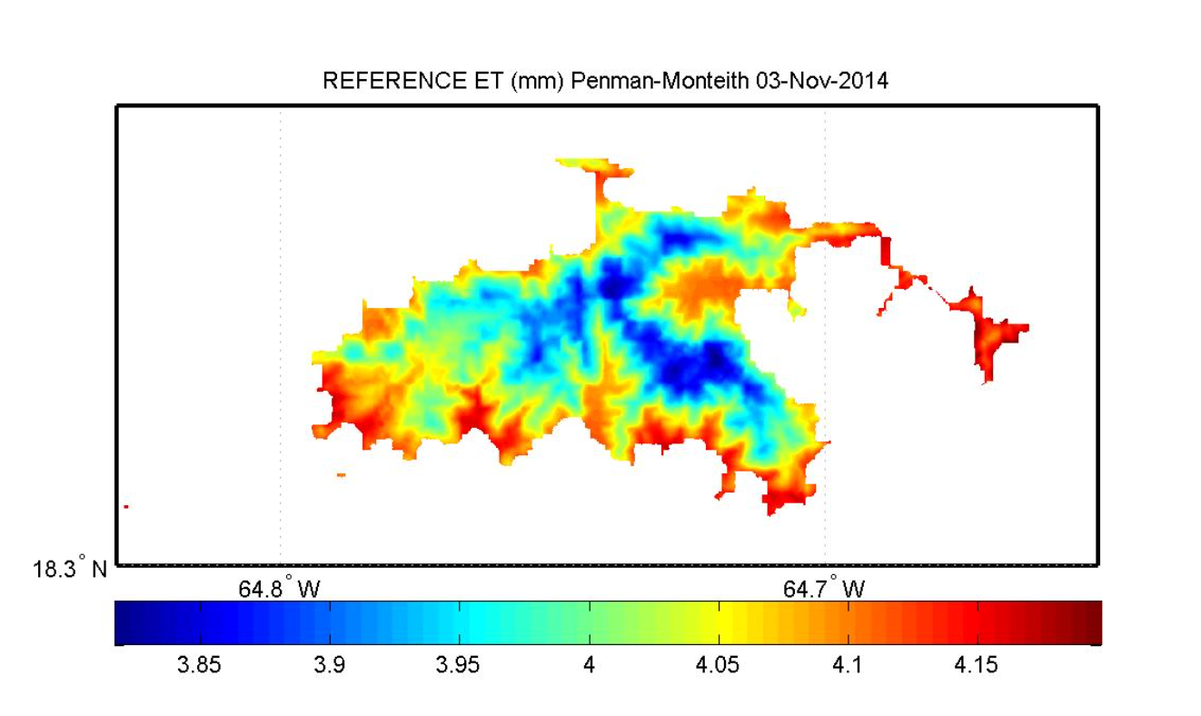
Real-Time and Archived Reference ET for Puerto Rico, USVI, Hispaniola and Jamaica
(http://pragwater.com)
Puerto Rico
St. Thomas
St. Croix
Hispaniola
Jamaica
St. John
Jamaica

Slide 43
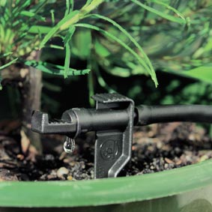
Soil Moisture Methods
Maintain soil water between
θ_{FC} and θ_{t}

Slide 44
Water Volume in Soil
DRAINABLE WATER
TOTAL
AVAILABLE WATER
IMMOBILE
WATER

Slide 45
The Soil Water Characteristic Curve
Soil Water
Pressure
STRESS
NO
STRESS
LOST
Threshold
Volumetric Soil Moisture Content (θ)

Slide 46
Maintain soil water between
θ_{FC} and θ_{t}

Slide 47
Soil Moisture Method
Perhaps the best method because it considers the readily available water in the soil.
Gravimetric method
Tensiometers
Electrical method
Water balance method

Slide 48
Water Balance Method
θ_{t2} = R + Irr – RO – ET_{c adj} – PERC + θ_{t1}
θ_{t2} = volumetric moisture content at time 2
θ_{t1} = volumetric moisture content at time 1
R = effective rainfall
RO = runoff
PERC = water that percolates past the root zone

Slide 49
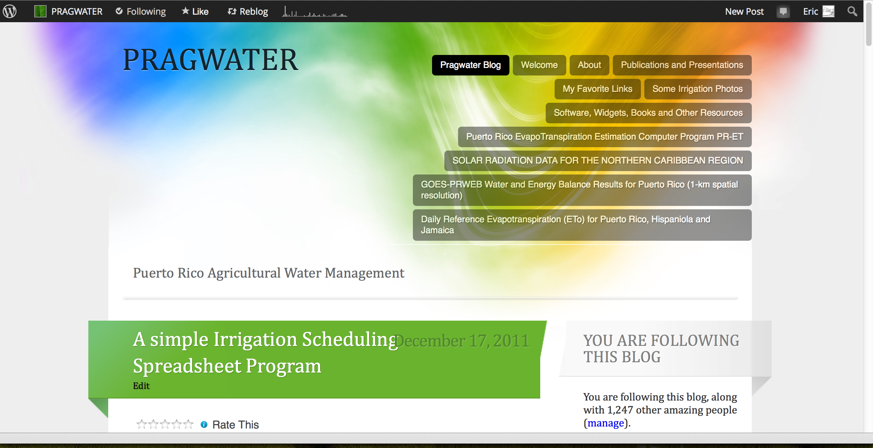
http://pragwater.com/2011/12/17/a-simple-irrigation-scheduling-spreadsheet-program/

Slide 50
Soil Water Management Spreadsheet
http://pragwater.com/2011/12/17/a-simple-irrigation-scheduling-spreadsheet-program/
User must enter the yellow spreadsheet cells

Slide 51
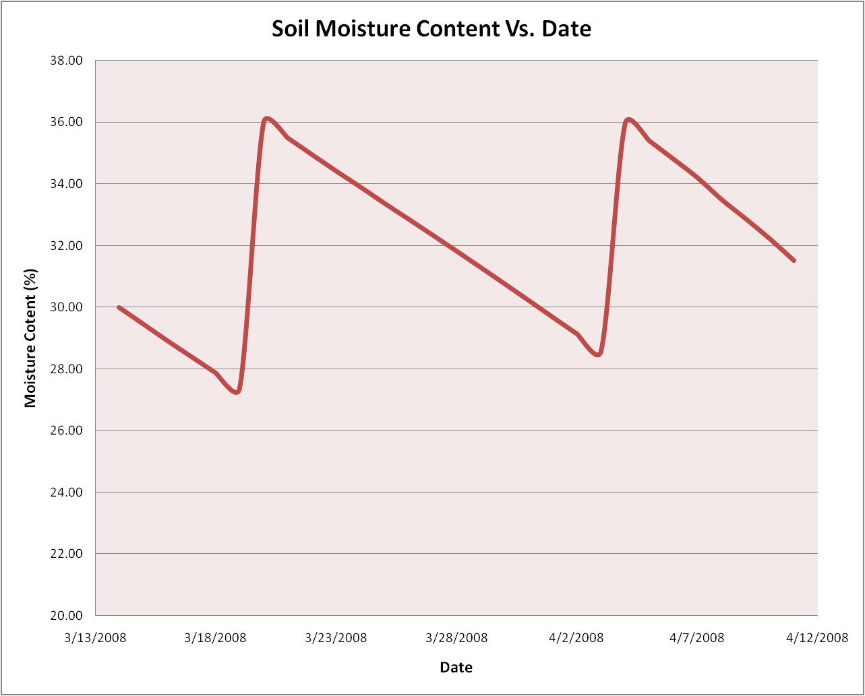
Field Capacity
Moisture Content, θ_{FC}
Crop is in stress
When moisture Content
is below this line!!

Slide 52
Conclusion
Maintain soil water between
θ_{FC} and θ_{t}

Slide 53
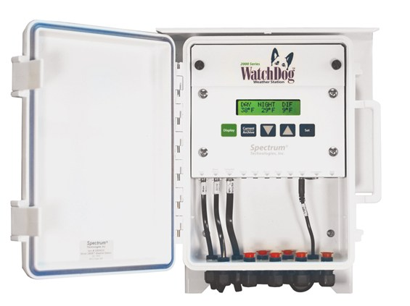
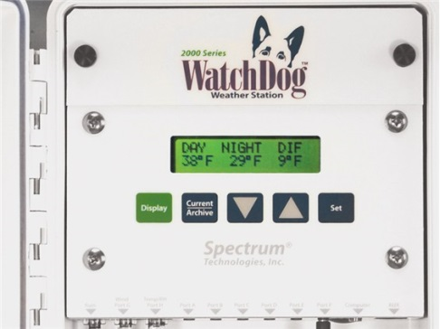
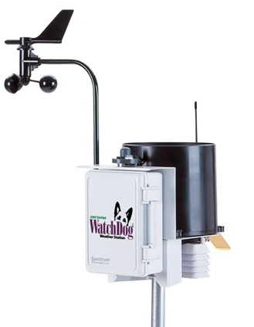
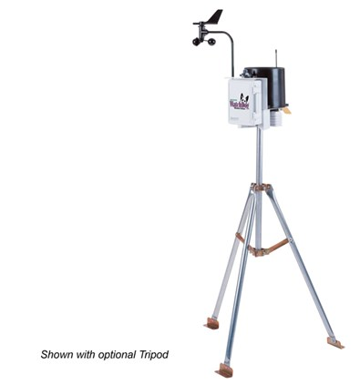
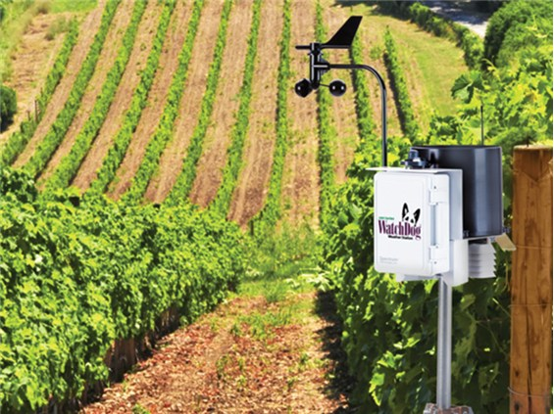
Many weather stations ($1,700 approx.) will calculate the daily reference evapotranspiration

Slide 54
RECOMMENDATIONS – Farm Scale
Build robust soil and water management systems.
Design for extreme wet and extreme dry conditions
Use scientific methods to determine crop water requirements
Avoid using methods based on long-term averages if possible.
Preferably use in-situ instrumentation to respond to site-specific, season-specific conditions.

Slide 55
RECOMMENDATIONS – Farm Scale
Weather station on each farm
Subscription for irrigation scheduling service
Use hardy plant varieties (drought tolerant/water tolerant)
For small farms, gardens and yards, capture roof rainfall, install ponds on some properties
Consider installing drainage systems for poorly drained sites

Slide 56
RECOMMENDATIONS – Institutional level
Capture more rainfall that runs off to ocean (e.g., Lago Loco)
Consider adding capacity to the irrigation districts. Currently they are not able to support intensive agriculture (e.g., “Energy Cane”).
Expand Agriculture in Puerto Rico
Build infrastructure to support expanded agriculture
Support the adoption of methods to conserve water
Support water harvesting efforts at all scales

Slide 57
Gracias!
For help with any of the methods covered in today’s presentation, please contact me by email at eric.harmsen@upr.edu

