Slide 1
Efectos del cambio
climático en la agricultura
Dr. Eric Harmsen
Professor, Dept. of Agricultural and Biosystems Eng.,
Univ. of Puerto Rico-Mayaguez
Curso para Agroempresarias por el Centro Empresarial para la Mujer en la Agricultura de Puerto Rico (CEMA)
Mayo 11, 2018

Slide 2
Background
Pre-PR (Pre 2000)
PR (2000 - present)
  Reference Evapotranspiration (ETo) research
  Weather parameter estimation for use in ETo equations
  ET estimation in the field
  Studies in rainfall spatial and temporal variability in PR
  Satellite remote sensing of solar radiation/validation
  Climate Change studies in Agricuture
  Water and Energy Balance studies
  Estimation of ETo for Northern Caribbean

Slide 3
The Greenhouse effect
https://www.thetalkingdemocrat.com/2018/03/what-is-the-green-house-effect/

Slide 4
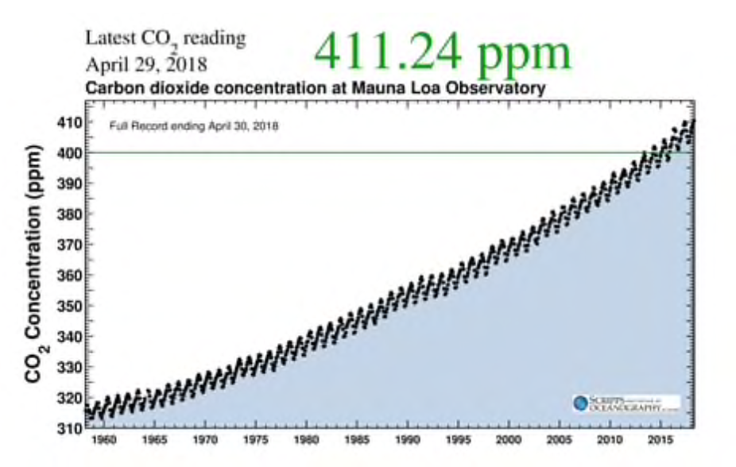
Atmospheric CO2 concentration
https://www.washingtonpost.com/

Slide 5
Change in global air temperature

Slide 6
Monthly Air Temperature

Slide 7
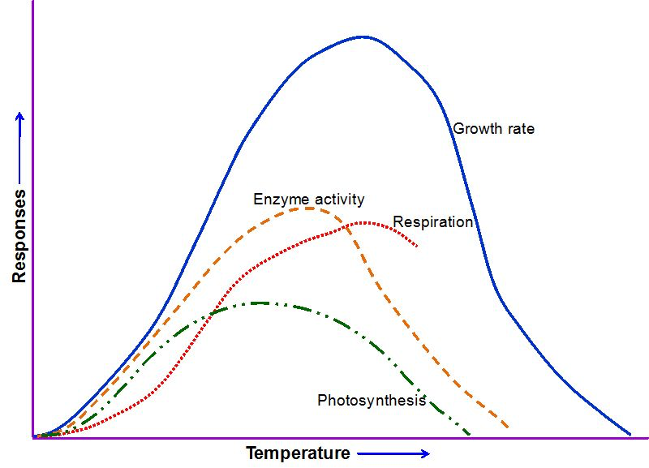
Effect of Temperature on Plant Growth
http://www.intechopen.com/source/html/43317/media/image1_w.jpg

Slide 8
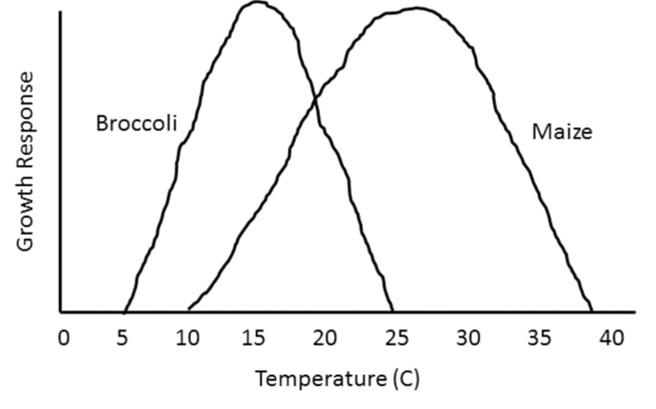
Effect of Temperature on Plant Growth
Jerry L.Hatfield, John H.Prueger, 2015. Temperature extremes: Effect on plant growth and development, Volume 10, Part A, December 2015, Pages 4-10
USDA Research and Programs on Extreme Events, Edited by Jerry L. Hatfield, Mark D. Brusber, Volume 10, Part A, Pages 1-72 (December 2015)

Slide 9
Potential climate change impacts on Agriculture
Temperature’s potential effect on growing period
  Duration of crop growth cycles are above all, related to temperature. An increase in temperature will speed up development. In the case of an annual crop, the duration between sowing and harvesting will shorten. The shortening of such a cycle could have an adverse effect on productivity because senescence would occur sooner.

Slide 10
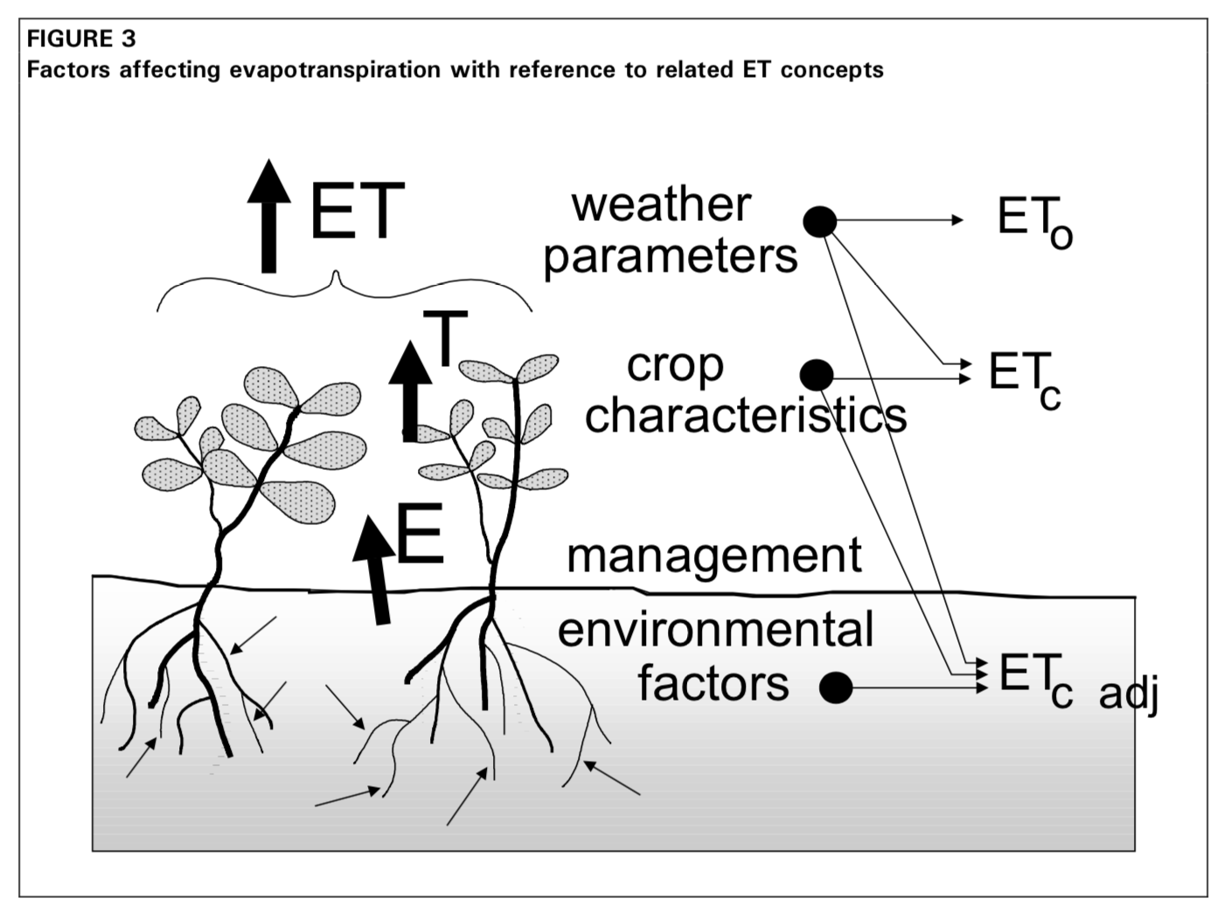
Evapotranspiration

Slide 11
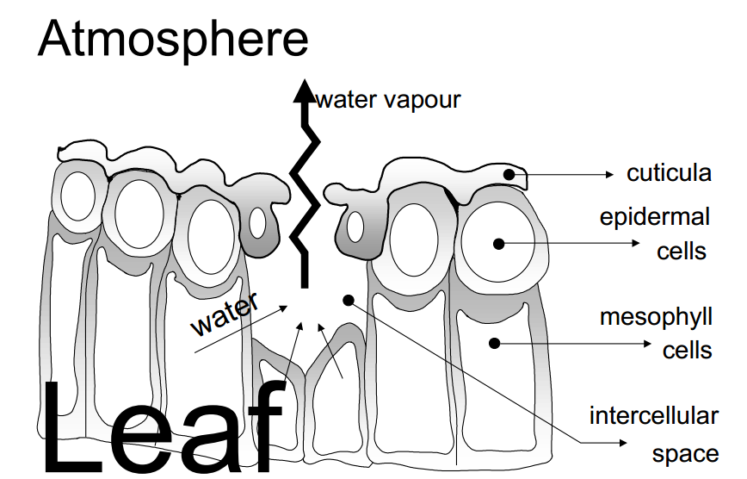
transpiration

Slide 12
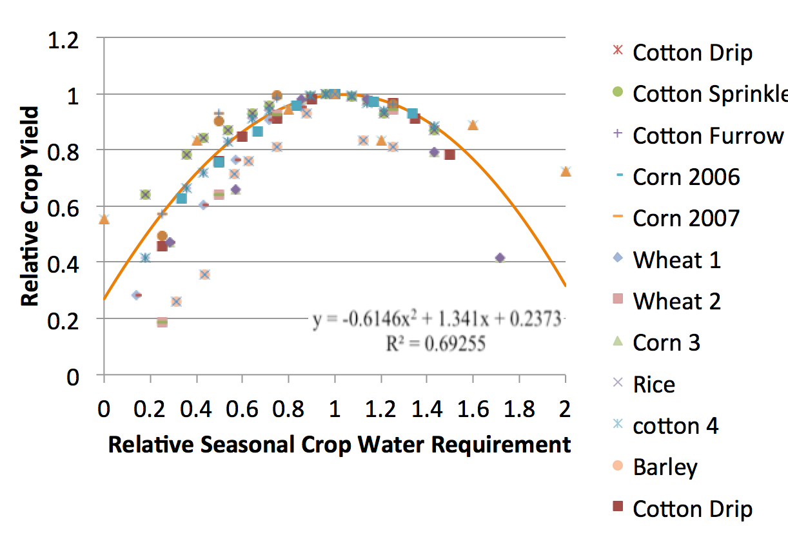
Relationship between relative crop yield and
relative seasonal crop water requirement applied

Slide 13

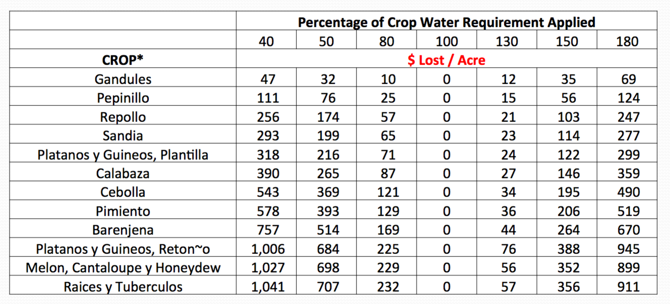
How much money are we talking about?
    *Based model budget data from the Conjunto Tecnológico, UPR Experment Station

Slide 14
Potential climate change impacts on Agriculture
Effect of elevated carbon dioxide on crops
  Increased CO2 is expected to have positive physiological effects by increasing the rate of photosynthesis. Under optimum conditions of temperature and humidity, the yield increase could reach 36%, if the levels of carbon dioxide are doubled.
  The effects of an increase in carbon dioxide would be higher on C3 crops (e.g., citrus, mango) than on C4 crops (such as sugarcane).
  Studies have shown that increased CO2 leads to fewer stomata developing on plants which leads to reduced water usage.
  Recent studies indicate that benefits of enhanced CO2 eventually diminish.

Slide 15
C3 and C4 Crops
C3 Plants (more sensitive to CO₂) | C4 Plants:
(C3 Plants: Rice, Wheat, Vegetables, Fruits:)
1. Rice | 1. Crab Grass
2. Wheat | 2. Corn
3. Oranges | 3. Amaranth
4. Grapes | 4. Sorgham.
5. Coffee plant | 5. Millet.
6. Tea Plants | 6. Sugarcane.
7. Peanut | 7. Nut grass
8. Lemon | 8. Crab Grass
9. Potatoes | 9. Barnyard grass.
10. Carrots | 10. fourwinged salt bush.
11. Peaches | 11.Chenopods.
12. Apples
13. Pears
14. Margarine
15. Mango

Slide 16
Potential climate change impacts on Agriculture
Effect on quality
Studies have shown that increases in CO2 lead to decreased concentrations of micronutrients in crop plants. This may have adverse effects on other parts of ecosystems as herbivores will need to eat more food to gain the same amount of protein.
Studies have shown that higher CO2 levels lead to reduced plant uptake of nitrogen (and a smaller number showing the same for trace elements such as zinc) resulting in crops with lower nutritional value. This would primarily impact on populations in poorer countries less able to compensate by eating more food, more varied diets, or possibly taking supplements.

Slide 17
Potential climate change impacts on Agriculture
Erosion and Fertility
The warmer atmospheric temperatures observed over the past decades are expected to lead to a more vigorous hydrological cycle, including more extreme rainfall events. Erosion and soil degradation is more likely to occur.
The possible evolution of the organic matter in the soil is a highly contested issue: while the increase in the temperature would induce a greater rate in the production of minerals, lessening the soil organic matter content, the atmospheric CO2 concentration would tend to increase it.

Slide 18
Potential climate change impacts on Agriculture
Pests, diseases and weeds
  A very important point to consider is that weeds would undergo the same acceleration of cycle as cultivated crops, and would also benefit from carbonaceous fertilization.
  In regions that become warmer and more humid, this could favor the development of fungal diseases.
  Similarly, because of higher temperatures and humidity, there could be an increased pressure from insects and disease vectors.

Slide 19
Potential climate change impacts on Agriculture
Poverty
  The poor will suffer more than the rich. Ironically, the majority of greenhouse gases have been produced as a result of the lifestyle of the rich.
  The poor will be severely affected in coastal areas affected by sea level rise and from the increase in extreme weather.

Slide 20
The Caribbean Region
Significant changes are expected to occur in the air temperature, sea surface temperature, sea level rise, and the magnitude and frequency of extreme weather events.
Potential impacts on water resources in rain-dominated catchments, such as those found in the Caribbean Region (IPCC, 2007) include: higher precipitation extremes, increase in stream flow seasonal variability, with higher flows during the wet season and lower flows during the dry season; increase in extended dry period probabilities; and a greater risk of droughts and flood.
Extended dry periods and the potential for greater evaporation will have a negative impact on lake levels used for freshwater supply.

Slide 21
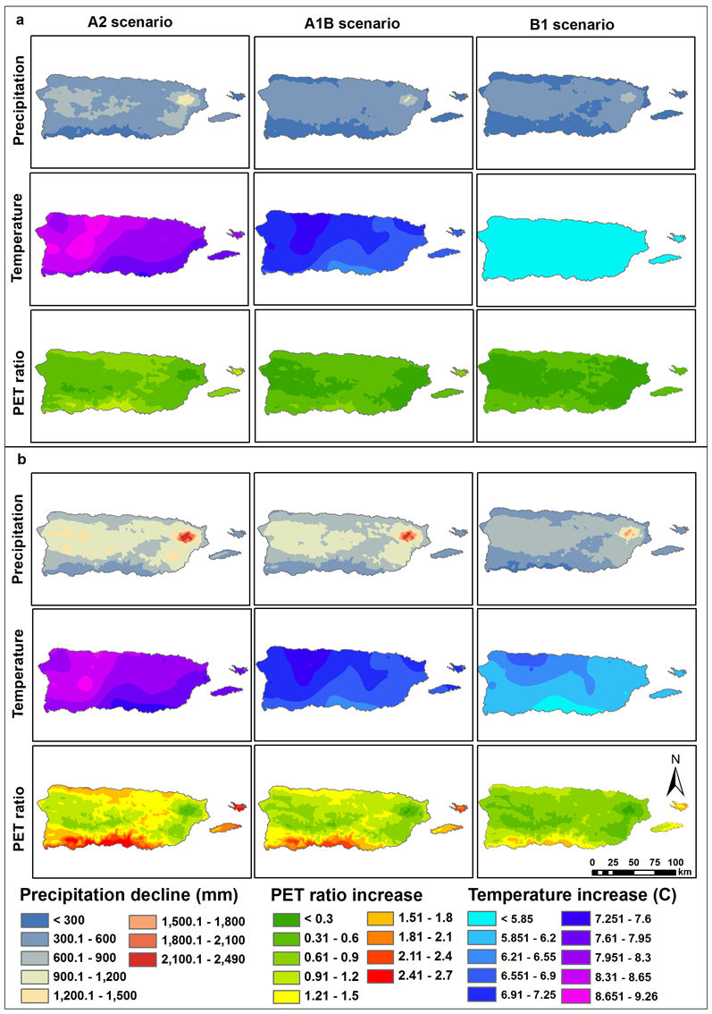
The total changes in precipitation, mean temperature and PET ratio from the first time interval (1960 to 1990) to the last time interval (2071 to 2099) based on the multi-model average of all twelve models
30%
Reduction
in rainfall
20%
Reduction
in rainfall
8 ºC
Increase in
Average
Temperature
4.5 ºC
Increase in
Average
Temperature
Henareh Khalyani, A., W. Gould, E. Harmsen, A. Terando, M. Quinones, and J. Collazo, 2016: Climate change implications for
tropical islands: Interpolating and interpreting statistically downscaled GCM projections for
management and planning. J. Appl. Meteor. Climatol. Vol. 55:265-282..

Slide 22
So we have a potentially catastrophic situation evolving in terms of water and temperature in Puerto Rico
  Water
    The 2015 Drought has shown us how vulnerable our water supply system is.
    Reservoirs were overdrawn and the irrigation districts were operating at a fraction of their production potential.
    Temperature
    Reduction in yields due to temperature stress
    Heat related public health problem, especially among the poor, young and elderly.

Slide 23
Sea Level Rise
Sea levels are expected to get up to one meter higher by 2100, though this projection is disputed.
A rise in the sea level would result in an agricultural land loss.
Erosion, submergence of shorelines, salinity of the water table will affect agriculture.
Greenland ice melt is a major contributor to observed sea level rise.

Slide 24
Sea level rise in Puerto Rico

Slide 25
Extreme Weather
The Drought of 2015 and Hurricane Maria may serve as a preview of extreme weather we may see more frequently in the future.

Slide 26
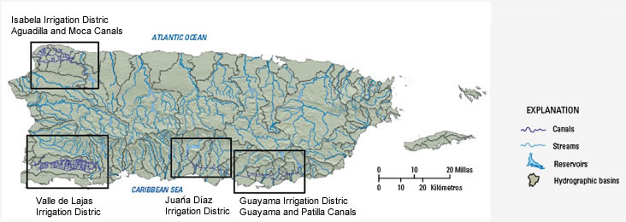
Irrigation Districts of PR
Irrigation Districts
Agricultural water requirements are not well understood in the island
Canals have limited spatial extent
Canals are in disrepair in some areas, and water is lost from the system
Water is essentially free to farmers

Slide 27
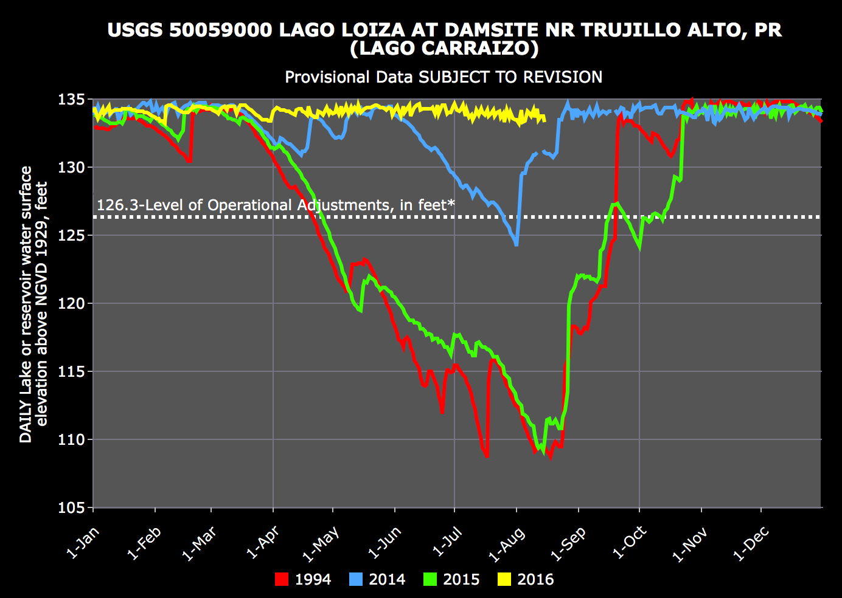

Slide 28
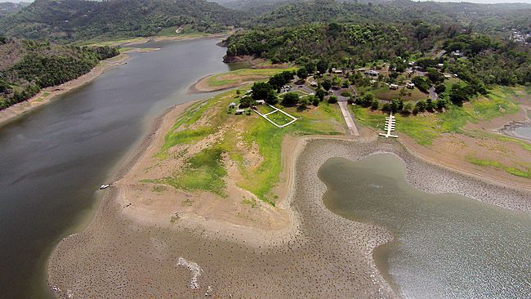
June 19, 2015, aerial photo shows the drought-affected lakeshore of La Plata reservoir in Toa Alta, Puerto Rico.

Slide 29
Water Conflicts
Conflicts exist between the agriculture and non-agricultural sectors. For example, in the Guayama Irrigation District, 28% of the water is used for agriculture, 72% for domestic/industrial use.
Expansion of agricultural production is being promoted, which will result in more competition for water resources.

Slide 30
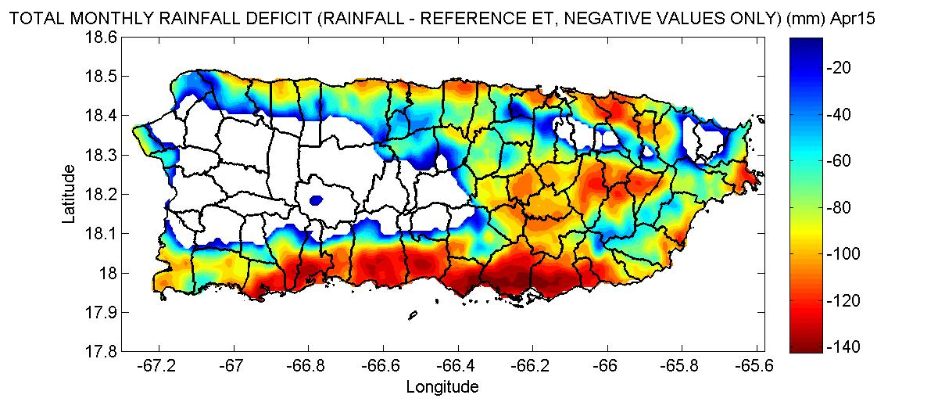
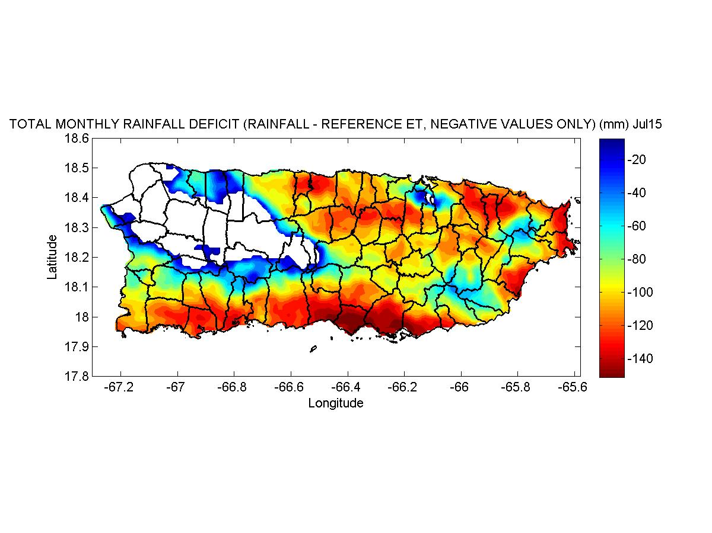
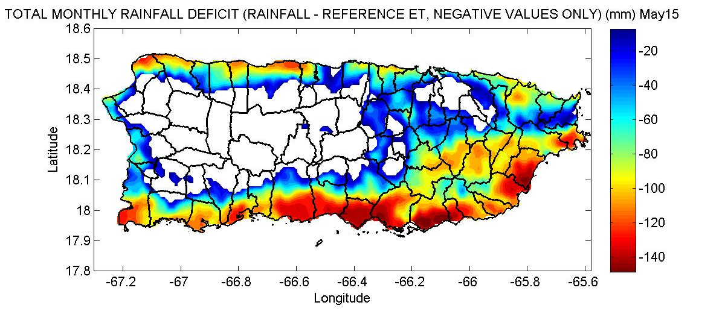
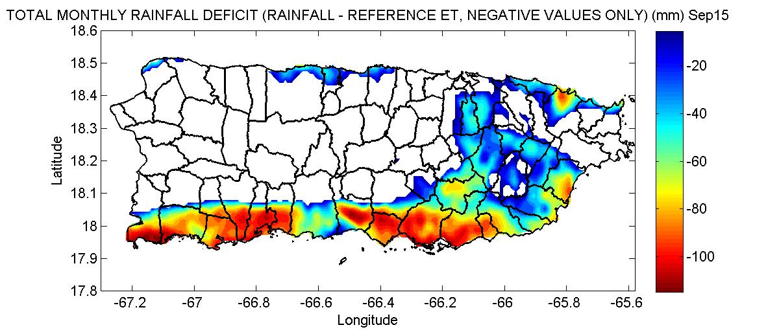
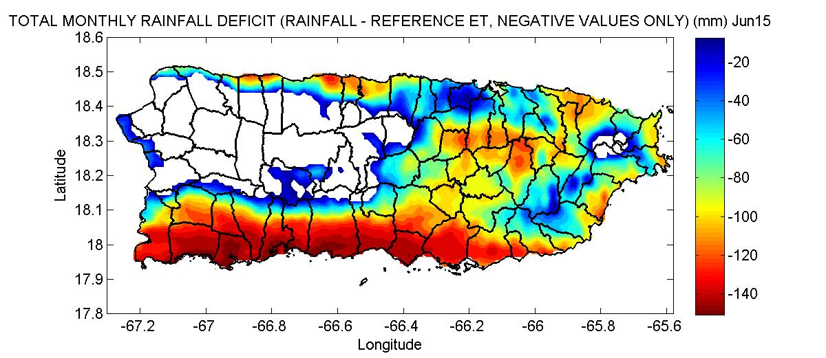
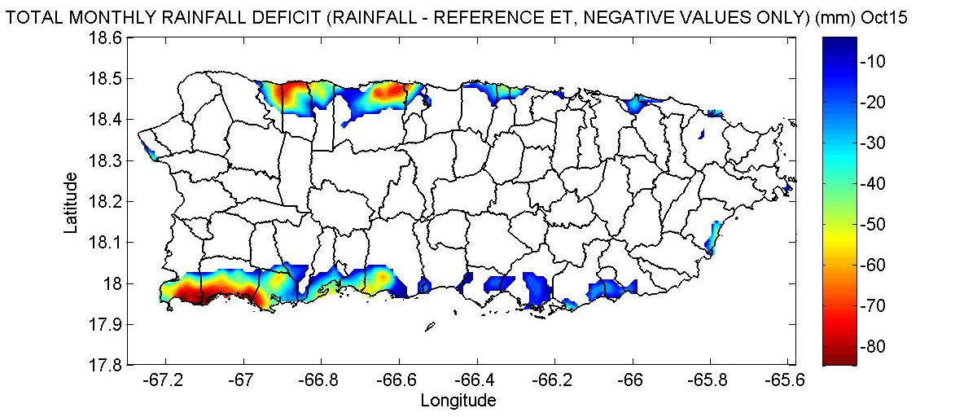
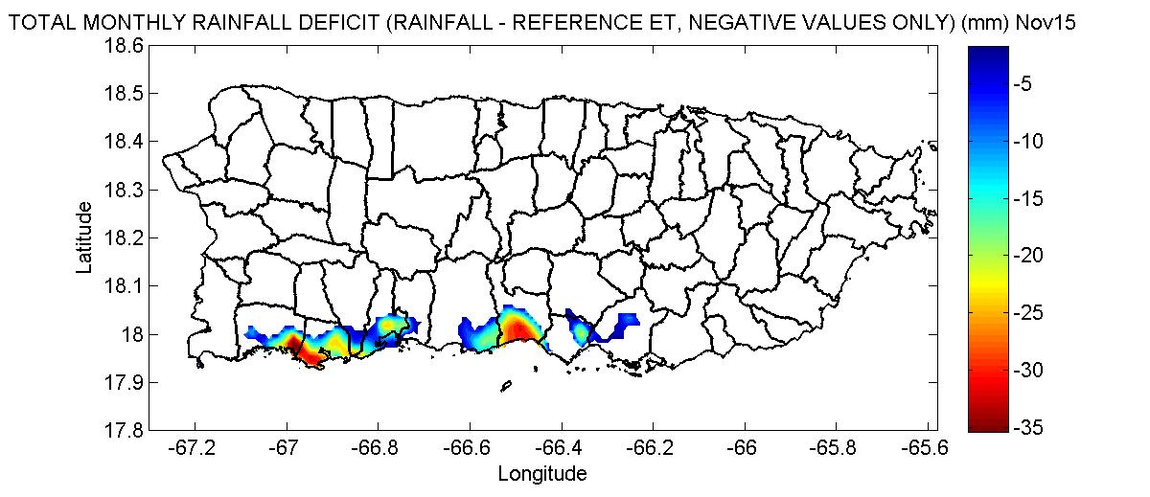
2015 Rainfall Deficit (negative values only) (mm)
Apr
May
Jun
Jul
Aug
Sep
Oct
Nov
Rainfall – Reference Evapotranspiration

Slide 31
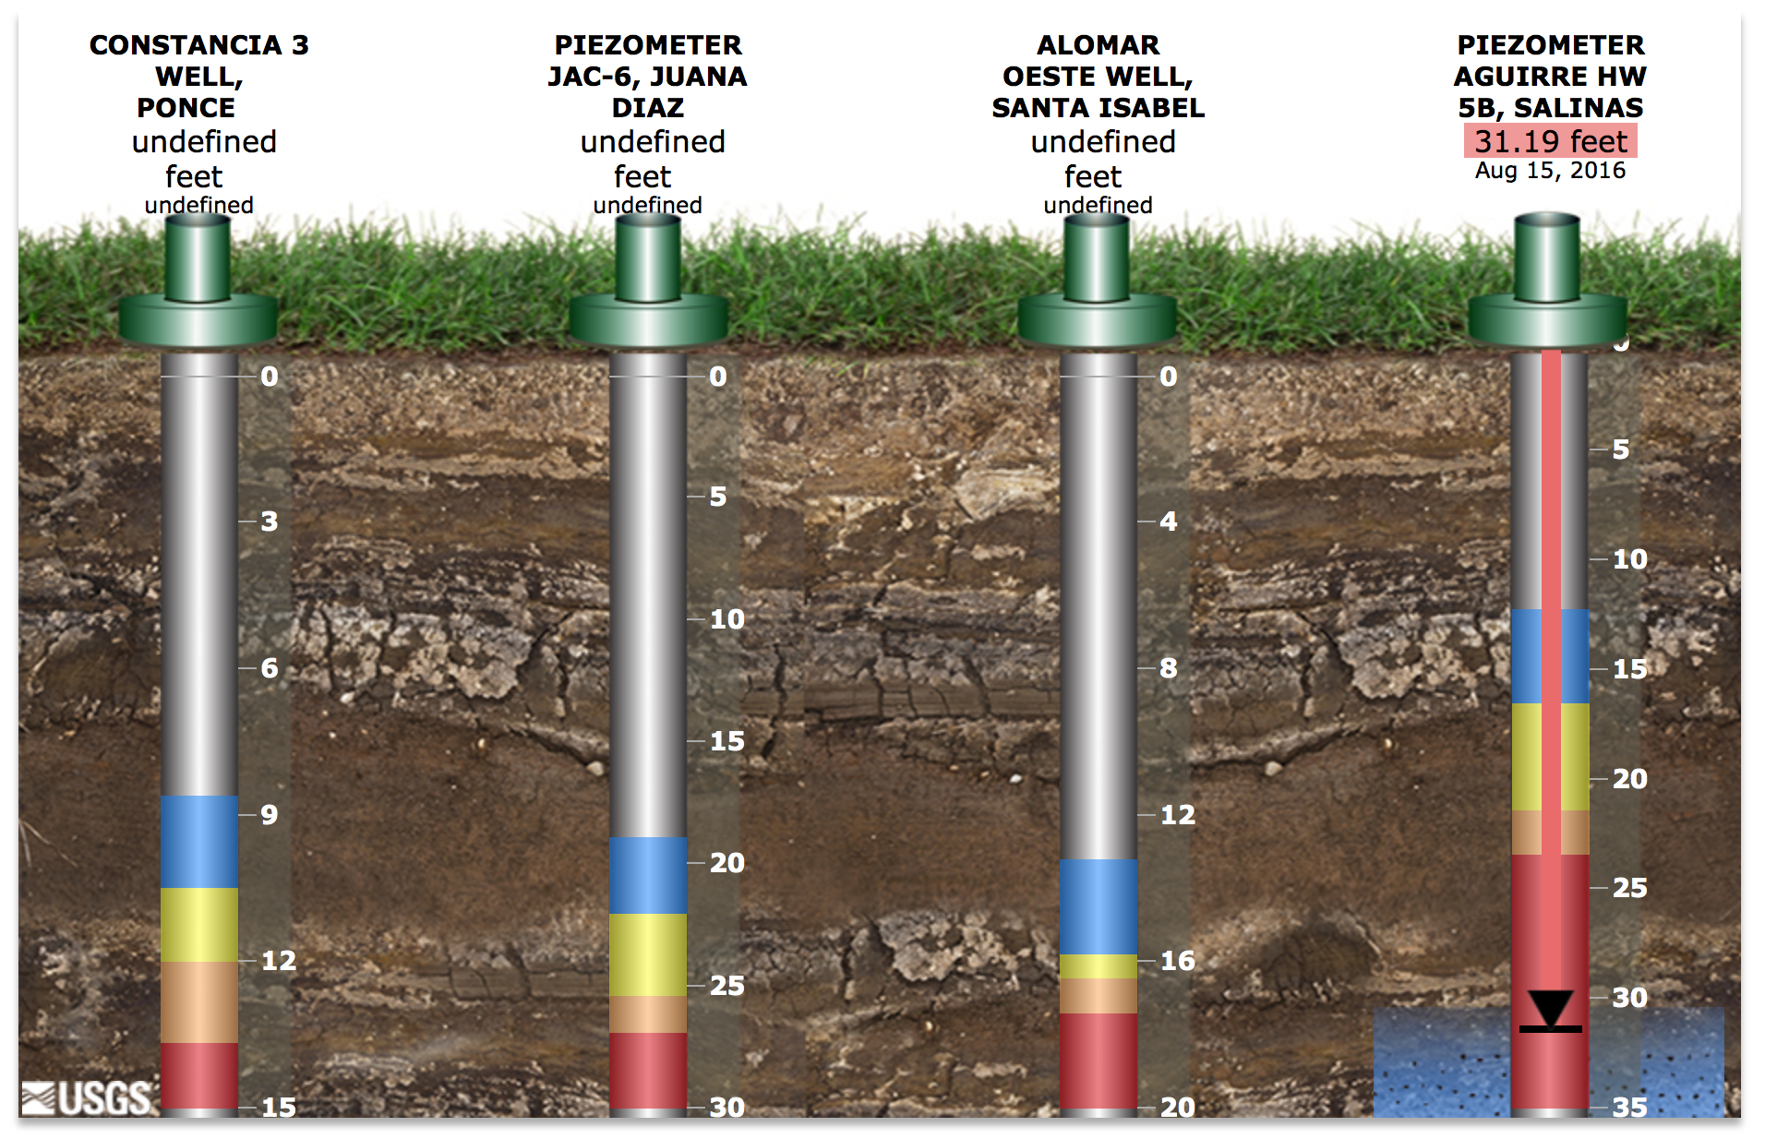

Slide 32
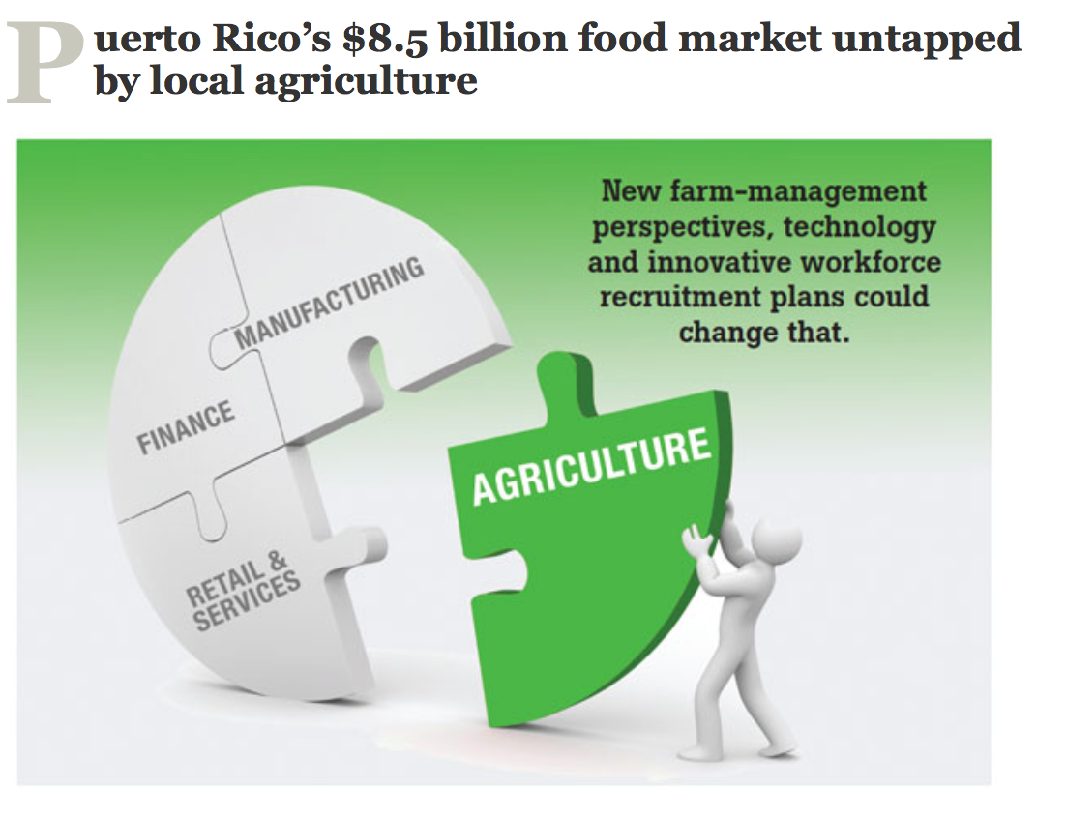
A few Recommendations:
Expansion of Agriculture in PR
If expansion of agricultural production is being promoted then a plan is needed to address water requirements.

Slide 33
Irrigation Districts
Additional irrigation districts (more than four) should be considered
Additional canals are needed to reach more farm land. (Farming with AAA water is not practical.)
The canals need to be upgraded and better maintained.
A study is needed to determine if the low cost of water is a disincentive for farmers to use water efficiently.
Conflicts between agriculture sector and non-agricultural sectors must be addressed.

Slide 34
A few Recommendations:
Genetic improvements are needed to increase
  Drought tolerance
  Flood tolerance
  Heat tolerance
  etc.

Slide 35
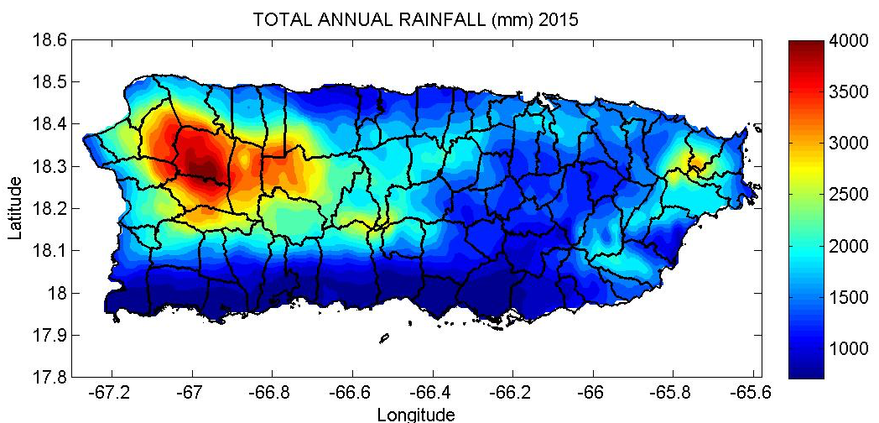
Comparisons of Rainfall in NW PR for drought and non-drought years
Compared average of:
17 Drought Years
94 Non-Drought Years

Slide 36
Groundwater
Additional induced aquifer recharge projects could be initiated in the south.
Groundwater wells installed too close to the ocean should be closed.
Advanced groundwater development in hard rock aquifers should be investigated (James Emery, Emery & Garrett Groundwater Investigations)

Slide 37
Recommendations for the Farm-scale
Tools for scheduling irrigation have been developed by the UPRM Agricultural Engineering Department. Several of these tools are available at the website http://pragwater.com
A greater effort is needed to educate farmers in the use of irrigation scheduling tools.
More collaboration is needed between the Agricultural Engineering faculty and the Cooperative Extension Service.
Regulations requiring farmers to practice irrigation scheduling should be considered

Slide 38
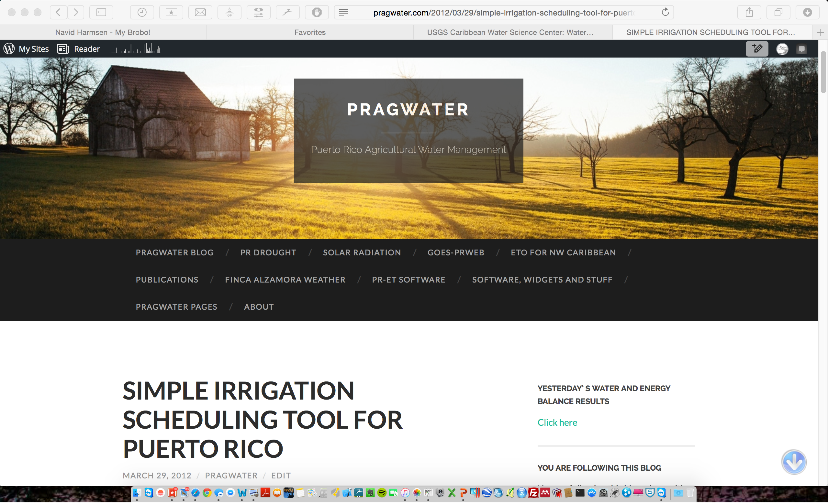
http://pragwater.com/2012/03/29/simple-irrigation-scheduling-tool-for-puerto-rico/

Slide 39
1- INCH PER WEEK IRRIGATION

Slide 40
OPTIMAL IRRIGATION

Slide 41
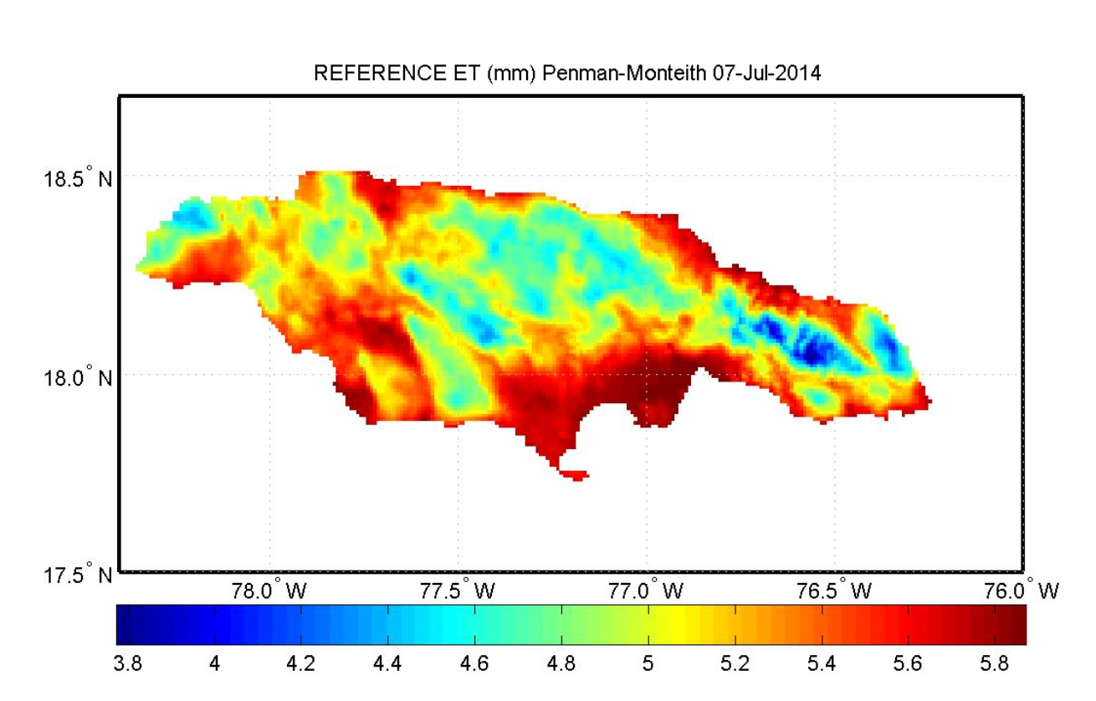
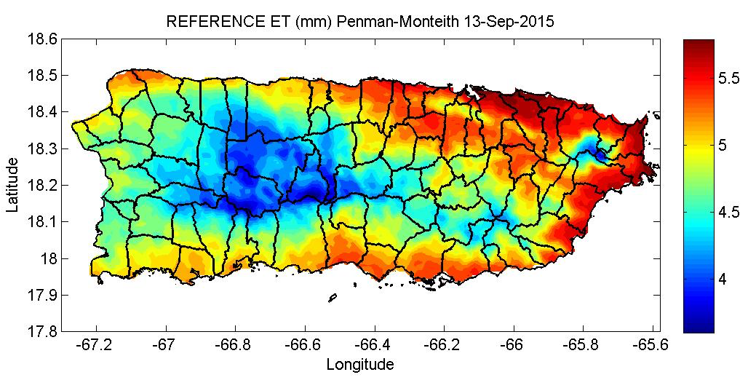
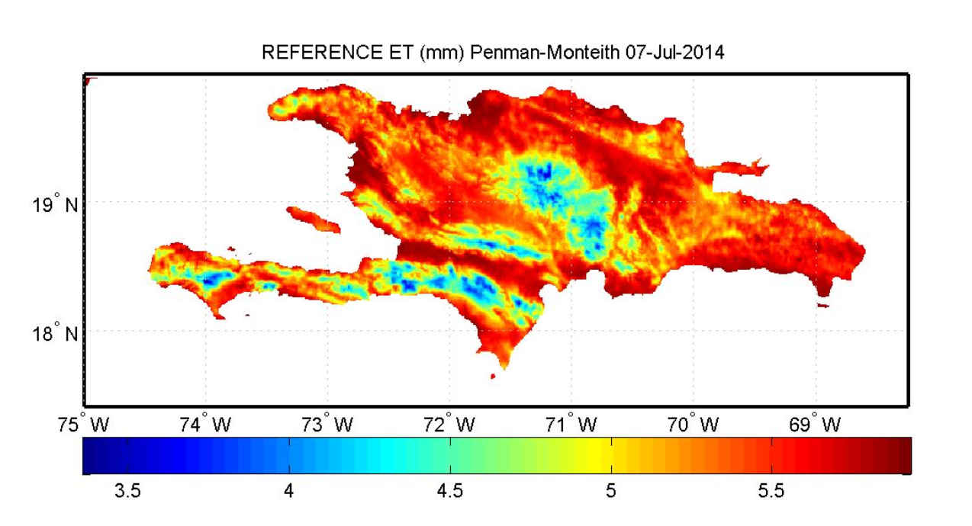
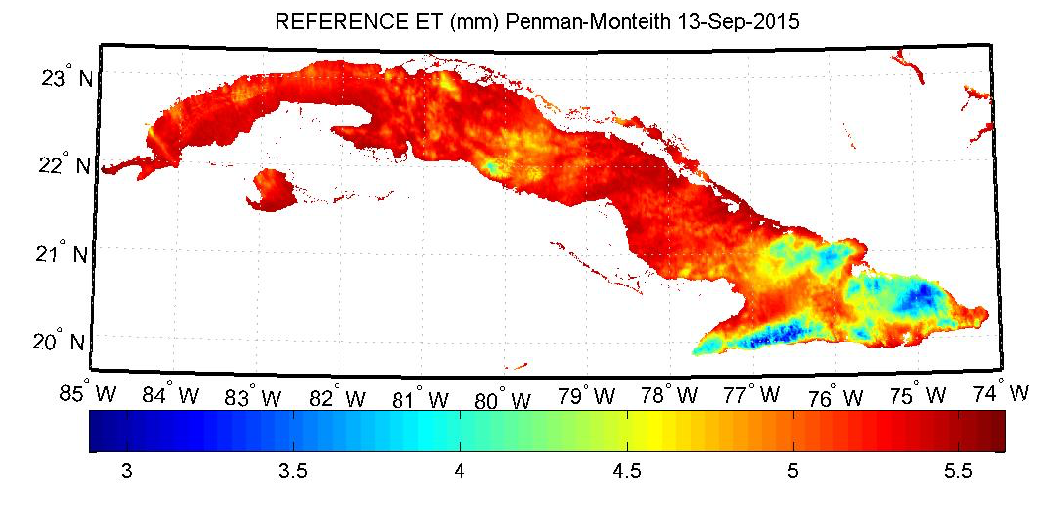
Reference ET for PR, USVI,
Hispaniola, Jamaica and Cuba pragwater.com
Puerto Rico
Jamaica
Cuba
Hispaniola

Slide 42
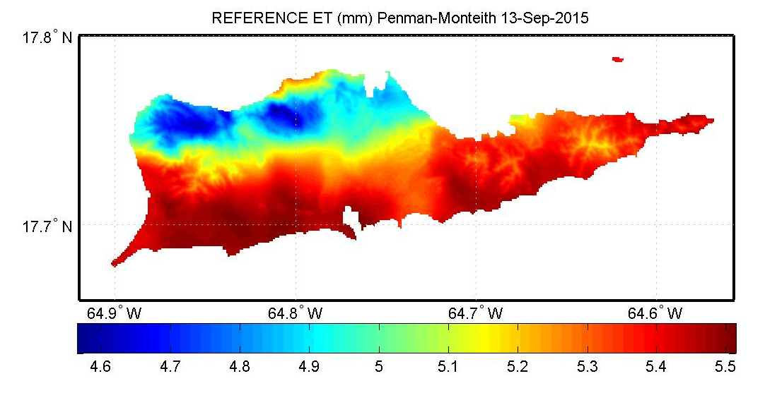
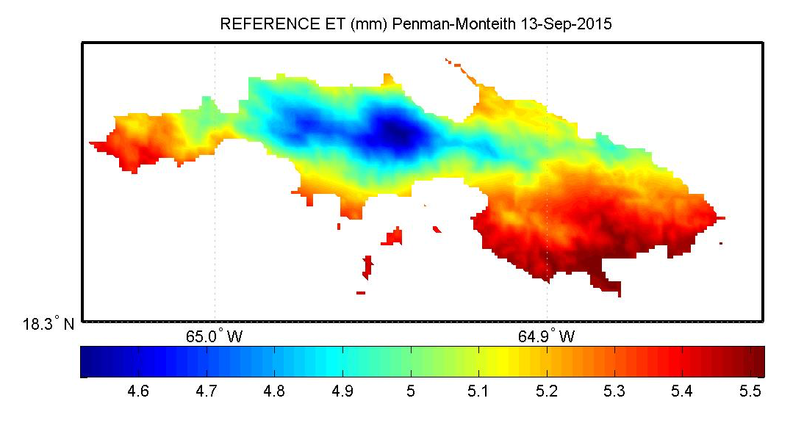
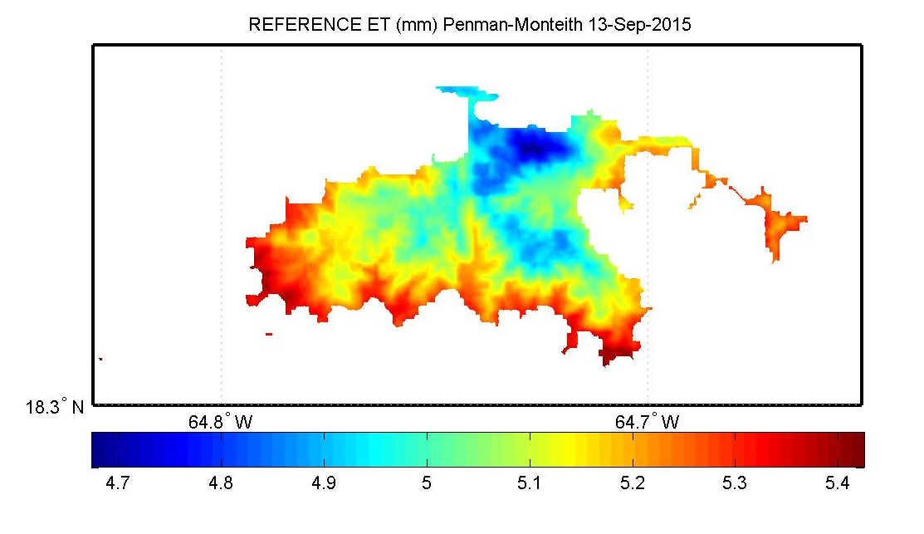
Reference ET for the U.S. Virgin Island pragwater.com
St. Croix
St. Thomas
St. John

Slide 43
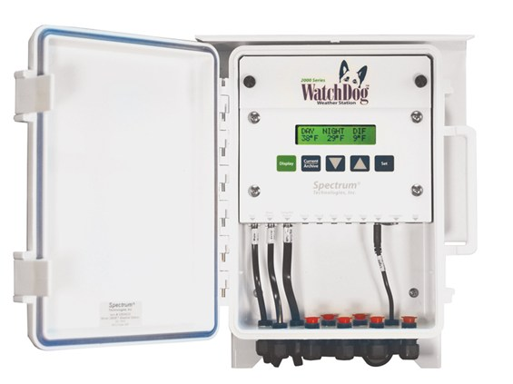
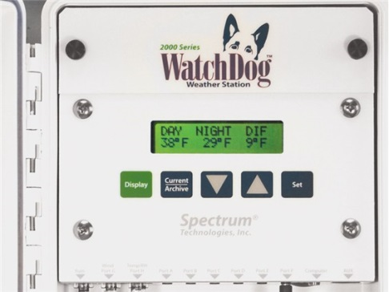
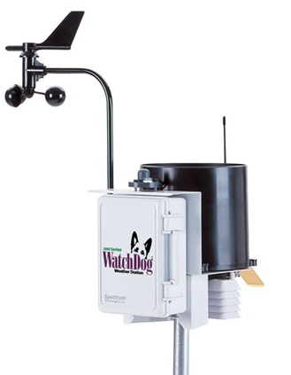
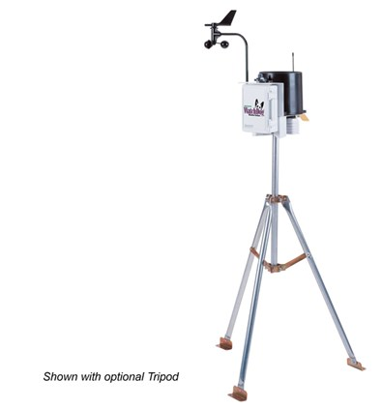
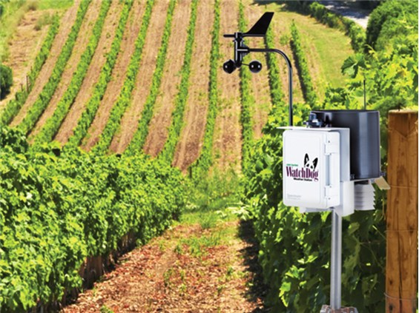
Many weather stations ($1,700 approx.) will calculate the daily reference evapotranspiration

Slide 44
Conclusions
Climate models predict drier conditions in the region, but potentially wetter wet seasons, due to more frequent tropical storms and hurricanes.
The 2015 Drought and Hurricane Maria may provide a preview of extreme weather events that may occur more frequently in the future.
Farmers should use the best available technology to minimize adverse impacts from climate change.

Slide 45



ACKNOWLEDGEMENT
Colegio de Ciencias Agrícolas, Universidad de Puerto Rico
USDA Hatch Project (H-402)
NOAA-CREST Project

