Slide 1
Web Tool For Scheduling Irrigation in the Northern Caribbean Region
Dr. Eric Harmsen
Professor, Dept. of Agricultural and Biosystems Eng., Univ. of Puerto Rico-Mayaguez
Victor J. Reventos
Undergraduate Research Assistant, Dept. of Electric and Computer Eng., Univ. of Puerto Rico-Mayaguez
Reunión Científica y Asamblea Anual SOPCA
Hormigueros, PR, Nov. 15, 2013

Slide 2
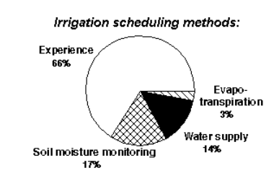
What is the problem?
There is anecdotal evidence that most farmers do not use scientific methods for scheduling irrigation
IRRIGATION SCHEDULING: the process used by irrigation system managers (farmers) to determine the correct frequency and duration of watering. (wikipedia.org)
Data from Idaho

Slide 3
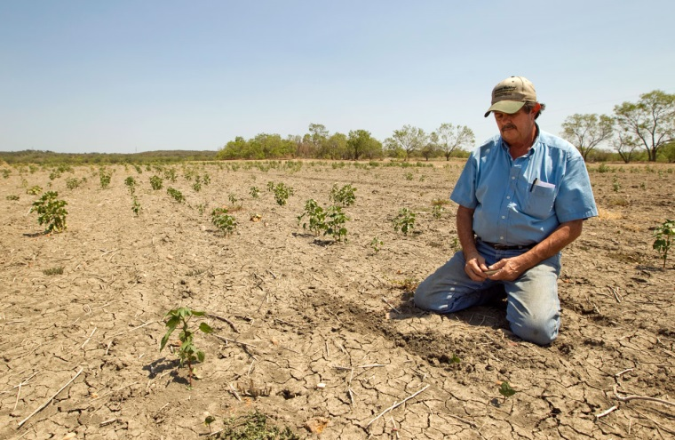
Why do we care?
Over application of water
Leads to the waste of
water
energy
chemicals
money
may lead to the contamination of ground and surface waters.
leaching of fertilizers past the root zone
water logging
lower crop yields.
Under-application of water
Lead to
crop water stress
reduced crop yields
loss of revenue to the grower
“I wish I would have applied more irrigation.”

Slide 4
How much money are we talking about?
 | Relative Irrigation Applied
 | 0.4 | 0.5 | 0.8 | 1.0 | 1.3 | 1.5 | 1.8
Cultivo* | $ Lost / Cuerda
Gandules | 47 | 32 | 10 | 0 | 12 | 35 | 69
Pepinillo | 111 | 76 | 25 | 0 | 15 | 56 | 124
Repollo | 256 | 174 | 57 | 0 | 21 | 103 | 247
Sandia | 293 | 199 | 65 | 0 | 23 | 114 | 277
Platanos y Guineos, Plantilla | 318 | 216 | 71 | 0 | 24 | 122 | 299
Calabaza | 390 | 265 | 87 | 0 | 27 | 146 | 359
Cebolla | 543 | 369 | 121 | 0 | 34 | 195 | 490
Pimiento | 578 | 393 | 129 | 0 | 36 | 206 | 519
Barenjena | 757 | 514 | 169 | 0 | 44 | 264 | 670
Platanos y Guineos, Reton~o | 1,006 | 684 | 225 | 0 | 76 | 388 | 945
Melon, Cantaloupe y Honeydew | 1,027 | 698 | 229 | 0 | 56 | 352 | 899
Raices y Tuberculos | 1,041 | 707 | 232 | 0 | 57 | 356 | 911
*Based model budget data from the Conjunto Tecnológico, UPR Experment Station

Slide 5
Objective
To introduce a simple web-based method for scheduling irrigation in Puerto Rico
The method calculates the number of hours a farmer has to run his or her pump.
The method is based on: TECHNICAL NOTE: A Simple Web-Based Method for Scheduling Irrigation in Puerto Rico. 2012, Harmsen E.W., J. Agric. Univ. P.R. 96 (3-4) 2012.
Available at http:/pragwater.com/selected-publications-and-presentations/

Slide 6
How much water should be applied?
Plant Water Requirement
=
Crop Evapotranspiration
(under well-watered conditions)

Slide 8
The most commonly used method for determing the Crop Water Requirement
ET_{c} = K_{c} ET_{o}
where
ET_{c} = evapotranspiration under well-watered conditions = crop water requirement
K_{c} = Crop Coefficient (unique for every crop)
ET_{o} = Reference Evapotranspiration (function of climate)

Slide 9
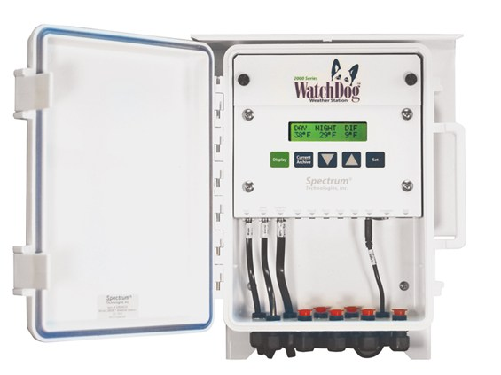
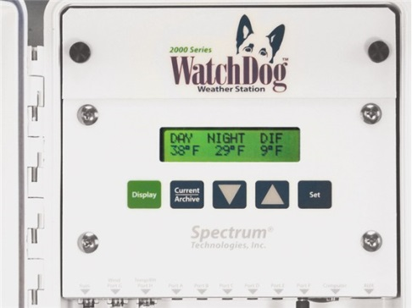
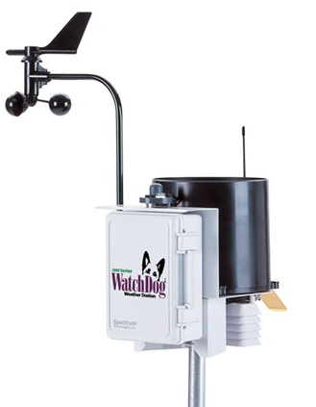
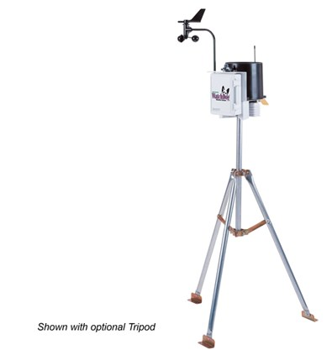
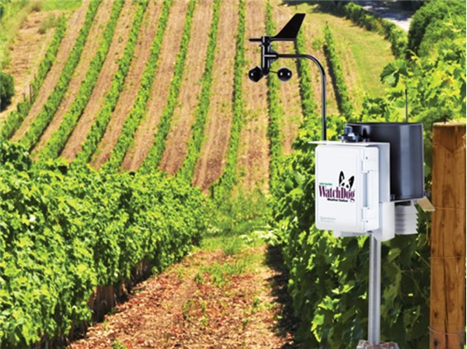
Many weather stations ($1,700 approx.) will calculate the daily reference evapotranspiration

Slide 10
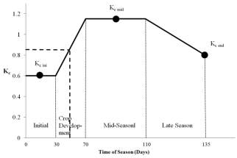
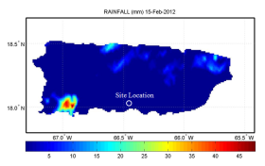
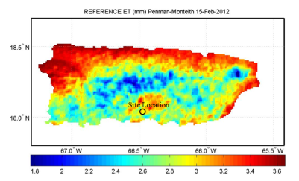
What if a farmer doesn’t have a weather station? Here’s a relatively simple web-based method for scheduling irrigation
Determine average K_{c} for the time period
Define problem (location, farm size, crop, etc.)
Determine rainfall
from onsite gauge or NEXRAD
Start
Determine ET_{o}
Estimate Crop Water Requirement
ET_{c} = K_{c} ET_{o}
Determine the number of hours to run the pump
T = 17.817 x [D x A]/[Q x eff]
Harmsen E.W., 2012. TECHNICAL NOTE: A Simple Web-Based Method for Scheduling Irrigation in Puerto Rico J. Agric. Univ. P.R. 96 (3-4) 2012.

Slide 11
Detailed Example
Determine the irrigation requirement for the 5 day period, February 15-19, 2012, for a tomato crop in Juana Diaz, Puerto Rico.
Required Hyperlinks

Slide 12
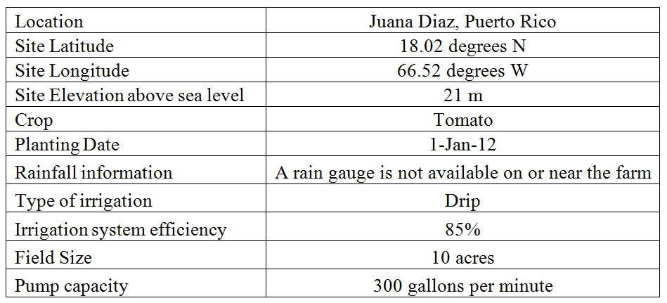
Step 1. Information used in example problem.

Slide 13
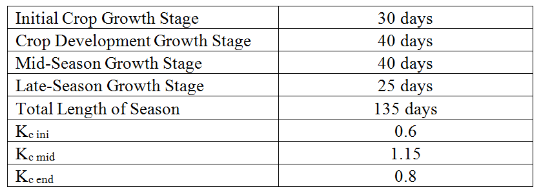
Step 2. Crop growth stage and crop coefficient data for example problem.
(http://www.fao.org/docrep/X0490E/x0490e00.htm)
Tomato Growth Stages and Crop Coefficients

Slide 14
Crop Coefficient
The averge K_{c} value of 0.85 for the five day period was obtained.
Crop coefficient curve for the example problem. The heavy dashed line applies to the example problem with day of season 46-50 (i.e., Feb 15-19) corresponding to an approximate crop coefficient of 0.85 (vertical axis).

Slide 15
Step 3. Rainfall (http://academic.uprm.edu/hdc/GOES-PRWEB_RESULTS/rainfall/)
Inspection of the rainfall maps at the URL provided indicates that there was no rainfall during the five day period.
Therefore, all of the crop water requirement will have to be satisfied with irrigation.

Slide 17
Step 4. Reference Evapotranspiration (ET_{o}) (http://academic.uprm.edu/hdc/GOES-PRWEB_RESULTS/reference_ET/ )
Inspection of the ET_{o} maps at the URL provided above indicates that there was 16.1 mm of ET_{o} during the five day period.

Slide 19
Step 5. Crop Water Requirement
The crop water requirement (ET_{c}) for the time period can now be estimated as follows:
ET_{c} = K_{c} ET_{o} = (0.85)(16.1 mm) = 13. 7 mm

Slide 20
Step 6. Number of hours to run the pump
Pumping time is estimated from a form of the well-known irrigation equation (Fangmeier et al., 2005) can be used:
T = 17.817 x [D x A]/[Q x eff]
where T is time in hours, D is depth of irrigation water (=ET_{c}) in mm, A is effective field area in acres, Q is flow rate in gallons per minute and eff is irrigation system efficiency.

Slide 21
Number of hours to run the pump to satisfy the crop water requirement for the example problem.
Using D = ET_{c} = 13.7 mm
A = 10 acres
Q = 300 gallons per minute
eff = 0.85, yields:
T = 17.817 x [13.7 x 10] / [300 x 0.85]= 9.57 hours.

Slide 22
Daily Reference Evapotranspiration (ETo)
for Puerto Rico, Hispaniola and Jamaica
www.pragwater.com

Slide 23
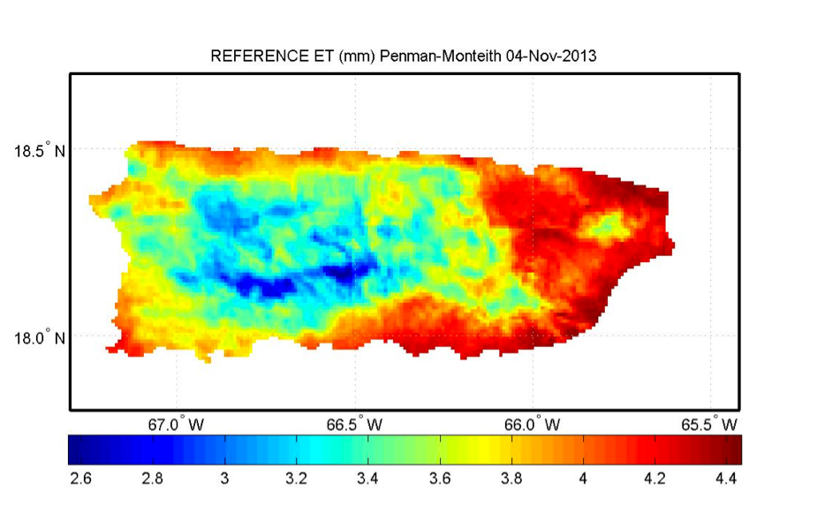
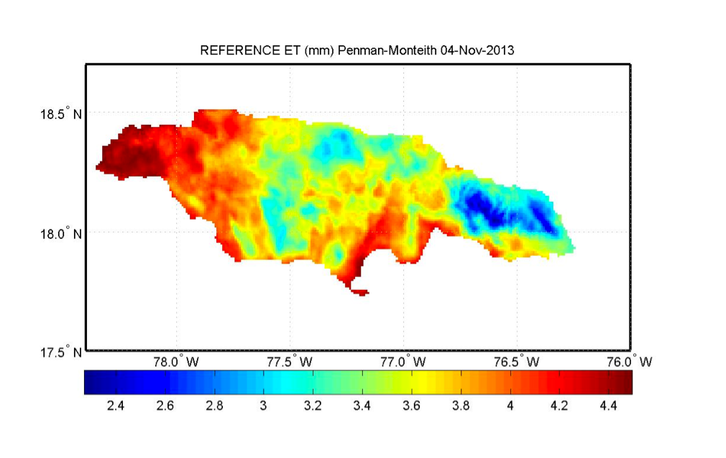
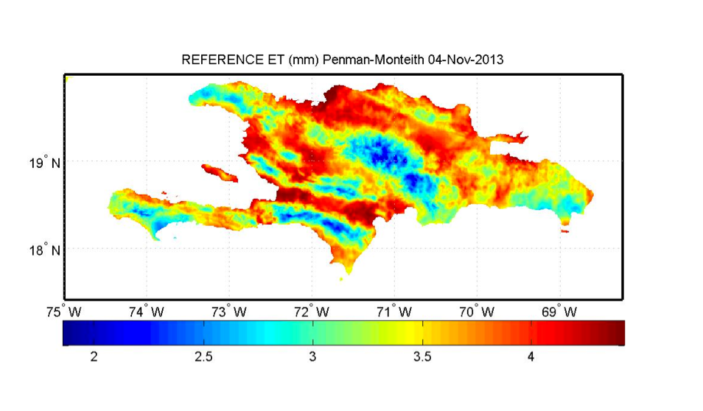
Archived Reference ET for Puerto Rico, Hispaniola and Jamaica (www.pragwater.com)
Puerto Rico
Jamaica
Hispaniola

Slide 24
In Conclusion
Many farmers do not systematically schedule irrigation
Application of the wrong quantity of water can lead to losses in water, fuel, chemicals, yield and money.
A simple web-based method was introduced for scheduling irrigation on farms without weather stations.
The approach presented here is relatively simple and the near-real time data is available to any farmer in Puerto Rico with internet access.
The method can also be used in Hispaniola and Jamaica, but on-site rainfall measurement would be required.

