Slide 1
Automation of GOES-PRWEB Algorithm
By: Victor J. Reventos Rosario
Supervisor: Eric Harmsen
Date: February 24, 2012
1st NOAA-CREST UPRM Technical Session

Slide 2
Objectives
Download three different files, located throughout different web servers using different protocols.
Prepare the files for processing, that way it can be used in the different applications.
Decompress and change format.
Upload the results to the server.
All of this has to be done without human intervention.

Slide 3
Python
Python is a general-purpose, high-level programming language
Dynamically typed
Offers high power with code readability
Supports multiple paradigms like OO, structured and imperative.
Mostly used for scripting and web applications

Slide 4
Wget
Wget is a computer program that retrieves data from web servers.
It’s a command line application
Most important feature
If a download does not complete due to a network problem, Wget will automatically try to continue the download from where it left off, and repeat this until the whole file has been retrieved.

Slide 5
Wput
Wput is a command-line ftp-client that looks like wget but instead of downloading, uploads files or whole directories to remote ftp-servers.

Slide 6
Degrib
The National Digital Forecast Database (NDFD) GRIB2 decoder
Need for the variable wind speed, which is in GRIB2 format.
Without it conversion was done through human intervention in a GUI application from NOAA.

Slide 7
Upload
Directory Structure
http://academic.uprm.edu/hdc/GOES-PRWEB_RESULTS/
It has a directory for each output variable, in which the jpegs will be named:
variableName_date.jpg
Output Data
For now just .jpeg formats.

Slide 8
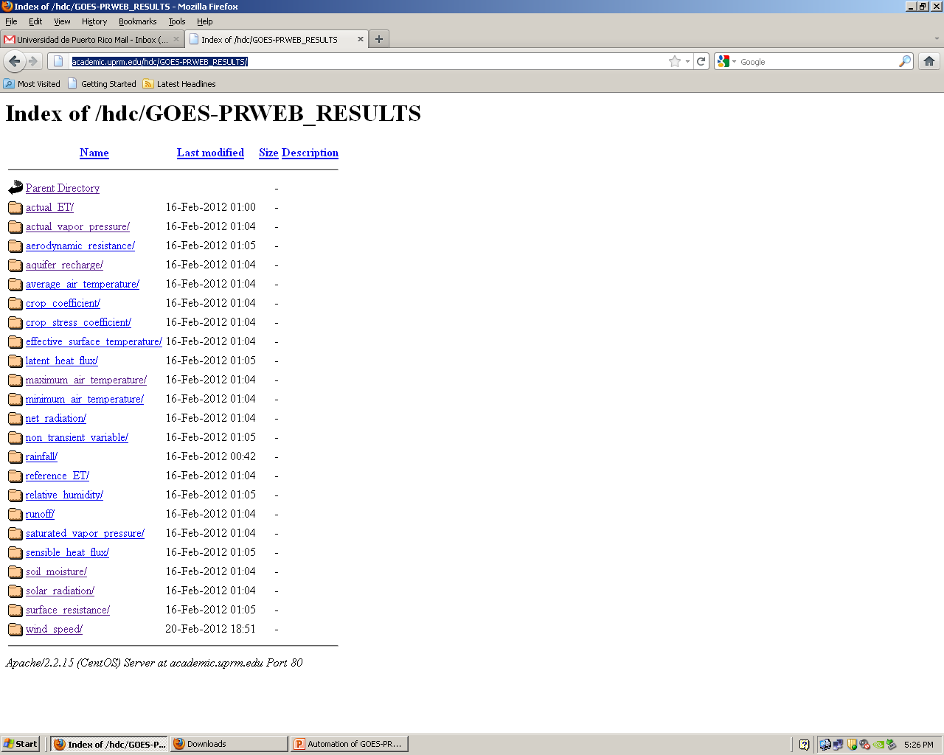

Slide 9
Gathered Experience
Learned python.
Learned matlab.
Created the script for automating GOES-PRWEB
Created a script for downloading the data in a range of dates and prepares the files for processing.

Slide 10
Program features
Automatically
Creates the necessary directories
Downloads, prepares and process the data
Creates a log file about the execution of the program
Sends you an email with the information of the log file. That way the client knows about the execution of the program without being in the computer.

Slide 11
Future Work
Help Pedro Tosado to automate the GOES-HISPANIOL-WEB algorithm.
Create a database using MySQL
MySQL is a database management system. It is free, and has earned a reputation for performance, reliability, and ease of use.
That way the client can issue a query of the data he wants, and not be looking for it one by one, on the site.

