Slide 1
Research Presentations Common Template For March 5-6, 2015 Joint Technical and Advisory Board meeting NCWCP, University of College Park, MD

Slide 2
Integrated Data Products, and Research to Operations (Led by Kyle McDonald and Maria Tzortziou)
Climate Indicators based on surface hydrologic states – (McDonald)
Global Soil Emissivity Product – (Hamidreza and Temimi)
LISCO Aeronet (Ahmed)
SAFE Data Products
List of Climate Data Products (Rossow – sent to Merchant)
Cirrus Clouds & PSC climatology Product (Hill)
Stratospheric Composition Products (Anderson)
R2O of Surface Inundation (McDonald)
?? Gladkova and Grossberg
GOES-PRWEB Puerto Rico Water and Energy Balance Algorithm (Harmsen)

Slide 3
NOAA CREST Cal/Val Activities (Led by Sam Ahmed and Roy Armstrong)
LISCO – Gilerson/Ahmed
UPRM Cal/Val – Armstrong
SMART – Temimi/Reza (McDonald??)
SAFE – Tarendra Lakhankar
Calibration of Visible IR channels of weather satellites (Rossow)
Another Bill – MW calibration (Luo)
SBUV validation – John Anderson (HU)
Water Vapor validation of GOES – Gross

Slide 4
NOAA-CREST Algorithm Development Activities (Led by Pat McCormick and Ruben Delgado)
Optimization OMPS LIMB profile Algorithm (Loughman)
Regional AOD for MODIS and VIIRS – Gross
Coastal Algorithm Improvement & Harmful Algal Bloom detection – Ahmed
Snow Cover and Properties retrievals from MW – Rossow
Real-time cloud detection from Weather Satellites - Rossow (more to add)
Freeze-Thaw (Cryosphere) – Kyle*
River Ice (Chouch/Temimi)
?? Gladkova/Grossberg

Slide 5
Observation and Monitoring (Led by Fred Moshary and John Anderson)
All tasks within Theme II project 2 (FRED AND FRED AND FRED)
LIDAR – CLN (Delgado, Parsiani, HU)
Aerosol Cloud Observation
Greenhouse gas Observation
MetNet

Slide 6
Environmental Modeling and Application (Led by Reza Khanbilvardi and Jorge Gonzalez)
u-WRF (Gonzalez)
Predictive Coastal Modeling (Hansong Tang)
Drought Indicators (Devineni)
Flash Flood Forecasting (Lakhankar/Khanbilvardi)
??Some inputs from Maria Tzortziou*
EaSM Regional Ecosystem Modeling (Vorosmarty*)
PM_{2.5} Estimator (Gross/Moshary)
Air Quality Impact Applications on Health (Maantay)
Groundwater-Dependent Ecosystem (GDE) Mapping (Krakeur*)
Landslide Susceptibility Index Mapping (Temimi/Khanbilvardi*)
Precipitation Estimation in Radar Blockage (Kibre/Zahraei)
Spatial and Temporal Precip Variation in Urban Metropolitan area (Khanbilvardi/Devineni)

Slide 7
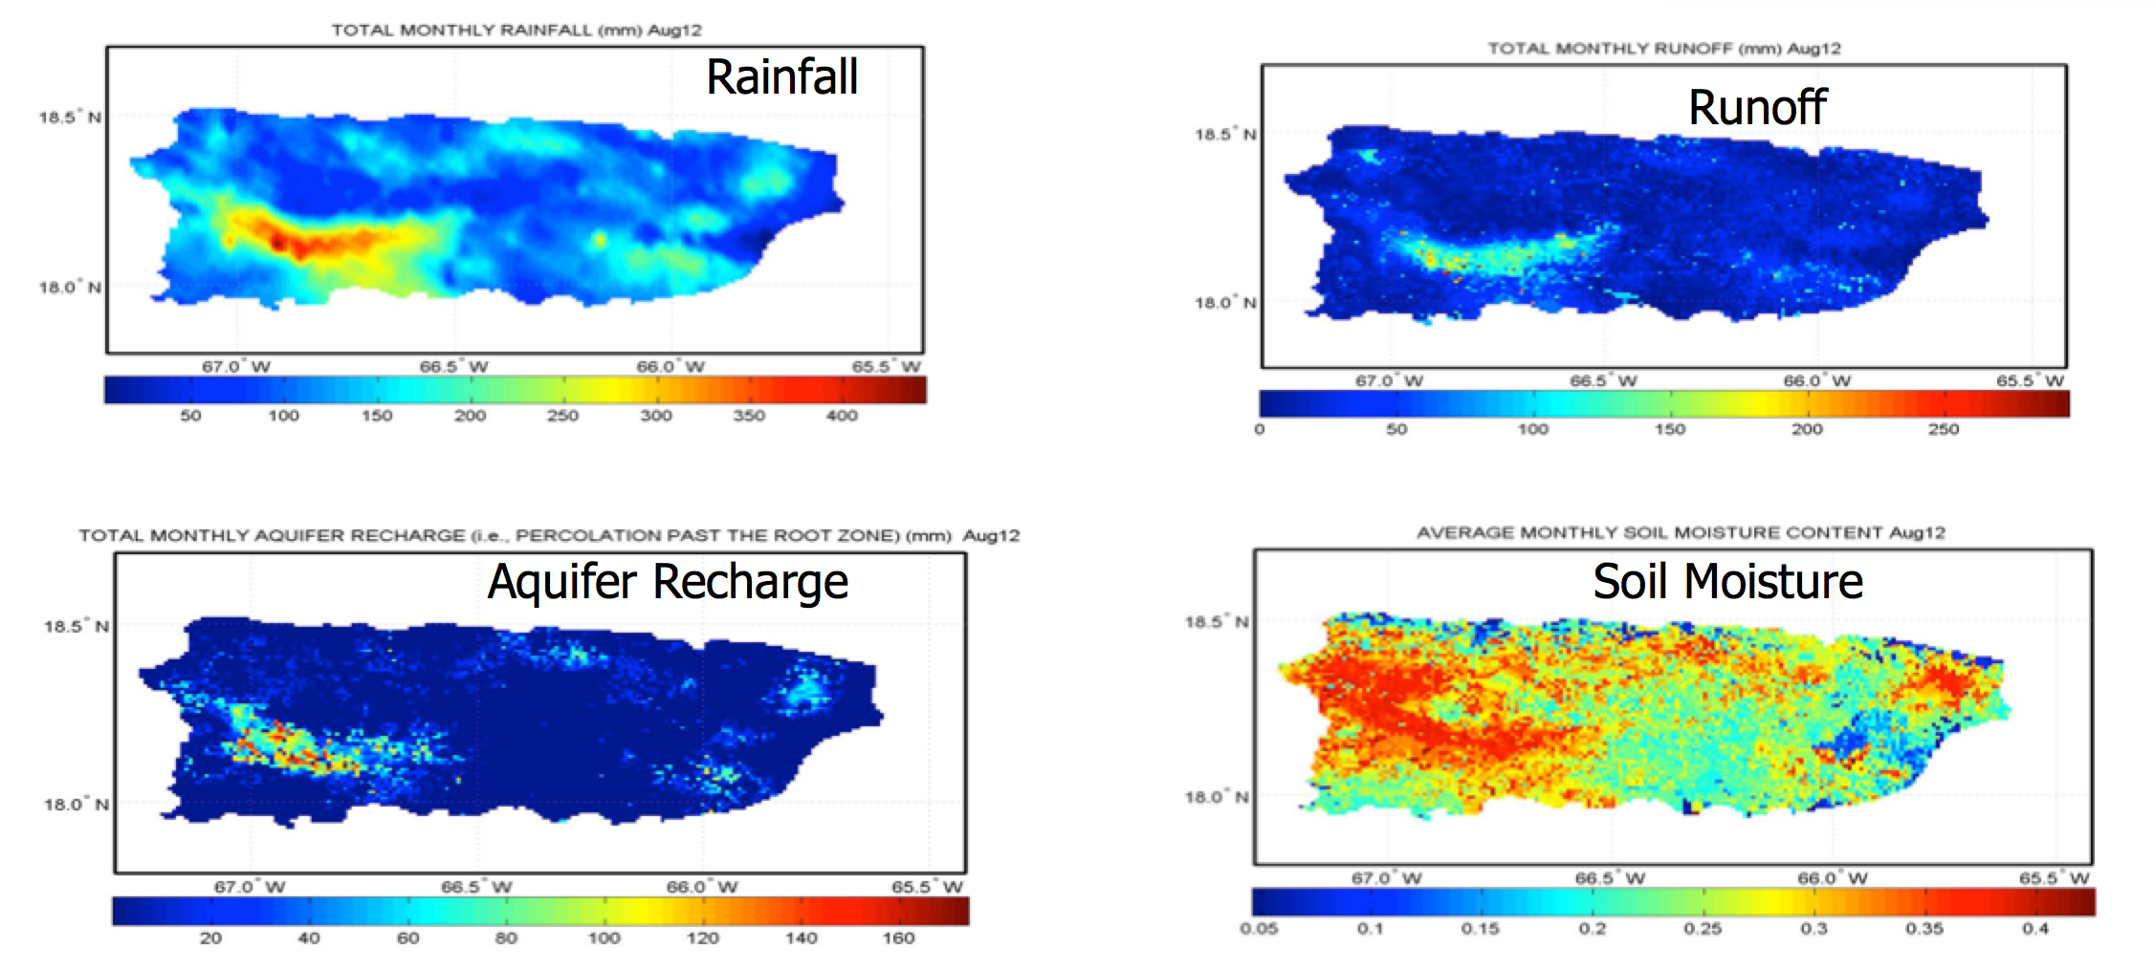
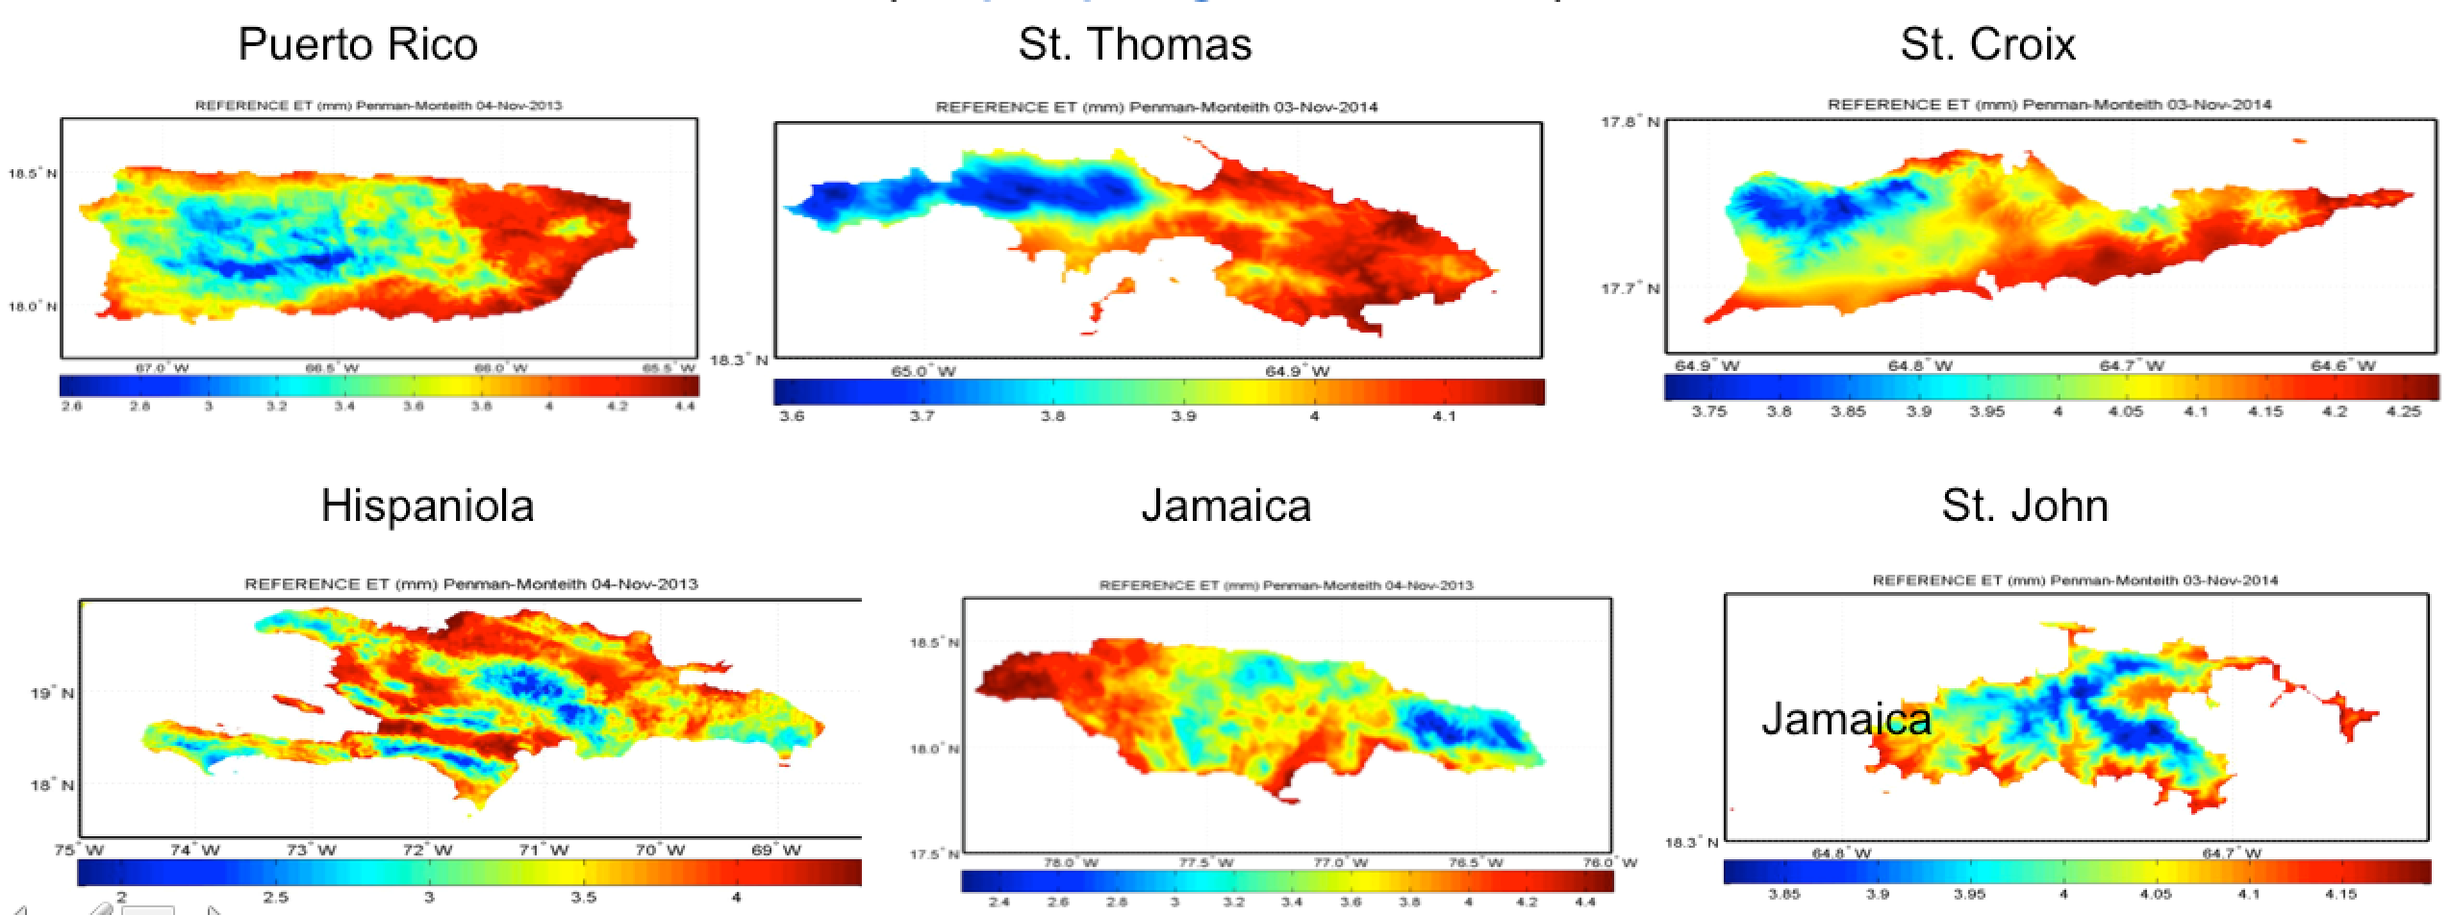
GOES-PRWEB Puerto Rico Water and Energy Balance Algorithm
Eric Harmsen
Collaborators: , Ernesto Rodriguez, Reggina Cabrera (leveraged), Luis Aponte (CariCOOS)
Funding Source NOAA CREST and USDA
Goal: Assimilate land surface parameters into land surface models for improved monitoring of hydrological processes and flood forecasting
NOAA Mission Relevancy: Weather-Ready Nation, Improved water resource management
Daily values of 25 hydro-climate variables for Puerto Rico, 1-km spatial resolution Daily reference Evapotranspiration for Puerto Rico, USVI, Haiti, Dominican Republic and Jamaica
EXPECTED OUTCOMES
Daily WEB Components; Irrigation Scheduling for Caribbean; Drought/Flood Indices; Carbon Sequestration; Daily Reference Evapotranspiration for seven Caribbean Island including Cuba; Flooding Prediction (SRFC)
Real-Time and Archived Reference ET for Puerto Rico, USVI, Hispaniola and Jamaica

Slide 8
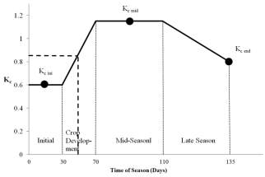
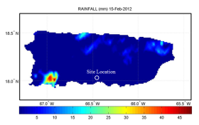
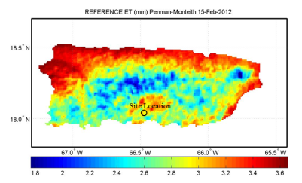
A Web-Based Irrigation Scheduling Tool to Help Farmers Save Water, Energy and Money
Determine average K_{c} for the time period
Start
Define problem (location, farm size, crop, etc.)
Determine rainfall from onsite gauge or NEXRAD
Determine ET_{o}
Estimate Crop Water Requirement
ET_{c} = K_{c} ET_{o}
Determine required flow rate and number of hours to run pump T = 17.817 x [D x A]/[Q x eff]
Harmsen E.W., 2012. TECHNICAL NOTE: A Simple Web-Based Method for Scheduling Irrigation in Puerto Rico J. Agric. Univ. P.R. 96 (3-4) 2012.

Slide 9
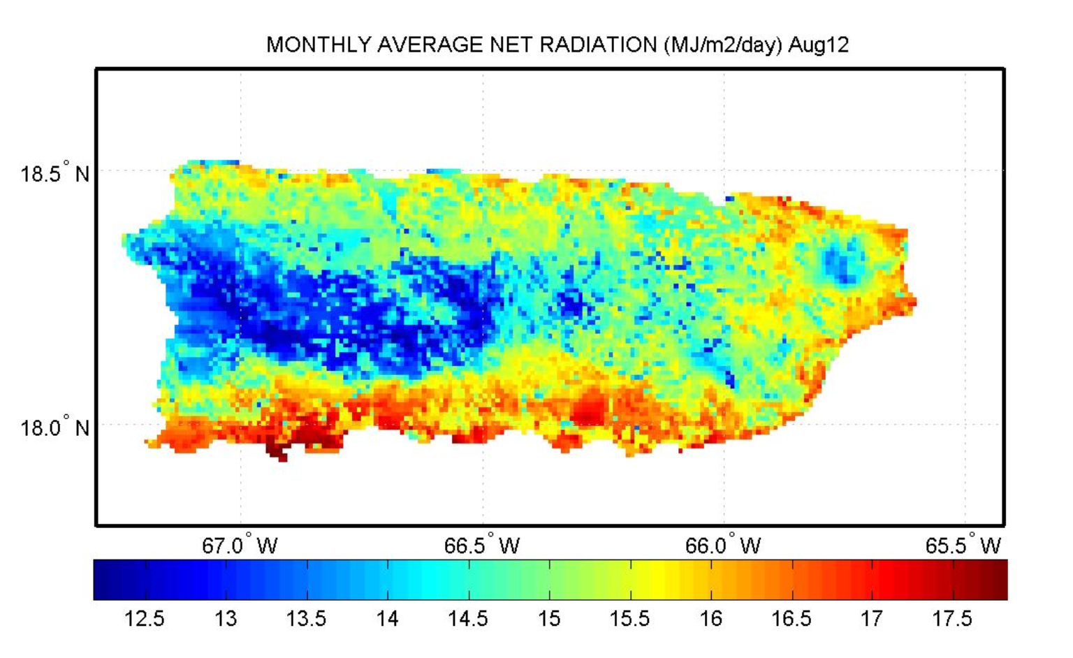
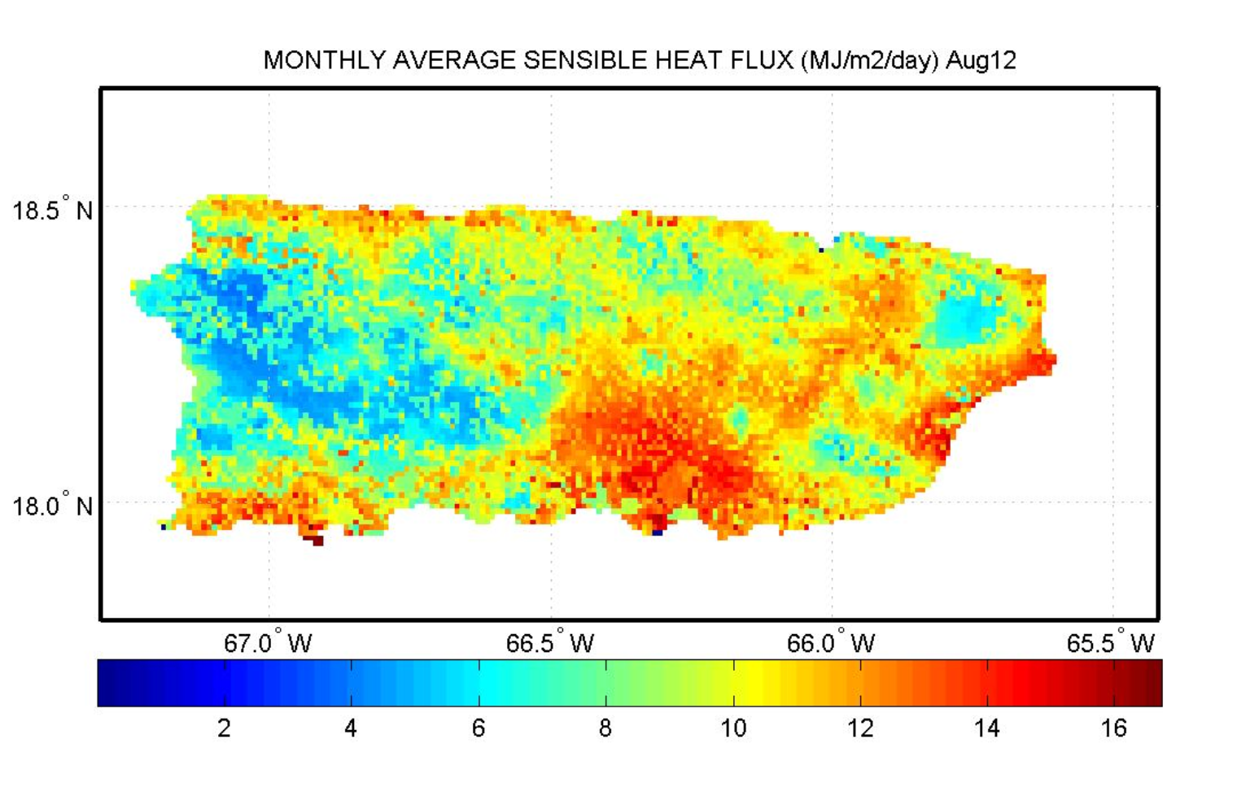
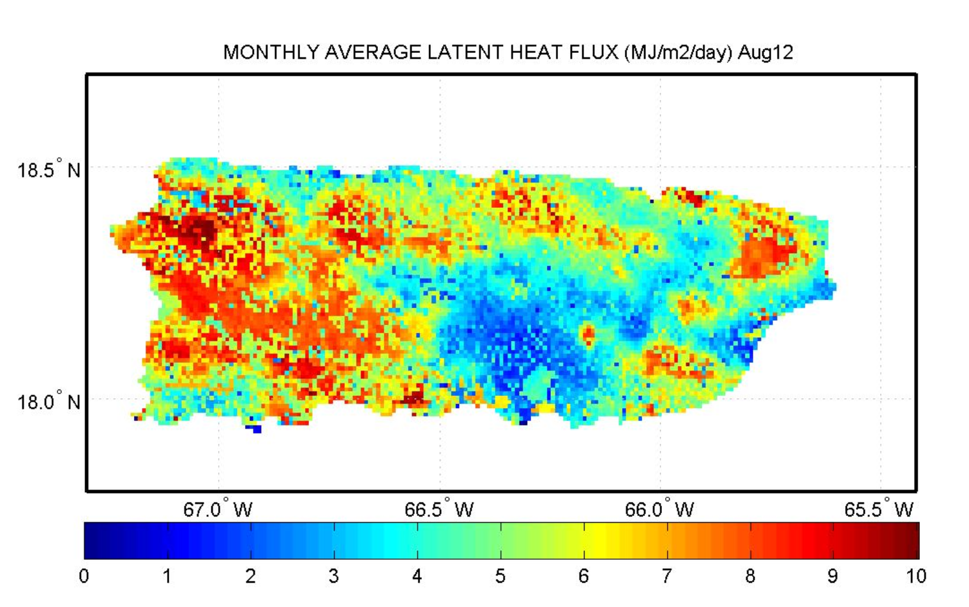
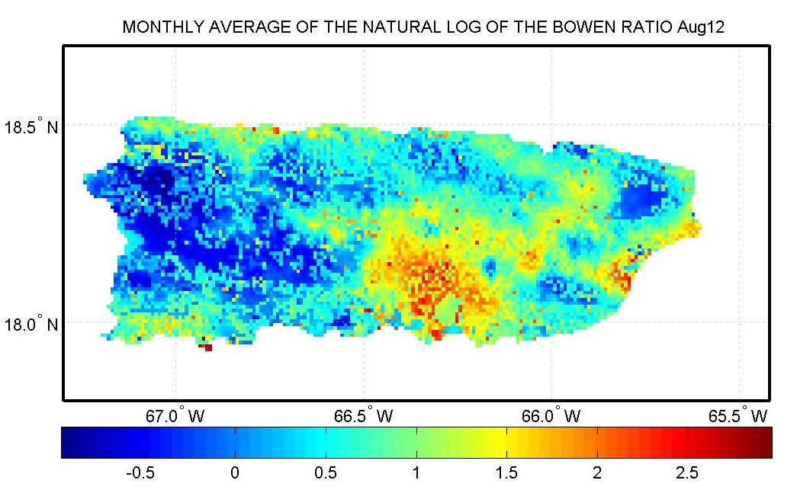
Monthly Average Net Radiation, Sensible Heat Flux, Latent Heat Flux and Bowen Ratio (Aug. 2012)
Net Radiation
Sensible Heat Flux
Latent Heat Flux
Bowen Ratio

Slide 10
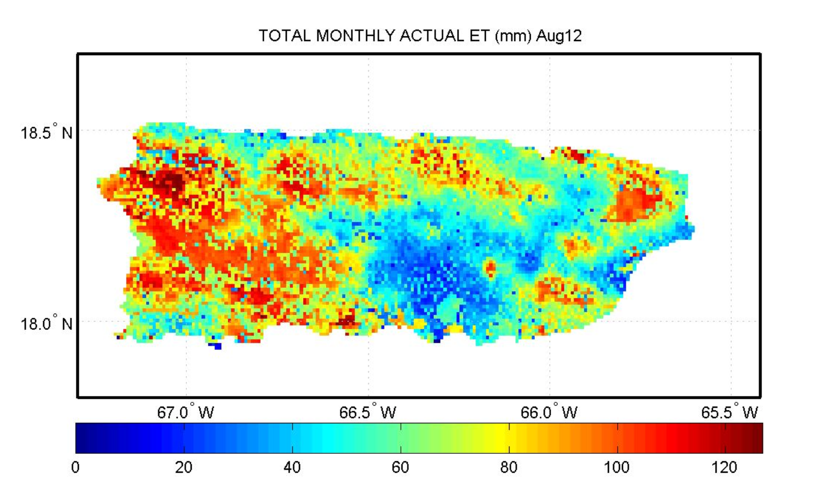
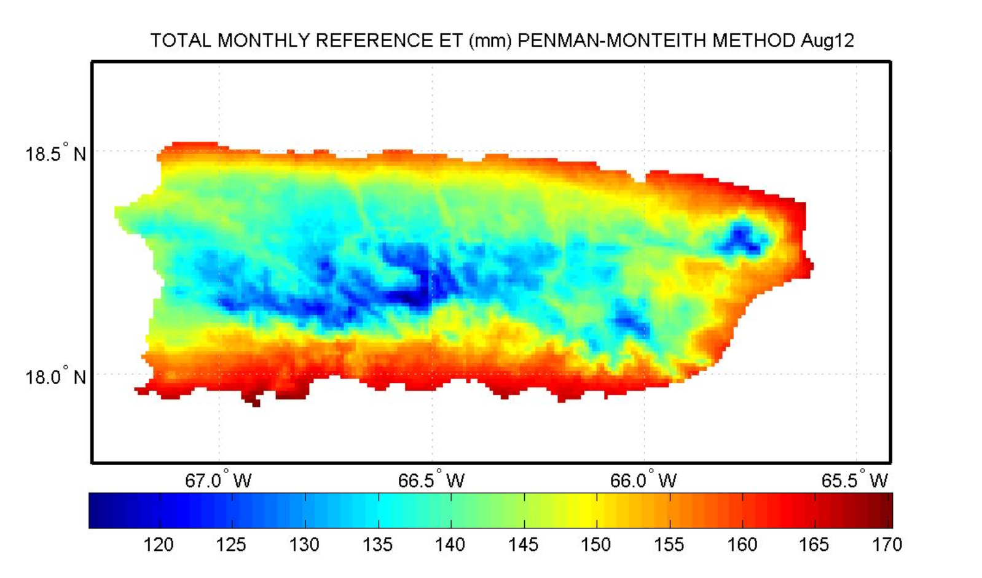
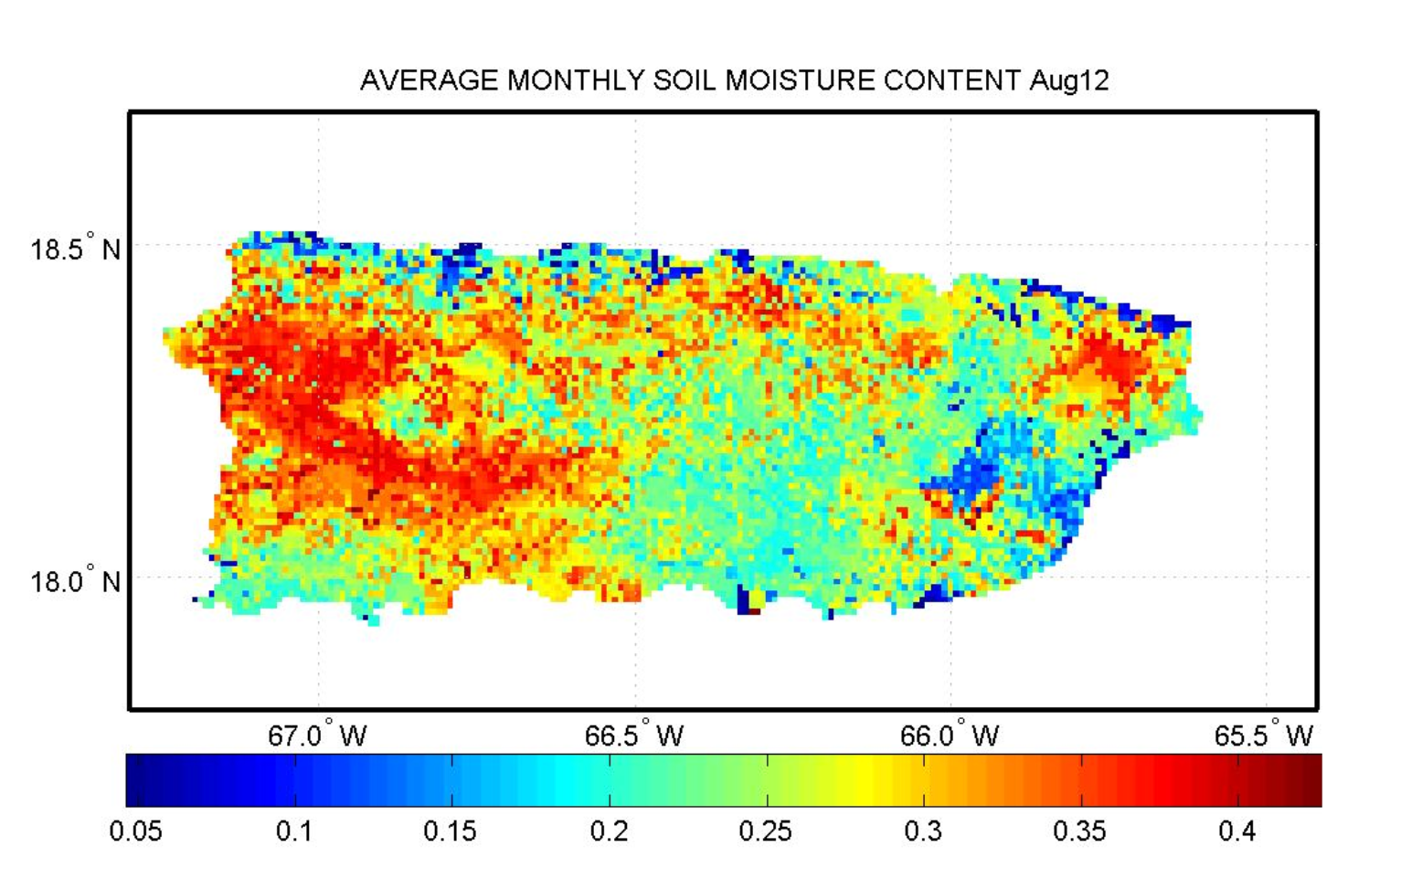
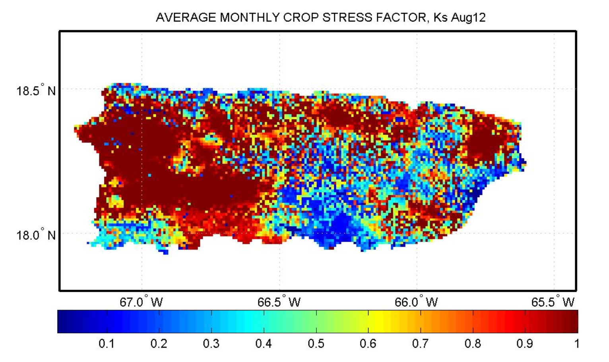
Monthly Average Actual and Reference Evapotranspiration, Soil Moisture and Crop Stress Factor (Aug. 2012)
Actual Evapotranspiration
Reference Evapotranspiration
Soil Moisture
Crop Stress Factor/Drought Index

Slide 11
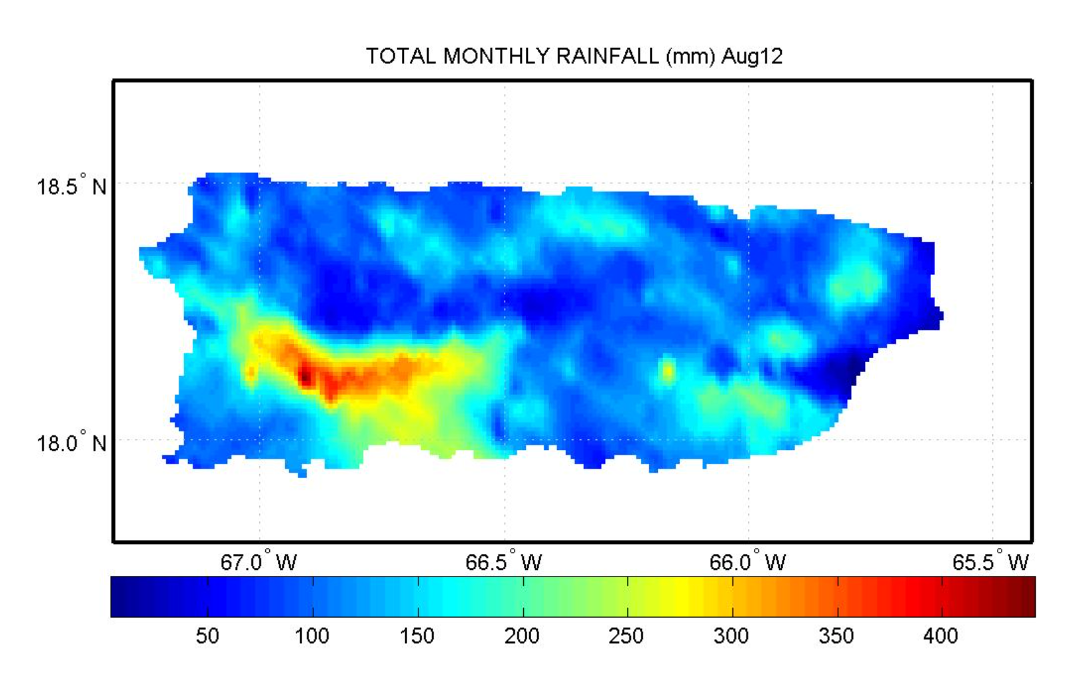
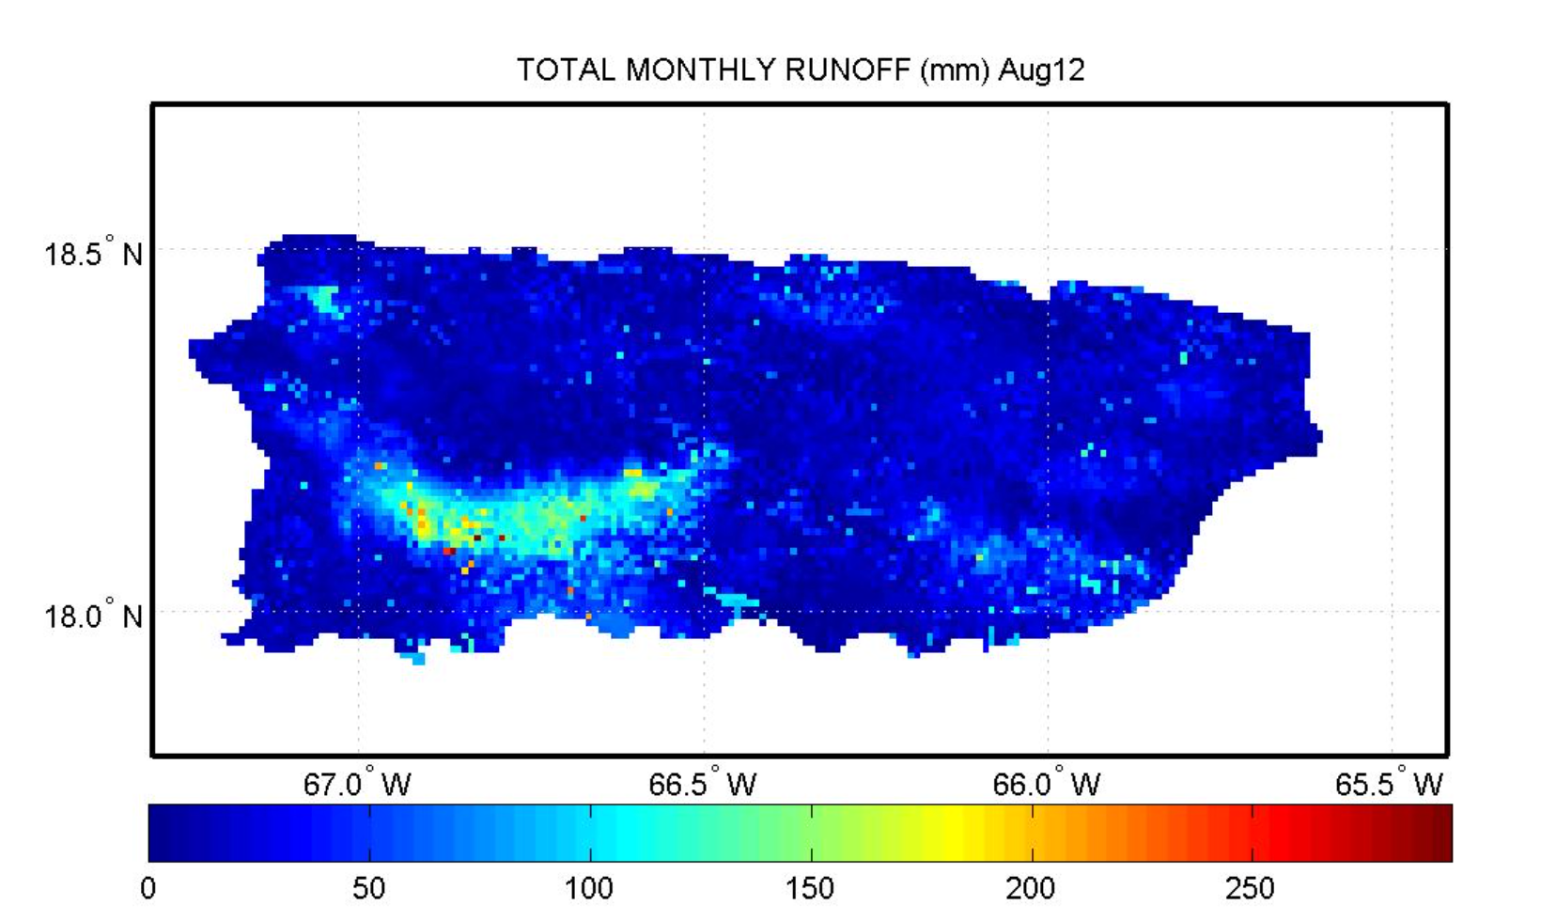
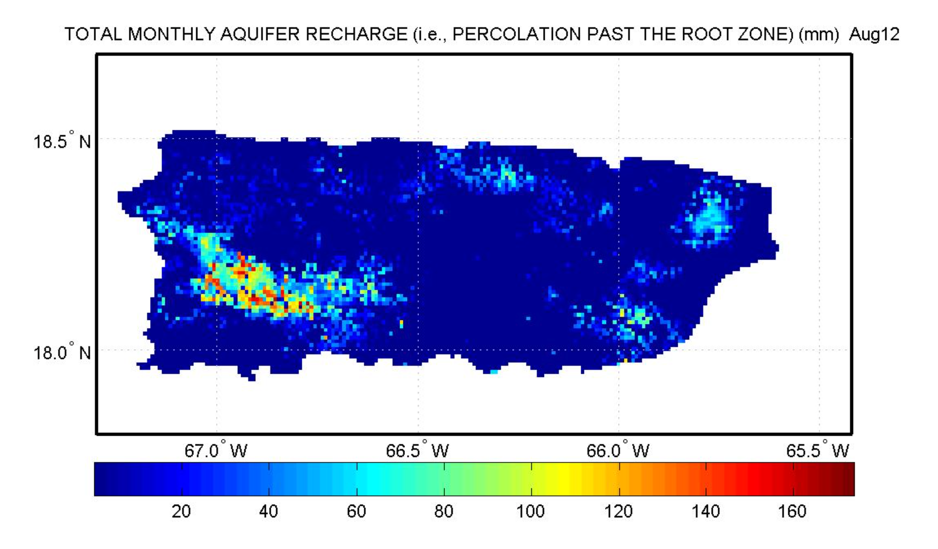
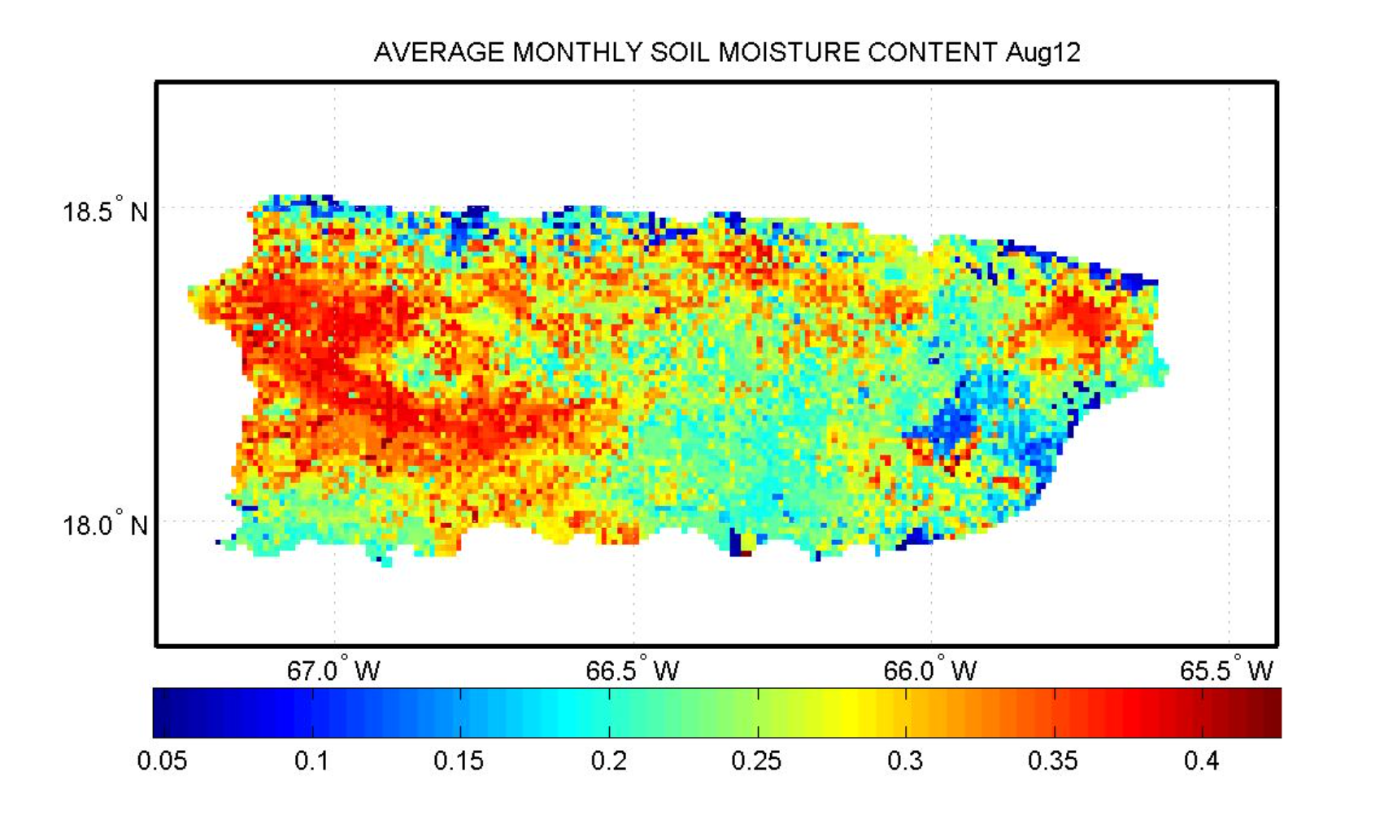
Monthly Average Rainfall, Runoff, Aquifer Recharge and Soil Moisture (Aug. 2012)
Rainfall
Runoff
Aquifer Recharge
Soil Moisture

Slide 12
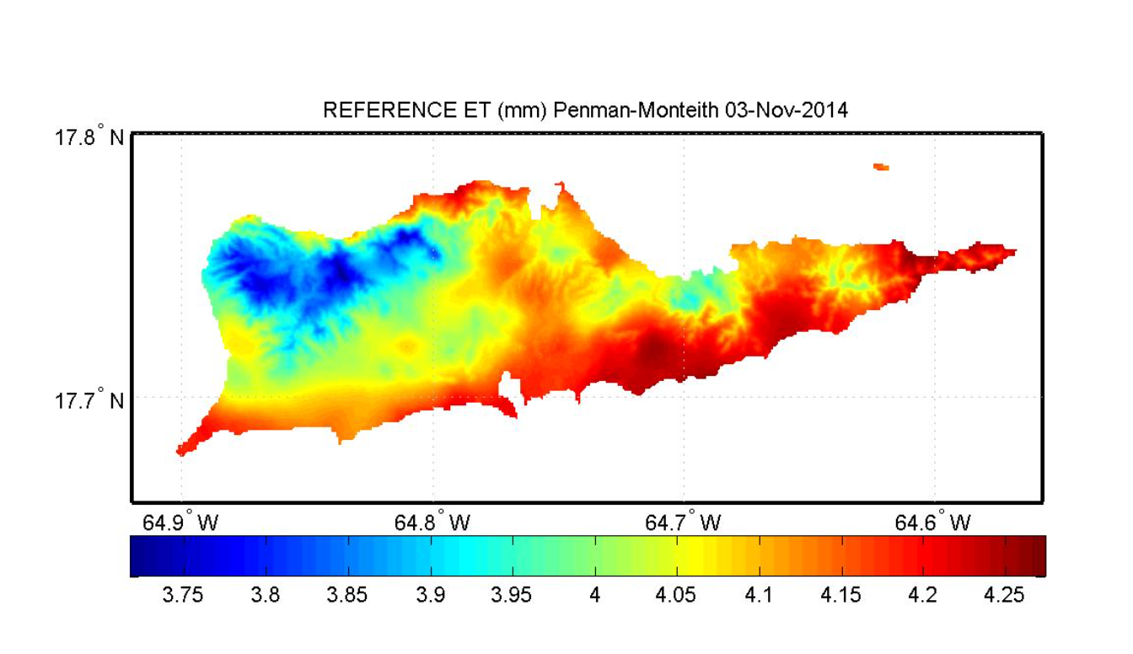
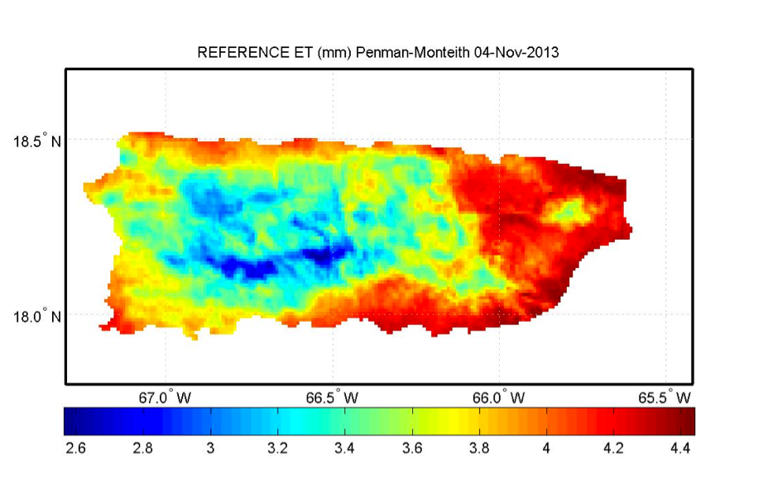
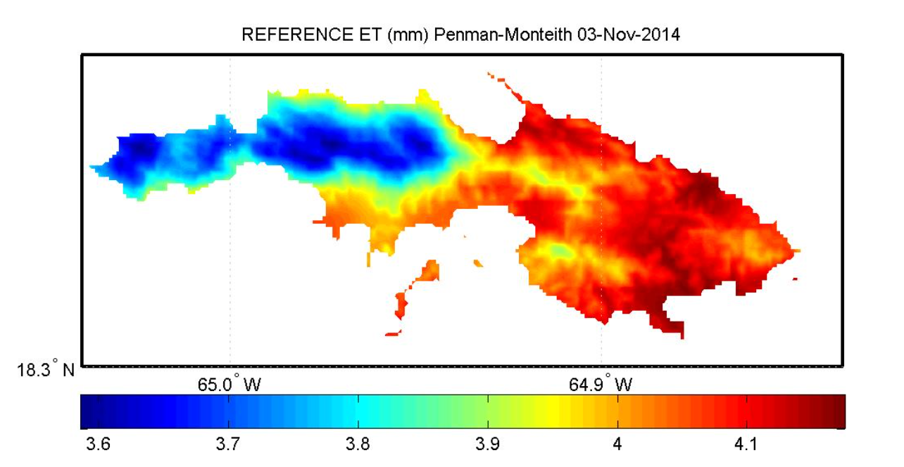
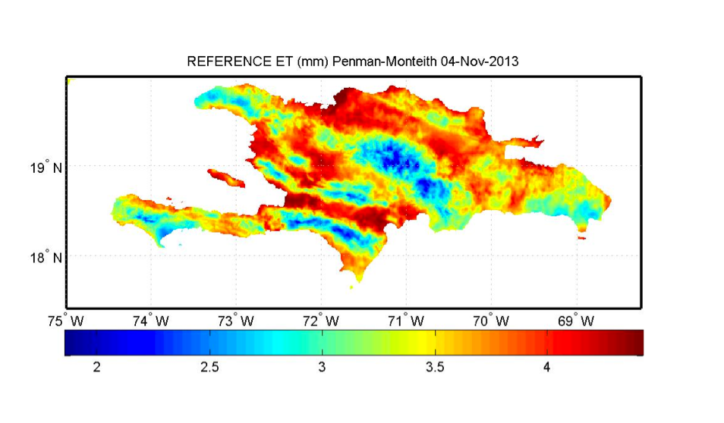
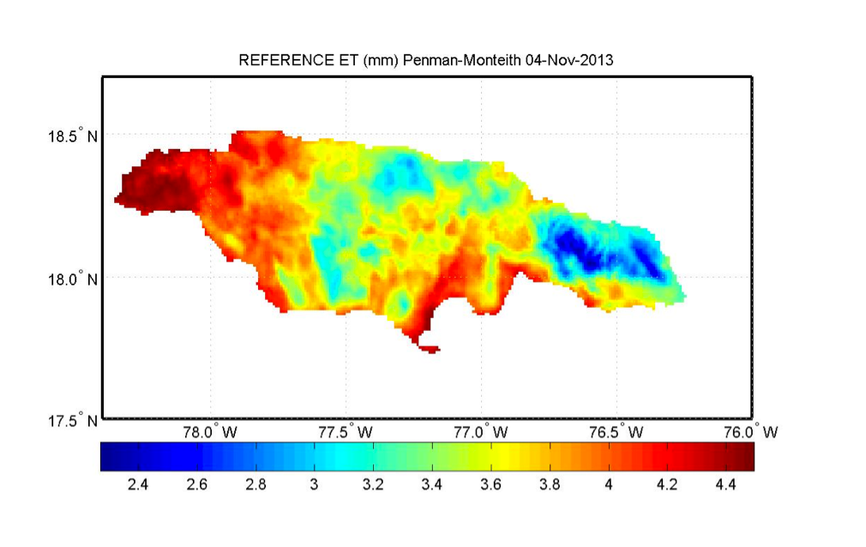
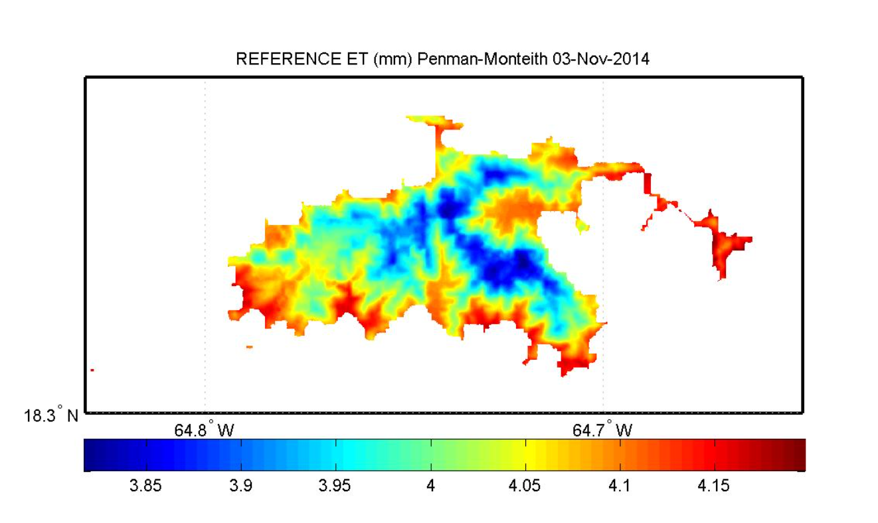
Real-Time and Archived Reference ET for Puerto Rico, USVI, Hispaniola and Jamaica (http://pragwater.com)
Puerto Rico
St. Thomas
St. Croix
Hispaniola
Jamaica
St. John
Jamaica

